Slide 1
Week07
🦜
🦜
🦜
✨No Laptop Monday! ✨
hi Jeannie
🦜
🦜
🦜
🦜
map (dictionary, table) interface
WARMUP
long, long, ago, many people owned a large, physical book called a ✨dictionary✨
- what was it used for?
- did you know there were different kinds of dictionaries?
[record lecture]

Slide 2
real-world dictionaries note: these are NOT hash maps (hash maps are NOT ordered)

Slide 3


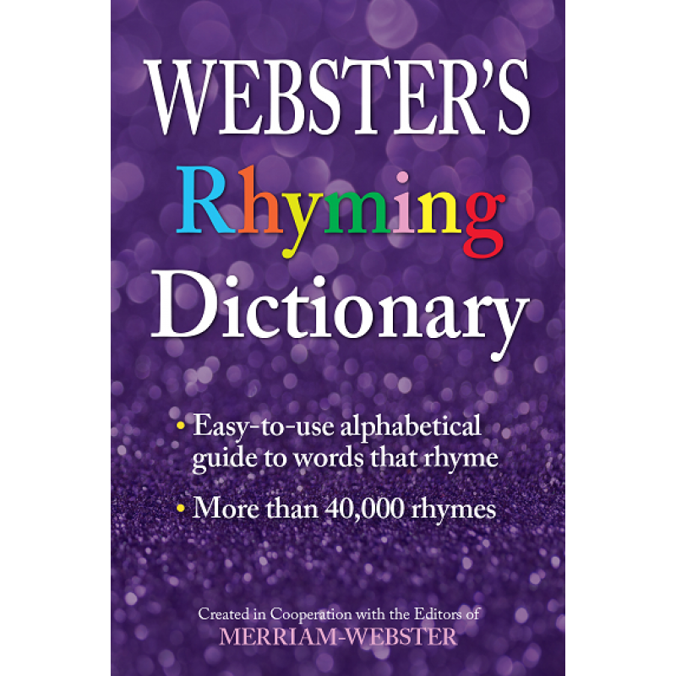
Map<String, String> dictionary;
// {Dog=A cute, four-legged mammal, ...}
Map<String, String> spanishToEnglishDictionary;
// {Gato=Cat, Perro=Dog, ...}
Map<String, List<String>> rhymingDictionary;
// {Dog=[Bog, Cog, Frog], ...}

Slide 4
common occurrence in ye olden times
child: "how do you spell trebuchet?"
parent: "look it up in the dictionary."

Slide 5
note: this advice made no sense

Slide 6
unless...

Slide 7
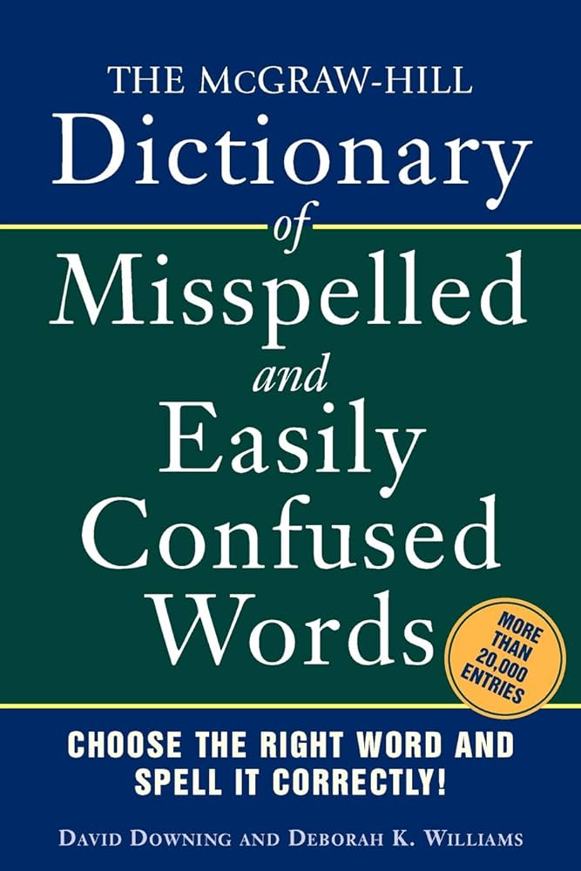

Slide 8

modern alternative

Slide 9
maps

Slide 10
map interface

Slide 11
map
a pair is two things
a map (dictionary, table) stores key-value pairs
in a map, you can lookup a key's value
a map in Java's standard library is HashMap<KeyType, ValueType>
HashMap<String, ArrayList<String>> rhymingDictionary;

Slide 12
analogy

Slide 13

let us imagine...

Slide 14
you have a three week long road trip planned to Bennington, but your prized parrot Hans is deathly afraid of driving it's time to put Hans in the bird kennel

Slide 15
🤵
🦜
map.put("Hans", 🦜)

Slide 16
you return invigorated from a lovely trek to Bennington it's time to get Hans from the bird kennel

Slide 17

here is Hans
🤵
Hans
squack
🦜
map.get("Hans")

Slide 18
HashMap<String, Bird>
🤵

Slide 19
map interface
// Put (add, insert) a new key-value pair into the map. // NOTE: Can also be used to update a key's value. // NOTE: All keys are unique. void put(KeyType key, ValueType value);
// Get (lookup) a key's value in the map. // NOTE: if key not in map, returns null ValueType get(KeyType key);
// Get the (unordered) set of all keys. // NOTE: Use a for-each loop to iterate through this. // for (KeyType key : map.keySet()) { ... } Set<KeyType> keySet();

Slide 20
simple example

Slide 21
HashMap<Character, Integer> map = new HashMap<>(); PRINT(map); // {} map.put('a', 1); PRINT(map); // {a=1} map.put('b', 1); PRINT(map); // {a=1, b=1} map.put('b', 2); PRINT(map); // {a=1, b=2}

Slide 22
motivating example

Slide 23
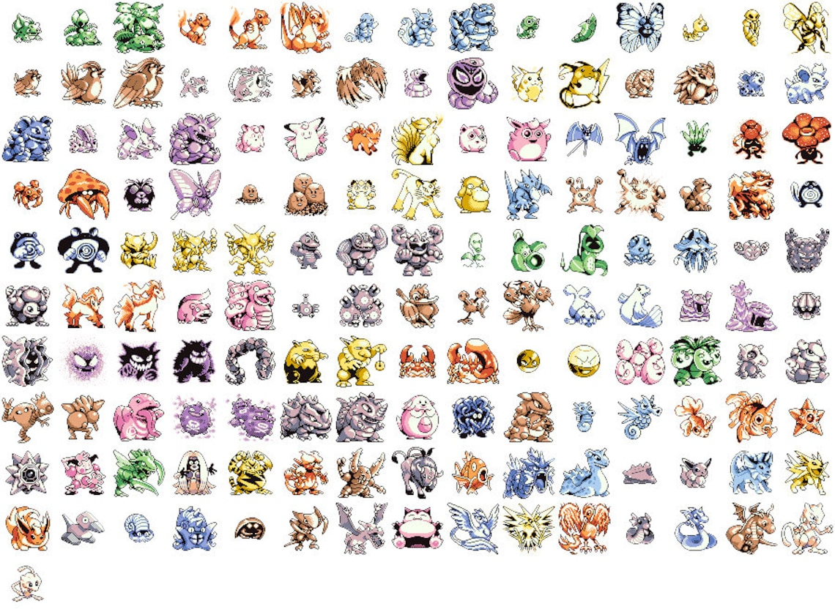
Pokémon
there are 151 Pokémon
each has its own number
Bulbasaur
Ivysaur
Venusaur
Charmander
...

Slide 24
number → name
1 → "Bulbasaur"
2 → "Ivysaur"
3 → "Venusaur"
4 → "Charmander"
...
what data structure should we use to implement this?

Slide 25
an array

Slide 26
the answer is always array

Slide 27
even during the map lecture

Slide 28
number → name (Option A)
String[] names = { "Bulbasaur", "Ivysaur", ... };
String name = names[number – 1]; // NOTE: Bulbasaur is #1

Slide 29
number → name (Option B)
String[] _names = { "Bulbasaur", "Ivysaur", ... };
String getName(int number) {
return _names[number – 1]; // NOTE: Bulbasaur is #1
}
String name = getName(number);

Slide 30
number → name (Option C)
// NOTE: Bulbasaur is #1
String[] names = { "", "Bulbasaur", "Ivysaur", ... };
String name = names[number];

Slide 31
lesson: if you're mapping from A → B, and A is something like 0, 1, 2, 3, ... ...then you can just use an array 🙂👍 (or an array list, if you don't know the length ahead of time)

Slide 32
buuut, if you're mapping from A → B, and A is nothing like 0, 1, 2, 3, ... ...then you're going to want a map 🗺️

Slide 33
name → number
what data structure will you need? (hint: HashMap<???, ???>)
how will you set it up (how will you populate it)?
how will you use it?
"Bulbasaur" → 1
"Ivysaur" → 2
"Venusaur" → 3
"Charmander" → 4
...
void put(KeyType key, ValueType value);
ValueType get(KeyType key);

Slide 34
name → number
// data structures
HashMap<String, Integer> numberFromName;
// setup
String[] names = { "Bulbasaur", "Ivysaur", ... };
numberFromName = new HashMap<>();
for (int i = 0; i < names.length; ++i) {
// Bulbasaur = 1
numberFromName.put(names[i], i + 1);
}
// usage
String name = ...;
int number = numberFromName.get(name);

Slide 35
[let's implement numberFromName] TODO (Jim): use keySet() method in test code

Slide 36
PokemonExample
Mewtwo -> 150
Raichu -> 26
Arbok -> 24
Kabuto -> 140
Charmander -> 4
Charmeleon -> 5
Shellder -> 90
Fearow -> 22
Kangaskhan -> 115
Mankey -> 56
Dodrio -> 85
Vaporeon -> 134
Golem -> 76
Marowak -> 105
Pikachu -> 25
Raticate -> 20
Kadabra -> 64
Primeape -> 57
Venomoth -> 49
Magikarp -> 129
Pidgeotto -> 17
Slowbro -> 80
Gastly -> 92
Magneton -> 82
Jolteon -> 135
Metapod -> 11
Diglett -> 50
Eevee -> 133
Caterpie -> 10
Goldeen -> 118
Abra -> 63
Blastoise -> 9
Magnemite -> 81
Pinsir -> 127
Machoke -> 67
Graveler -> 75
Meowth -> 52
Staryu -> 120
Gengar -> 94
Moltres -> 146
Dragonite -> 149
Golbat -> 42
Persian -> 53
Dugtrio -> 51
Onix -> 95
Hypno -> 97
Machop -> 66
Victreebel -> 71
Krabby -> 98
Jynx -> 124
Seadra -> 117
Rhydon -> 112
Jigglypuff -> 39
Machamp -> 68
Psyduck -> 54
Rapidash -> 78
Pidgey -> 16
Horsea -> 116
Poliwrath -> 62
Omastar -> 139
Clefairy -> 35
Exeggutor -> 103
Farfetch'd -> 83
Clefable -> 36
Oddish -> 43
Weedle -> 13
Gloom -> 44
Vileplume -> 45
Vulpix -> 37
Slowpoke -> 79
Lickitung -> 108
Golduck -> 55
Tentacruel -> 73
Weezing -> 110
Zapdos -> 145
Doduo -> 84
Haunter -> 93
Poliwhirl -> 61
Squirtle -> 7
Omanyte -> 138
Wigglytuff -> 40
Arcanine -> 59
Hitmonlee -> 106
Kabutops -> 141
Sandshrew -> 27
Venusaur -> 3
Kakuna -> 14
Tangela -> 114
Ekans -> 23
Wartortle -> 8
Venonat -> 48
Muk -> 89
Articuno -> 144
Electrode -> 101
Electabuzz -> 125
Cubone -> 104
Nidoran♀ -> 29
Magmar -> 126
Nidoran♂ -> 32
Dewgong -> 87
Tauros -> 128
Mr. Mime -> 122
Koffing -> 109
Starmie -> 121
Bulbasaur -> 1
Gyarados -> 130
Nidoqueen -> 31
Seel -> 86
Mew -> 151
Alakazam -> 65
Nidoking -> 34
Drowzee -> 96
Seaking -> 119
Rattata -> 19
Sandslash -> 28
Tentacool -> 72
Grimer -> 88
Ponyta -> 77
Exeggcute -> 102
Ditto -> 132
Flareon -> 136
Growlithe -> 58
Beedrill -> 15
Nidorina -> 30
Ivysaur -> 2
Cloyster -> 91
Kingler -> 99
Nidorino -> 33
Scyther -> 123
Dratini -> 147
Spearow -> 21
Charizard -> 6
Hitmonchan -> 107
Paras -> 46
Aerodactyl -> 142
Parasect -> 47
Butterfree -> 12
Snorlax -> 143
Weepinbell -> 70
Zubat -> 41
Chansey -> 113
Lapras -> 131
Voltorb -> 100
Dragonair -> 148
Ninetales -> 38
Bellsprout -> 69
Rhyhorn -> 111
Porygon -> 137
Geodude -> 74
Pidgeot -> 18
Poliwag -> 60
import java.util.*;
class Main extends Cow {
public static void main(String[] args) {
// setup
HashMap<String, Integer> numberFromName = new HashMap<>();
String[] names = { "Bulbasaur", "Ivysaur", "Venusaur", ... };
for (int number = 0; number < names.length; ++number) {
numberFromName.put(names[number], number + 1);
}
// usage
for (String name : numberFromName.keySet()) {
PRINT(name + " -> " + numberFromName.get(name));
}
}
}

Slide 37
reminder: hash maps are NOT ordered (even though we put Pokemon into the hash map in order, the hash map did NOT store them in order)

Slide 38
maps in other languages

Slide 39
🐍 Python has a built-in map (dictionary)
numbers = {}
numbers["Bulbasaur"] = 1
numbers["Ivysaur"] = 2
print(numbers["Bulbasaur"]) # 1
print(numbers) # {"Bulbasaur": 1, "Ivysaur": 2}
# hmm...
map = {}
map[True] = False
map['Jim'] = 3
map[-1] = map
print(map) # {True: False, 'Jim': 3, -1: {...}}

Slide 40
🥰 Lua's only data structure is a map (table)
why?
how?
what about like...arrays?
names = {}
names[1] = "Bulbasaur" -- okay fine, i guess Lua also has strings
names[2] = "Ivysaur"
print(names[1]) -- Bulbasaur

Slide 41
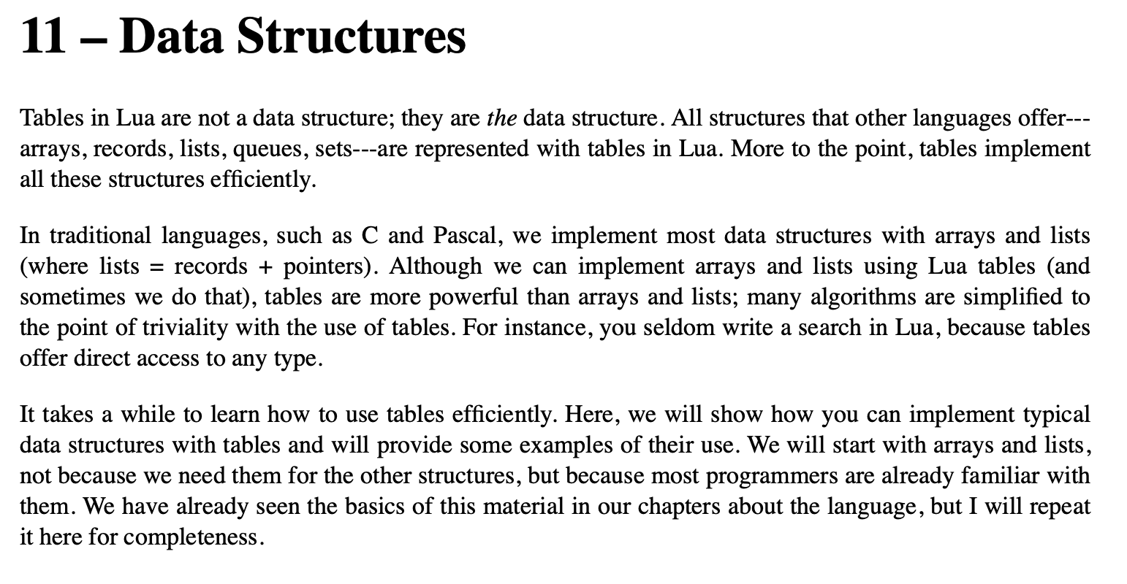

Slide 42
Week07b
hi Jeannie
✨Wednesday! ✨
🦜
🦜
🦜
🦜
hash functions
hash map with separate chaining
🦜
🦜
🦜
WARMUP: what does this print?
HashMap<String, String> map = new HashMap<>();
map.put("hello", "world");
map.put(map.get("hello"), "on fire");
PRINT(map.get("world"));
PRINT(map.get("on fire"));
[record lecture]

Slide 43
map interface
// Put (add, insert) a new key-value pair into the map. // NOTE: Can also be used to update a key's value. // NOTE: All keys are unique. void put(KeyType key, ValueType value);
// Get (lookup) a key's value in the map. // NOTE: if key not in map, returns null ValueType get(KeyType key);
// Get the (unordered) set of all keys. // NOTE: Use a for-each loop to iterate through this. // for (KeyType key : map.keySet()) { ... } Set<KeyType> keySet();

Slide 44
ANNOUNCEMENTS
today is Prof. Bill Is Visiting LEC-02 Laptop Wednesday! WARMUP what is 7 % 3 ?
- ✏️do it on paper
- ☕️do it in Java (java means coffee)
- 🐍 do it in Python (a python is a kind of snake)
what is (-7) % 3 ?
- ✏️do it on paper
- ☕️do it in Java
- 🐍 do it in Python TODAY hash maps

Slide 45
record LEC-01

Slide 46
motivation

Slide 47
let's get motivated

Slide 48
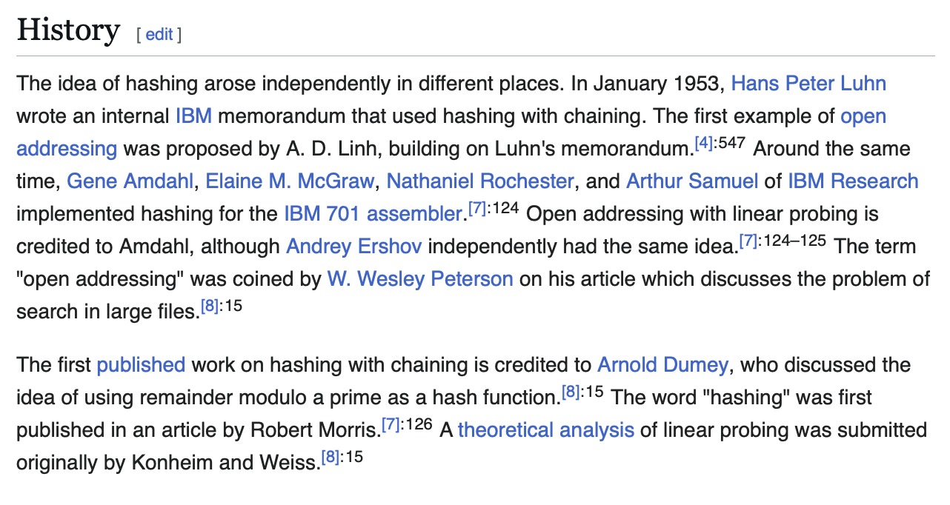

Slide 49
so basically...

Slide 50
in ~1953 someone realized that if you combined an array, the %, and something called a "hash function," you could implement a map that ran in O(1)...

Slide 51
let's learn how this works 🙂👍

Slide 52
review: % vs. MODULO (Math.floorMod)

Slide 53
7 % 3
2
R1
3
7
-
6
1

Slide 54
🐍 -7 % 3
☕️ Math.floorMod(-7, 3)
🐮.☕️ MODULO(-7, 3)
☕️ -7 % 3
-2
R-1
3
-7
-7 - (-6)
= -7 + 6
= -1
+ 3 = 2
-
-6
-1
-1

Slide 55
%
x % y returns the remainder of (x / y) and is read "x modulo y"
int foo = 17 % 5; // 2 ("17 divided by 5 is 3 remainder 2")
☠ % probably doesn't do what you expect for negative numbers; if x can be negative, use Math.floorMod(x, y) instead
5 % 3 // 2
4 % 3 // 1
3 % 3 // 0
2 % 3 // 2
1 % 3 // 1
0 % 3 // 0
-1 % 3 // -1 WAIT WHAT 🤔
MODULO(-1, 3) // 2 🙂👍

Slide 56
MODULO(x, y)
MODULO( 5, 3) // 2
MODULO( 4, 3) // 1
MODULO( 3, 3) // 0
MODULO( 2, 3) // 2
MODULO( 1, 3) // 1
MODULO( 0, 3) // 0
MODULO(-1, 3) // 2
MODULO(-2, 3) // 1
MODULO(-3, 3) // 0
MODULO(-4, 3) // 2
MODULO(-5, 3) // 1
MODULO(-6, 3) // 0
MODULO(-7, 3) // 2

Slide 57
hash function

Slide 58
hash function

Slide 59
hash function
a hash function takes some data and returns an integer called the data's hash code (hash, hash value)
this is called "hashing" the data
🚨 a hash function MUST be deterministic
given the same data, a hash function MUST return the same value every time is is called
a hash collision (hash clash) happens when two different pieces of data have the same hash code
a good hash function has very few collisions

Slide 60
hash function
a hash function takes some data and returns an integer called the data's hash code (hash, hash value)
this is called "hashing" the data
🚨 a hash function MUST be deterministic
given the same data, a hash function MUST return the same value every time is is called
a hash collision (hash clash) happens when two different pieces of data have the same hash code
a good hash function has very few collisions

Slide 61
let's play...is it a hash function?
int foo(String a) { return a.length(); }
yes, though it's bad.
note: "foo" and "bar" collide
int bar(String a) { return 0; }
yes, though it's so bad.
note: everything collides
int baz(String a) { return random.nextInt(); }
no, function is not deterministic.

Slide 62
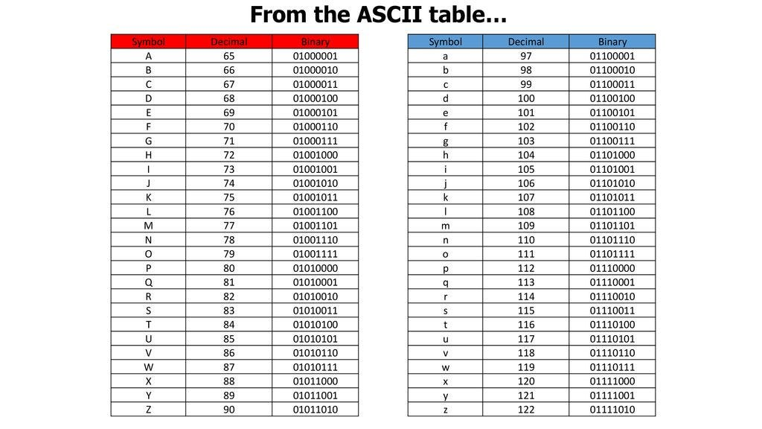

Slide 63
let's play...do they collide?
"a" and "z"?
"cat" and "dog"?
"abc" and "ABC"?
"iamlordvoldemort" and "tommarvoloriddle"?
int hash(String string) { int result = 0; for (int i = 0; i < string.length(); ++i) { result += string.charAt(i); // NOTE: chars are integers } return result; }

Slide 64
hashCode()

Slide 65
hashCode()
all Java objects have a built-in hash function called hashCode()
hashCode() can be negative!
PRINT( "Hans".hashCode()); // 2241694
PRINT( "Gary".hashCode()); // 2212033
PRINT("Kahoot".hashCode()); // -2054990942
PRINT("Kahoot".hashCode()); // -2054990942

Slide 66
hashCode()
often, you want to use a hash code to index into an array
✨ MODULO(object.hashCode(), array.length)
int N = 10;
PRINT(MODULO( "Hans".hashCode(), N)); // 4
PRINT(MODULO( "Gary".hashCode(), N)); // 3
PRINT(MODULO("Kahoot".hashCode(), N)); // 8
PRINT(MODULO("Kahoot".hashCode(), N)); // 8

Slide 67
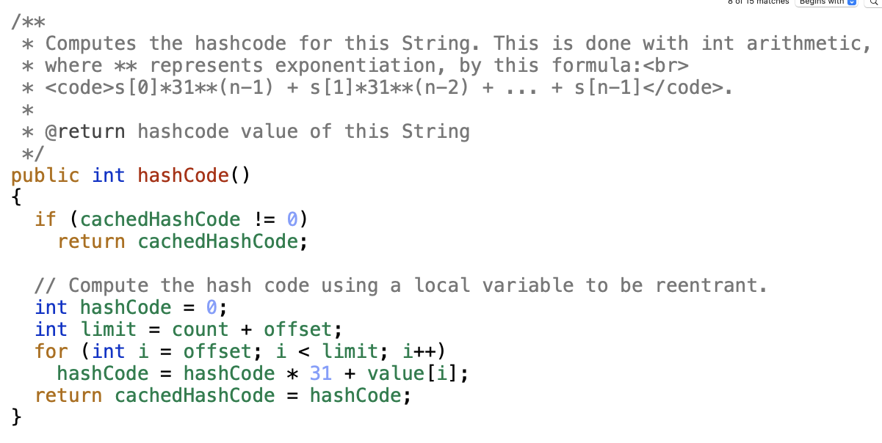

Slide 68
hash maps

Slide 69
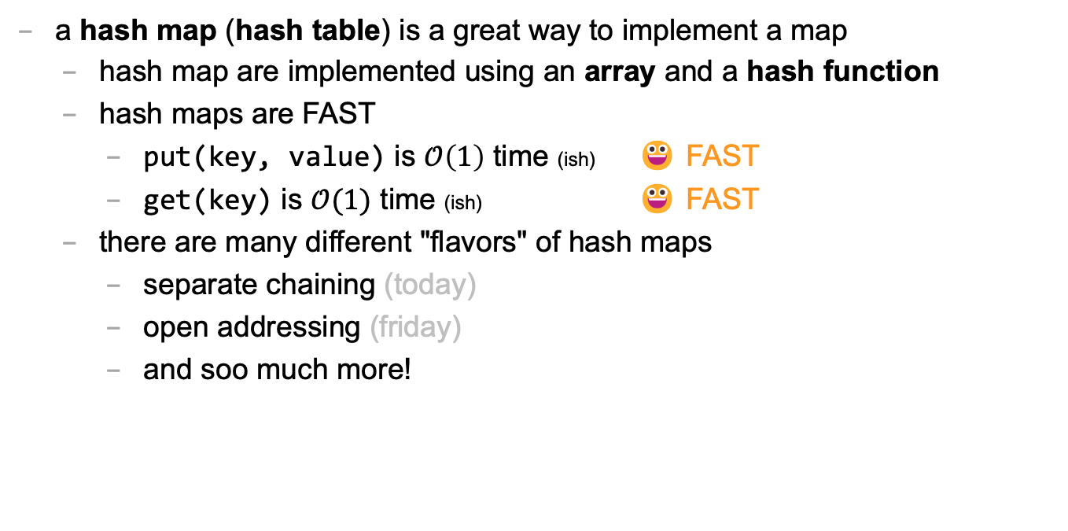
hash map
a hash map (hash table) is a great way to implement a map
hash map are implemented using an array and a hash function
hash maps are FAST
put(key, value) is $𝒪\left(1\right)$ time (ish) 😀 FAST
get(key) is $𝒪(1)$ time (ish) 😀 FAST
there are many different "flavors" of hash maps
separate chaining (today)
open addressing (friday)
and soo much more!

Slide 70
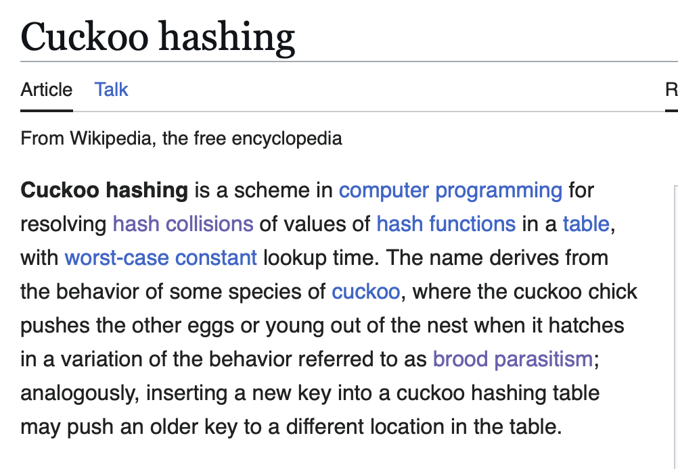

Slide 72
separate chaining

Slide 73
separate chaining
separate chaining is one way of implementing a hash map
key-value pairs are stored in an array of buckets
one good choice of bucket is an array list
ArrayList<KeyValuePair> bucket;
in practice, you don't have to use an array list; you can use linked lists, binary search trees, or some mixture of the two (this is actually what Java does)

Slide 74
analogy

Slide 75

previously, on Hans the Parrot

Slide 76
you have a three week long road trip planned to Bennington, but your prized parrot Hans is deathly afraid of driving it's time to put Hans in the bird kennel

Slide 77
🤵
🦜
map.put("Hans", 🦜)

Slide 78
you return invigorated from a lovely trek to Bennington it's time to get Hans from the bird kennel

Slide 79
here is Hans
🤵
Hans
squack
🦜
map.get("Hans")

Slide 80
HashMap<String, Bird>
🤵

Slide 81
now, let us imagine again...

Slide 82
in a thrilling twist, it turns out that the Bennington trip was secretly cover for Agent Hans's corporate espionage of the bird kennel (rumor had it they were keeping the birds in buckets 🤨) it's time to get Hans back to the hideout

Slide 83
🐧🦉
🦜
🐤
🪣
🪣
🐦
🦆🐓🦃
🪣
🪣
🪣
Joe Kahoot Cheep Hans Doug Io Gary Max
0
1
2
3
4
👮

Slide 84
is this Hans?
bucket.get(i).key.equals("Hans")?
✅ bucket.get(1).key.equals("Hans")
🐧🦉
🦜
🐤
🪣
🪣
🐦
🦆🐓🦃
🪣
🪣
🪣
Joe Kahoot Cheep Hans Doug Io Gary Max
0
1
2
2
3
4
👮
which bucket is Hans in?
MODULO("Hans".hashCode(), buckets.length)
map.get("Hans")

Slide 85
int[] arrayOfInts; ArrayList<KeyValuePair>[] buckets;

Slide 86
// Bucket[] buckets ArrayList<KeyValuePair>[] buckets;

Slide 87
ArrayList<KeyValuePair>[] buckets;
to construct the hash map
create a new buckets array
iterate through the array and create a new (empty) bucket in each slot

Slide 88
ArrayList<KeyValuePair>[] buckets;
to put a key-value pair into the hash map (or update an existing key's value)
// hash key to get bucket index // NOTE: hashCode() can be negative, so use MODULO bucketIndex = MODULO(key.hashCode(), buckets.length)
// if key in the map, update corresponding value
iterate through that bucket
if you find a key-value pair with matching key...
update its value
return;
// otherwise, add key-value pair to map
if you did NOT find any key-value pair with matching key
add the key-value pair to the bucket

Slide 89
ArrayList<KeyValuePair>[] buckets;
to get a key's value from the hash map
// hash key to get bucket index bucketIndex = MODULO(key.hashCode(), buckets.length)
// if key in the map, return corresponding value
iterate through that bucket
if you find a key-value pair with matching key...
return its value
// otherwise, return null
if you did NOT find any key-value pair with matching key
return null;

Slide 90
hash map questions

Slide 91
how big should we make the array?

Slide 92
why would need to resize (grow) a hash map? how do we resize a hash map? why might this be slow?

Slide 93
Week07c
✨Less-fun Friday! ✨
🦜
🦜
🦜
🦜
hash map runtime review
hash map with separate chaining tutorial
🦜
🦜
🦜
WARMUP: a leetcode easy
https://leetcode.com/problems/two-sum/description/?envType=problem-list-v2&envId=hash-table
[record lecture]

Slide 94
Given an array of integers nums and an integer target, return indices of the two numbers such that they add up to target. You may assume that each input would have exactly one solution, and you may not use the same element twice. You can return the answer in any order. Example 1: Input: nums = [2,7,11,15], target = 9 Output: [0,1] Explanation: Because nums[0] + nums[1] == 9, we return [0, 1]. Example 2: Input: nums = [3,2,4], target = 6 Output: [1,2] Example 3: Input: nums = [3,3], target = 6 Output: [0,1]

Slide 95
ANNOUNCEMENTS
today is an important Colloquium! 2:35 in Wege (TCL 123)
also juggling club after colloquium :)
🦉 today is Kahoot Friday! today is also No Blazer Friday :(
WARMUP last class, i said that hash maps have O(1) put and O(1) get
why is this sus? 🤨 list as many reasons as you can
TODAY more hash maps

Slide 96
review: hash maps are O(1) (ish)

Slide 97
what happens when we call map.get(key)?

Slide 98
is this Hans?
buckets[bucketIndex].get(i).key.equals("Hans")?
🐧🦉
🦜
🐤
🪣
🪣
🐦
🦆🐓🦃
🪣
🪣
🪣
Joe Kahoot Cheep Hans Doug Io Gary Max
0
1
2
2
3
4
👮
which bucket is Hans in?
MODULO("Hans".hashCode(), buckets.length)
map.get("Hans")

Slide 99
step 1: hashing the key (in our specific case, where key is a String and we use key.hashCode())

Slide 100
step 1: hashing the key (our specific case, where key is a String and we use key.hashCode())
// hash the key (not including the Math.floorMod) hash = 0 foreach character in string hash *= 31 hash += character return hash
🤨 this is O(numberOfCharactersInString)
but, if we assume all strings are less than, say, 64 characters... (assume a constant time hash function)
O(1) 😀

Slide 101
getting (a reference to) the correct bucket (our specific case, where bucket is an unsorted ArrayList<KeyValuePair>)
// get the bucket int bucketIndex = Math.floorMod(hash, buckets.length); ArrayList<KeyValuePair> bucket = buckets[bucketIndex];
O(1) 😀

Slide 102
searching the bucket for the key (our specific case, where bucket is an unsorted ArrayList<KeyValuePair>)
// find a key-value pair in the bucket with matching key // (or conclude no such pair exists)
foreach pair in bucket if (key matches pair.key): return pair.value return null
🤨 this is actually O(numberOfPairsInBucket)
assume a lot of buckets...
assume a good hash function...
do a lot of math...
O(1) 😀

Slide 103
growing

Slide 104
🤨 also what about growing the hash map (when it gets too full)?! that has to make map.put O(n) !

Slide 105
put is O(1) amortized runtime 🙂🤨

Slide 106
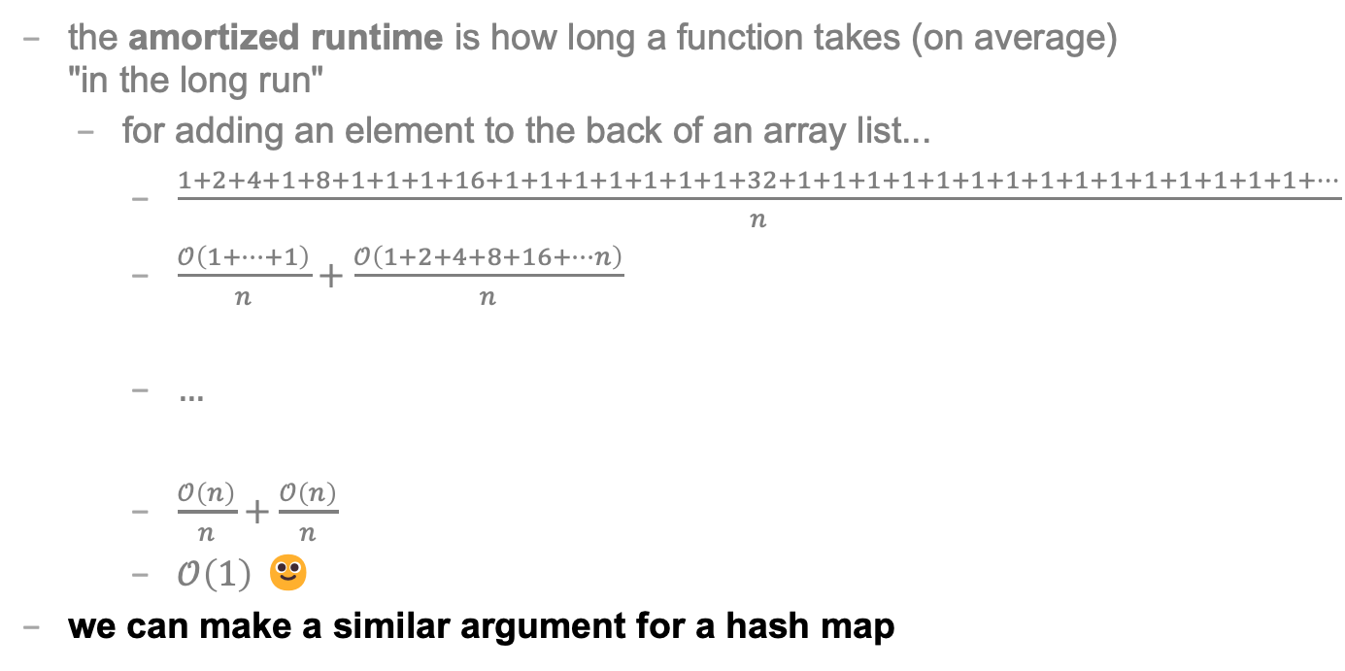
REVIEW: amortized
the amortized runtime is how long a function takes (on average) "in the long run"
for adding an element to the back of an array list...
$\frac{1+2+4+1+8+1+1+1+16+1+1+1+1+1+1+1+32+1+1+1+1+1+1+1+1+1+1+1+1+1+1+1+…}{n}$
$\frac{𝒪\left(1+…+1\right)}{n}+\frac{𝒪\left(1+2+4+8+16+…n\right)}{n}$
$…$
$\frac{𝒪\left(n\right)}{n}+\frac{𝒪\left(n\right)}{n}$
$𝒪\left(1\right)$ 🙂
we can make a similar argument for a hash map

Slide 107
summary

Slide 108
lesson: there is a lot of subltety hiding in the seemingly simple statement "hash maps are O(1)" buuut, in an interview, still probably just say O(1) 🙂👍

Slide 109
Tutorial: hash map with separate chaining (using array list buckets)

Slide 110
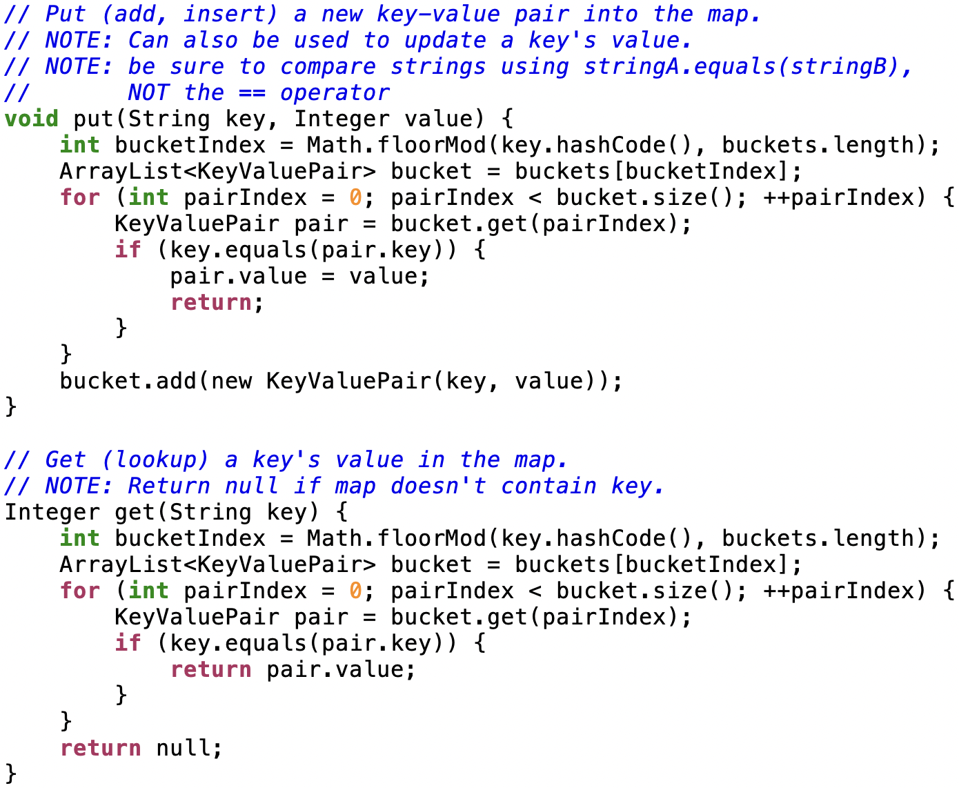

Slide 111
open addressing

Slide 112
a hash map with separate chaining used an array of buckets of key-value pairs put(key,value) hash key to find bucketIndex add (key, value) to buckets[bucketIndex]

Slide 113
a hash map with open addressing just uses an array of key-value pairs (slots) put(key, value) hash key to find slotIndex if slots[slotIndex] is full, try slots[slotIndex + 1] if slots[slotIndex + 1] is full, try slots[slotIndex + 2] if slots[slotIndex + 2] is full, try slots[slotIndex + 3] ... put (key,value) in first empty slot

Slide 114
get(key) is interesting hash key to find slotIndex is key in slots[slotIndex]? if yes, return slot.value; is key in slots[slotIndex + 1]? if yes, return slot.value; is key in slots[slotIndex + 2]? ... give up if you hit an empty slot map does NOT contain key → return null;

Slide 115
note: must be very careful when removing (deleting) key-value pairs from a hash map implemented using open addressing

Slide 116
note: these slides described a specific kind of open addressing called linear probing open addressing is a strategy for resolving collisions linear probing is just one way of doing open addressing

Slide 117
fun friday menu - jim rants about comments and syntax highlighting - jim codes (some of) microsoft paint from scratch - jim updates you on his CAD software - jim talks about his favorite element - jim reads aloud from grugbrain.dev - jim reads aloud from vim creep - jim reads aloud from hexing the technical interview - jim reads aloud from the truth about lisp - jim reads aloud from the worst API ever made

Slide 118
🦉 would you fancy a Kahoot?

Slide 119
Week06
🦜
🦜 🦜 🦜🦜
✨Fun Friday! ✨
this week sure flew by, didn't it?
🦜
deque
Python vs. Java vs. C philosophy of data structures
fun friday
WARMUP
what does random access (direct access) mean in the context of data structures?
TODO: record lecture

Slide 120
review: queue

Slide 121
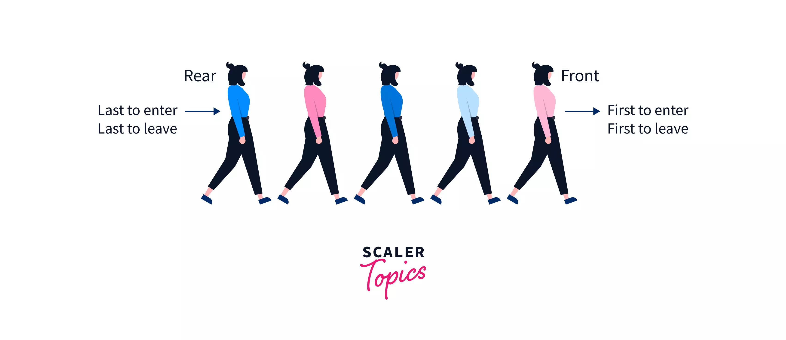
Back

Slide 122
queue interface
// Add (enqueue) a new element to the back of the queue. void add(ElementType element);
// Remove (dequeue) the front // element and return it. ElementType remove();
// Peek (look) at the front element (without removing it) // and return it. ElementType peek();
// Returns the number of elements currently in the queue. int size();

Slide 123
deque (double-ended queue)

Slide 124
deque

Slide 125
deque interface
addFront(...)
removeFront()
addBack(...)
removeBack()
🧠 what is the amortized runtime of these functions if we were to implement the deque interface using an array list?
O(1) addBack(...) and removeBack() 😀
O(n) addFront(...) and removeFront() 😐
🧠 can we do better?

Slide 126
1
1
2
4
1
8
1
1
1
16
1
1
1
1
1
1
1
32
1
1
1
1
1
1
1
1
1
1
1
1
1
1
1
64
1
1
1
1
1
1
1
1
1
1
1
1
1
1
1
1
1
1
1
1
1
1

Slide 127
neat idea: store the queue in the middle
BACK [ null null null null null null null ] FRONT
// addBack(1111)
BACK [ null null null 1111 null null null ] FRONT
// addBack(2222)
BACK [ null null 2222 1111 null null null ] FRONT
// addBack(3333)
BACK [ null 3333 2222 1111 null null null ] FRONT
// removeFront()
BACK [ null 3333 2222 null null null null ] FRONT
// addFront(4444)
BACK [ null 3333 2222 4444 null null null ] FRONT
// addFront(5555)
BACK [ null 3333 2222 4444 5555 null null ] FRONT
// removeBack()
BACK [ null null 2222 4444 5555 null null ] FRONT

Slide 128
neat idea: store the queue in the middle
BACK [ null 3333 2222 1111 null null null ] FRONT
🧠 does this waste space? (in the worst case) (relative to an array list)
🧠 can we fix this?
int front;
note: many possible implementations;
key point: you have to keep track of back and front somehow
int back;

Slide 129
extension: treat the array as circular
null 3333 2222 1111 null null null

Slide 130
extension: treat the array as circular
6666 3333 2222 1111 5555 8888 7777

Slide 131
big picture lesson

Slide 132
once you get past CS136, data structures are acually kind of rich and complicated and messy

Slide 133
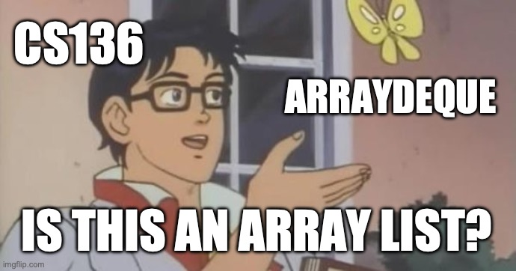

Slide 134
Java vs. C philosophy of data structures

Slide 135
[scavenger hunt]

Slide 136
can i call get(...) or set(...) on Java's ArrayDeque? why or why not?

Slide 137
fun friday menu - jim rants about comments and syntax highlighting - jim codes (some of) microsoft paint from scratch - jim updates you on his CAD software - jim talks about usage code - jim talks about his favorite element - jim reads aloud from grugbrain.dev - jim talks incoherently about Vim

Slide 138
Tungsten queube 😀 did you know Tungsten is really hard? Tungsten alloys can be as hard as Sapphire! that's really hard! did you know the density of Tungsten is 19.25 g/cm³? that's really dense!—almost as dense as gold! (Gold is 19.32 g/cm³) Tungsten is not suuper cheap (cube from the Amazon.com was $60) but Tungsten is also not like...expensive what could YOU do with Tungsten?

Slide 139


Slide 140


Slide 141
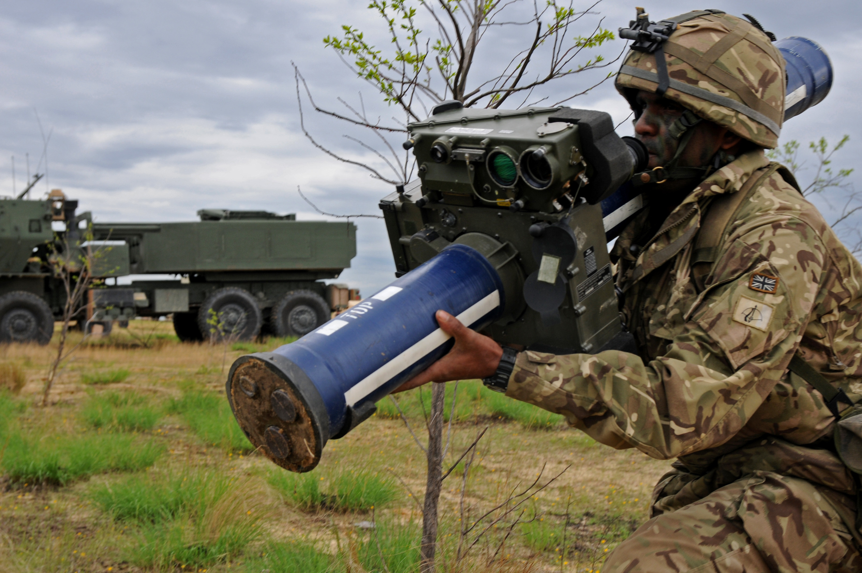
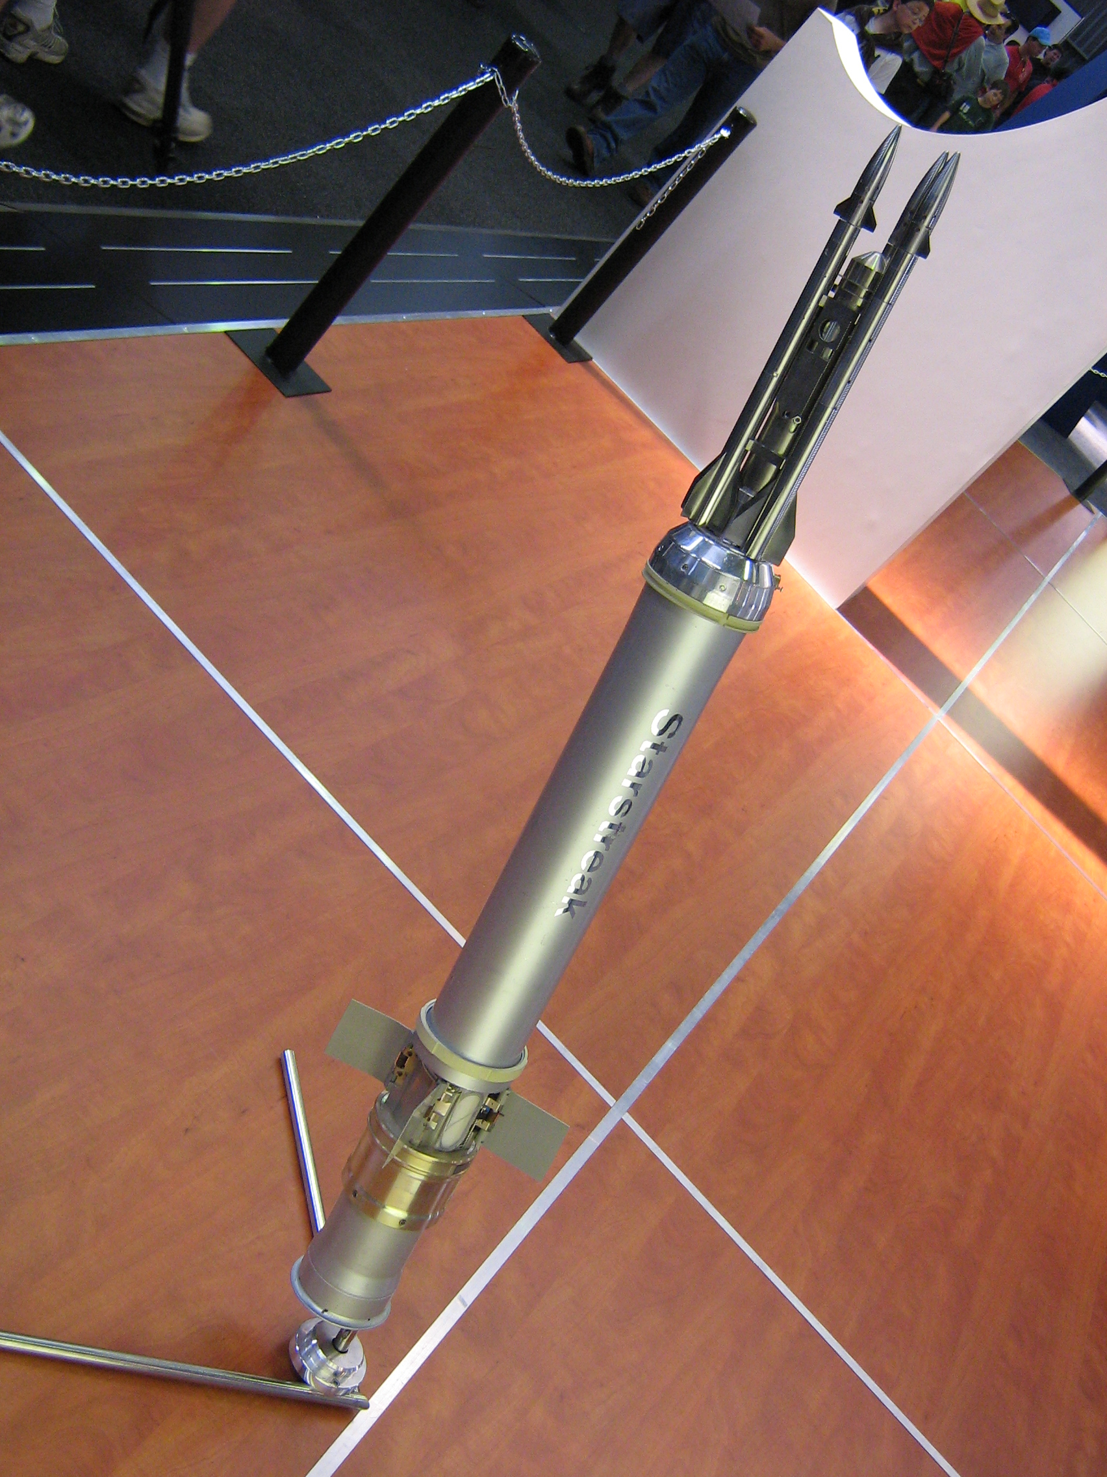


Slide 142
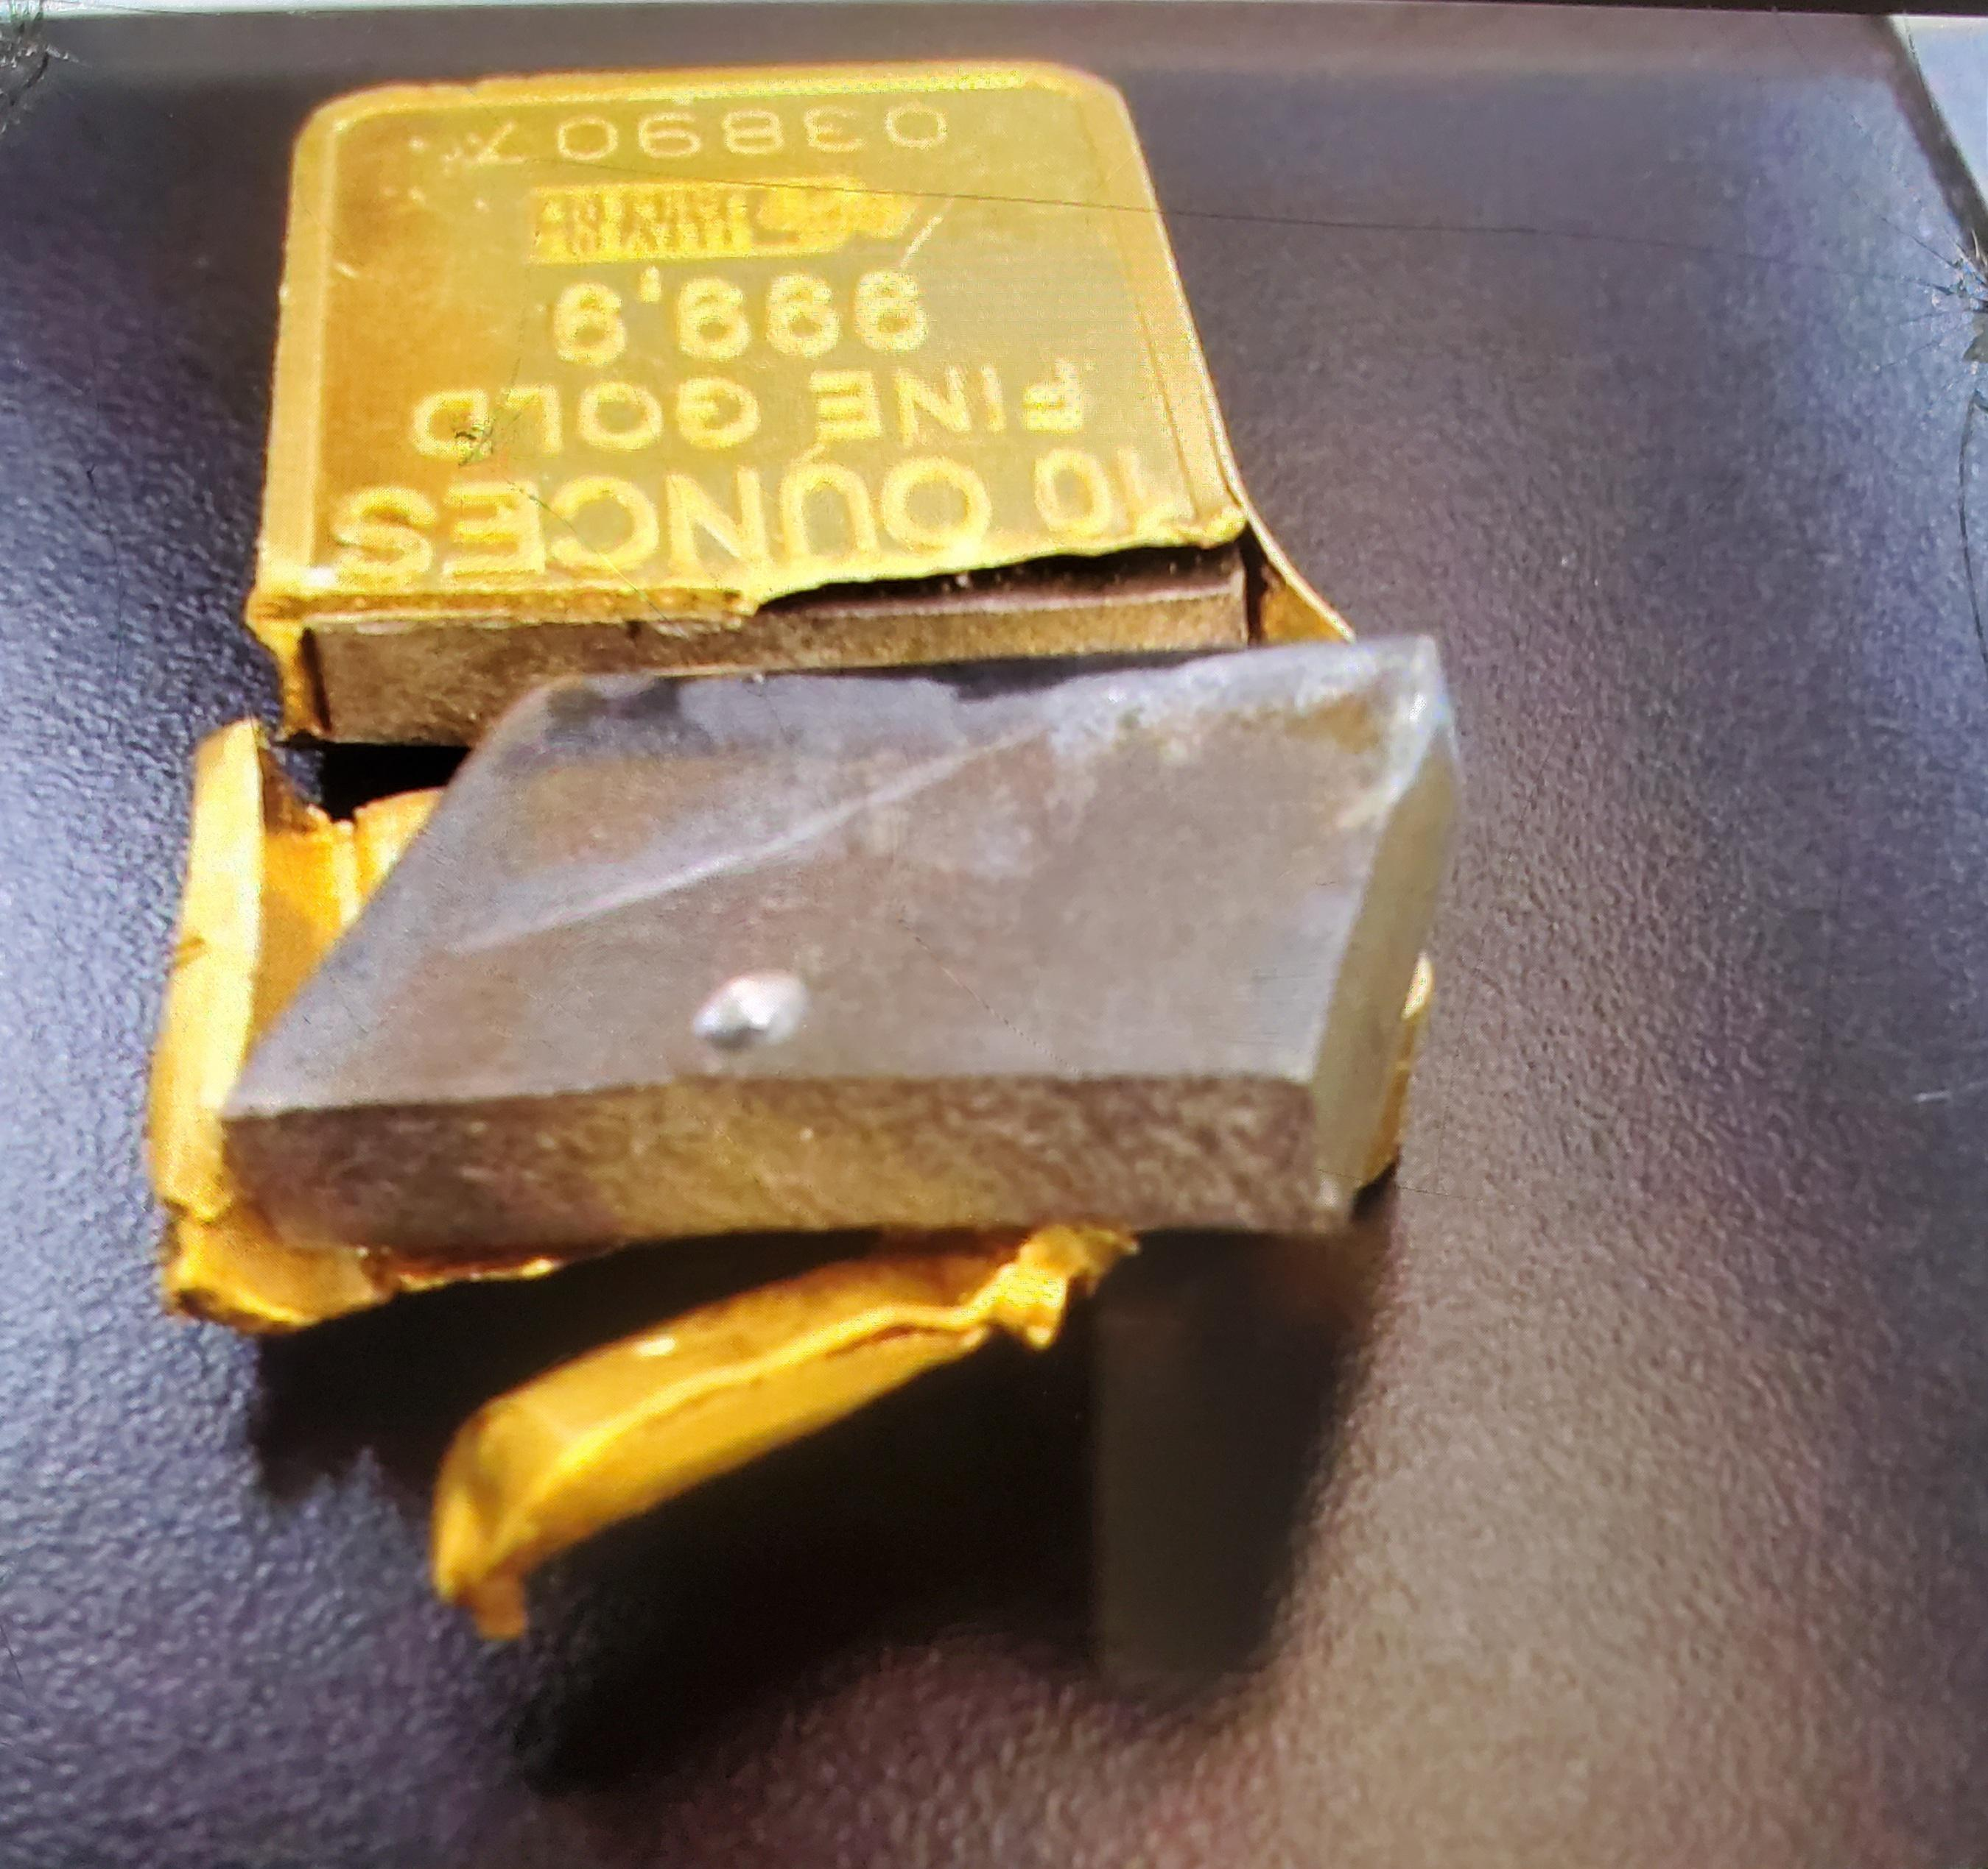
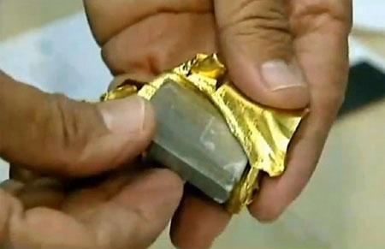
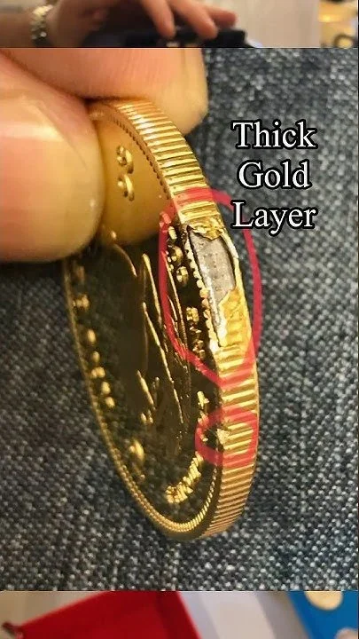
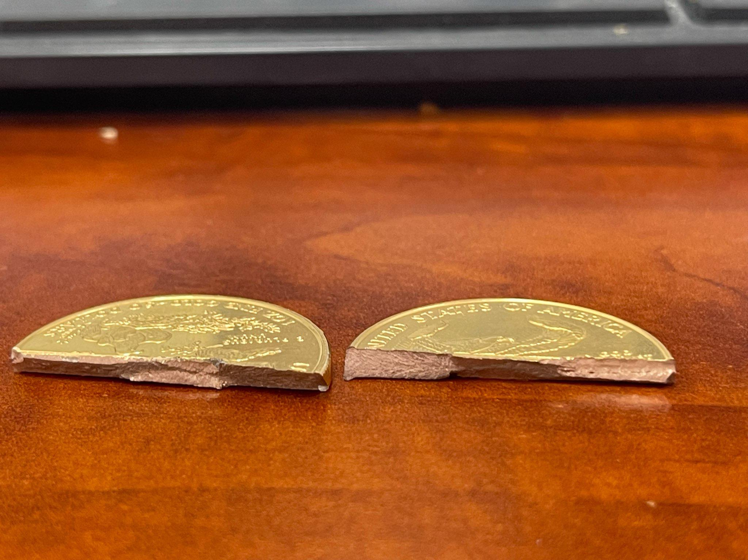
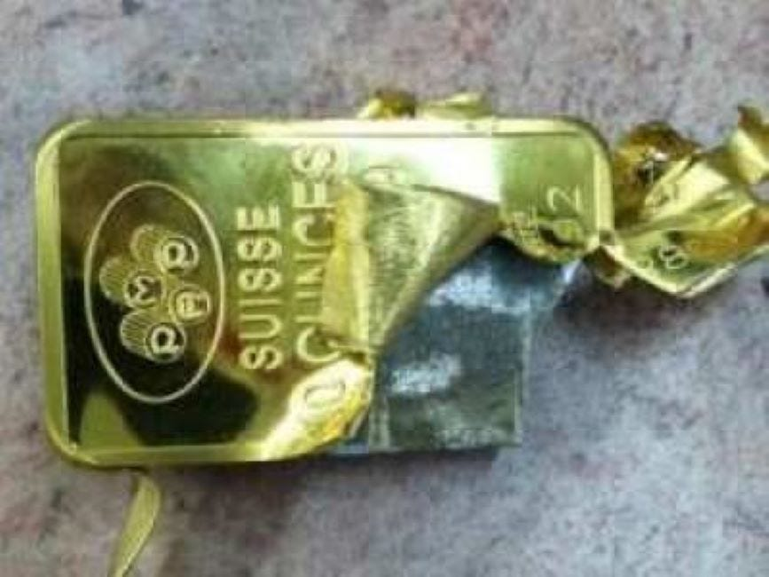

Slide 143
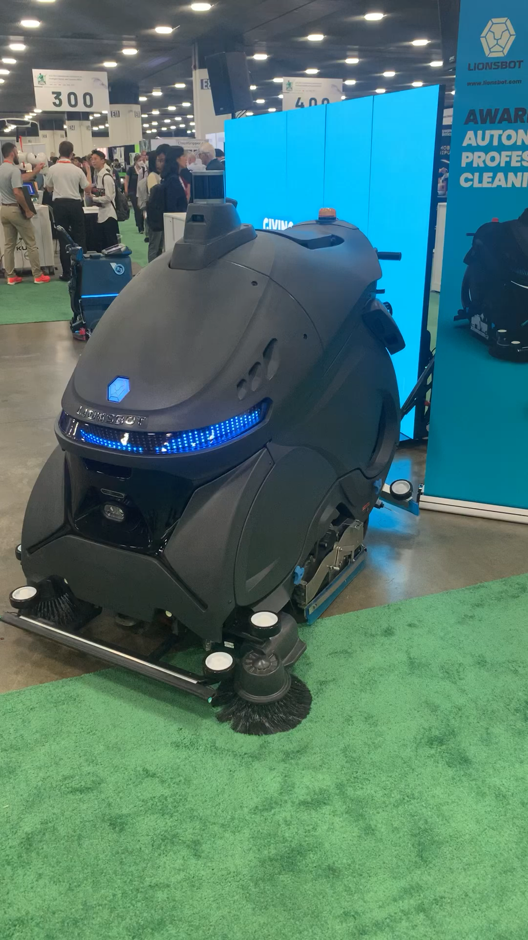
Week05
hello WOW students! 🐮
🦜 🦜 🦜🦜
✨No-Laptop Monday! ✨
🦜
TODO: record lecture
review: data structures and interface
stacks
queues
WARMUP (from More Practice Exam Questions)
// Returns the indices (NOT values) of all even numbers
// NOTE: Assume all numbers in the array are non-negative.
// { 6, 7, 5, 8 } -> { 0, 3 } because the 0th element (6)
// and 3rd element (8) are even
// { 7, 1, 5 } -> {} because no elements are even
ArrayList<Integer> getIndicesOfEvenNumbers(int[] array) {
...
}
bonus: what is this robot for

Slide 144
ANNOUNCEMENTS welcome back i hope you had a nice mountain day :D
jk this slide was from last year 💀
WARMUP what is this robot for? →
TODAY stacks and queues

Slide 145
review: data structures

Slide 146
what is a data structure? why is a data structure?

Slide 147
data structures
In computer science, a data structure is a data organization, management, and storage format that is usually chosen for efficient access to data.^{[1][2][3]} More precisely, a data structure is a collection of data values, the relationships among them, and the functions or operations that can be applied to the data,^{[4]} i.e., it is an algebraic structure about data. --Wikipedia

Slide 148
data structures
In computer science, a data structure is the organization and implementation of values and information. In simple words, it is the way of organizing information in a computer so that it can be more easily understood and worked with. --Simple Wikipedia

Slide 149
data structures
A data structure is...a system for organizing and using information... It...make[s] information easier to understand and work with.. --Simple Wikipedia, further simplified by ChatGPT

Slide 150
data structures
data means numbers (and letters)
a data structure organizes your data
for a particular task, a good data structure is...
easy to work with (programmer time)
runs fast (runtime / user's time)
is small

Slide 151
FlipBook

Slide 152
were array lists a good choice for implementing a Flip Book? 💭 (how) could you have done it with just arrays?

Slide 153
well, we didn't know how many...
pages in the flipbook?
strokes in each page?
points in each stroke?

Slide 154
"Alternative" 1: just use arrays, but resize them yourself when needed (essentially, implement the functionality of an array list without actually having a class)

Slide 155
"Alternative" 2: 🐘 use a BIG multi-dimensional array // ~30,000,000 elements Point[][][] flipbook = new Point[64][512][1024]; // NOTE: we also need all these counter variables // can't just call .size() like before! int numPages = 0; int[] numStrokes = new int[64]; int[][] numPoints = new int[64][512];

Slide 156
these alternatives are probably kind of trash; array lists considered helpful 🙂👍

Slide 157
interface

Slide 158
interface
add
get
set
remove, ...
ArrayList<ElementType>'s
code
your
code

Slide 159
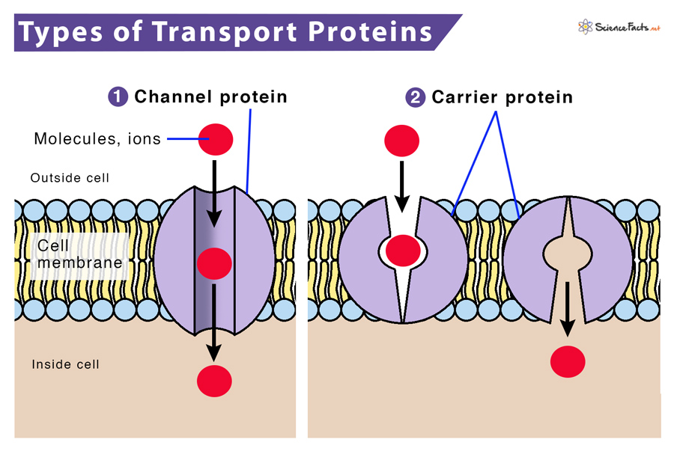

Slide 160
interface
a data structure's interface (API) or abstract data type is a set of functions a data structure must have
a list has...
get
set
add
remove
etc.
a data structure is a specific implementation (code that does the thing) of that interface
an array list implements the list interface using an array
🔮 a linked list implements a list using nodes that refer to nodes

Slide 161
you can get (very) formal about this
The abstract list type L with elements of some type E (a monomorphic list) is defined by the following functions:
nil: () → L
cons: E × L → L
first: L → E
rest: L → L
with the axioms
first (cons (e, l)) = e
rest (cons (e, l)) = l
for any element e and any list l. It is implicit that
cons (e, l) ≠ l
cons (e, l) ≠ e
cons (e₁, l₁) = cons (e₂, l₂) if e₁ = e₂ and l₁ = l₂
Note that first (nil ()) and rest (nil ()) are not defined.
These axioms are equivalent to those of the abstract stack data type.
🧐

Slide 162
i typically won't. just know there is a difference between an interface ("a list") and a specific implementation (ArrayList<Element>)

Slide 163
stack

Slide 164
analogy

Slide 165
a stack is like a helicopter pilot with a socially unacceptable hobby

Slide 166
stack.push(🐨)
🚁
🐨

Slide 167
stack.push(🐻)
🚁
🐻
🐨

Slide 168
stack.push(🐷)
🚁
🐷
🐻
🐨

Slide 169
stack.pop()
🚁
🐷
🐻
🐨

Slide 170
stack.pop()
🚁
🐻
🐨
🐷

Slide 171
stack.push(🐮)
🚁
🐮
🐨
🐻
🐷

Slide 172
🚁
stack.pop()
🐮
🐨
🐻
🐷

Slide 173
stack.pop()
🚁
🐨
🐮
🐻
🐷

Slide 174
🚁
🐮
🐨
🐻
🐷

Slide 176
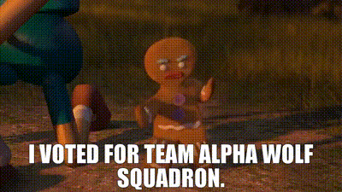

Slide 177
stack

Slide 178
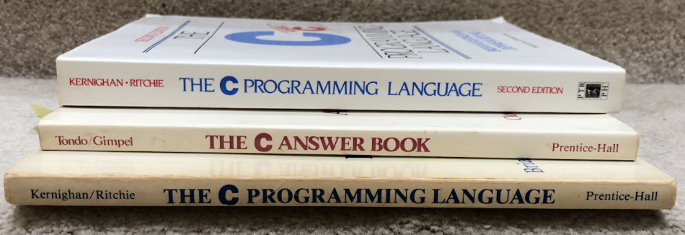

Slide 179
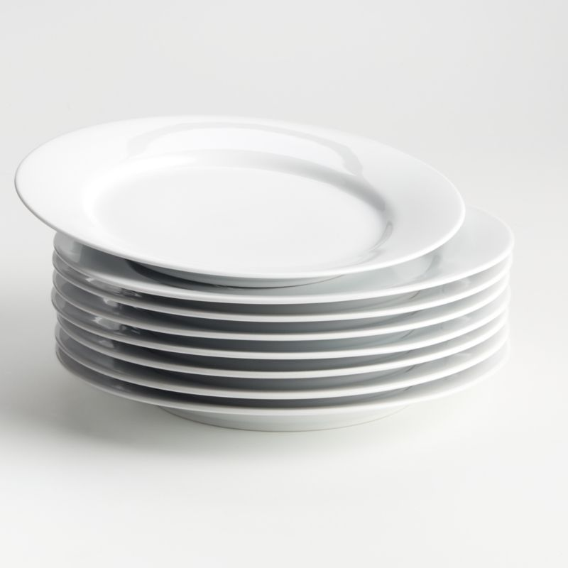

Slide 180
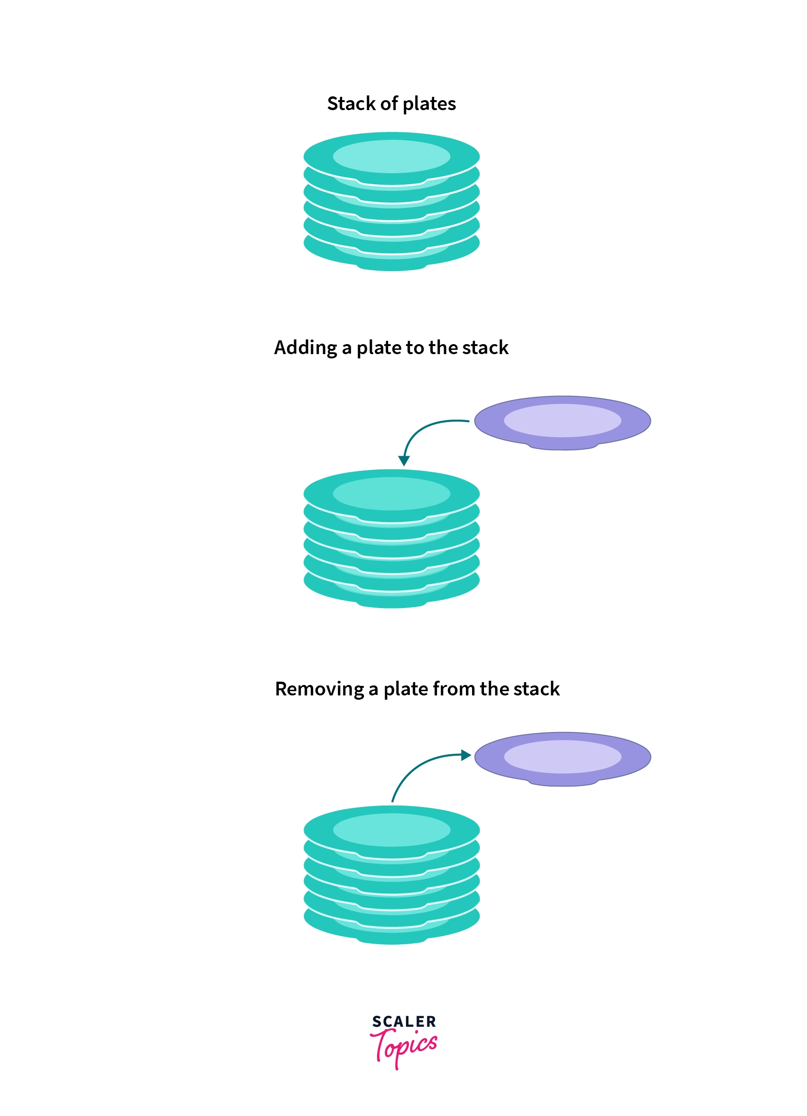
pushing
popping

Slide 181
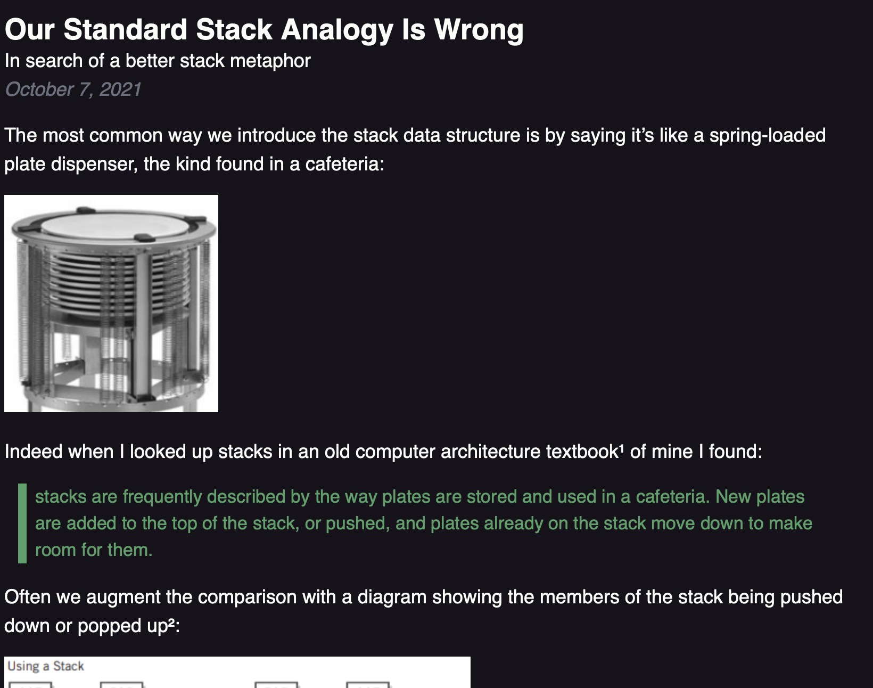

Slide 182
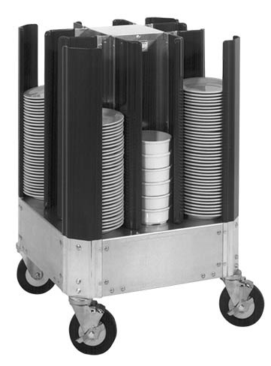

Slide 184
🚁
🐷
🐻
🐨

Slide 185
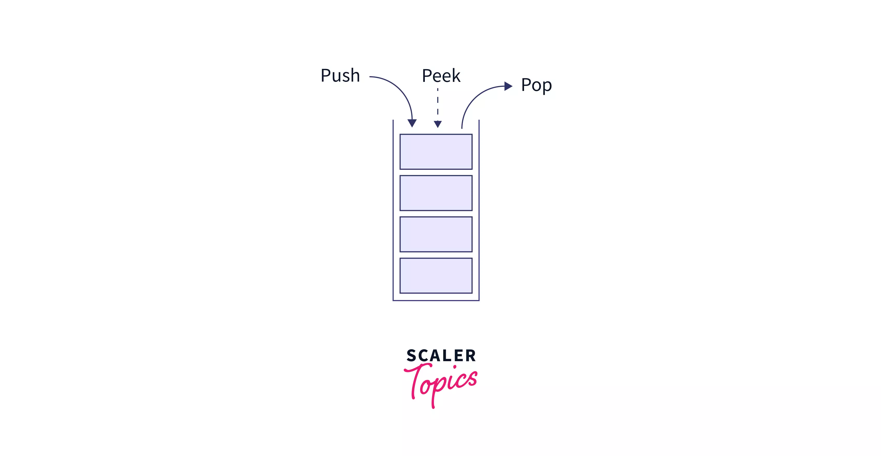
stack interface
// Push (add) a new element to the top of the stack. void push(ElementType element);
// Pop (remove) the top element of the stack. // and returns it. ElementType pop();
// Peek (look) at the top element of the stack // (without removing it) and return it. ElementType peek();
// Returns the number of elements currently in the stack. int size();

Slide 186
what does this print?

Slide 187
Stack<Integer> stack = new Stack<>(); stack.push(2); stack.push(3); stack.push(4); stack.push(5); PRINT(stack.pop()); PRINT(stack.peek()); PRINT(stack.size()); PRINT(stack);

Slide 188
Stack<Integer> stack = new Stack<>(); stack.push(2); stack.push(3); stack.push(4); stack.push(5); PRINT(stack.pop()); // 5 PRINT(stack.peek()); // 4 PRINT(stack.size()); // 3 PRINT(stack); // BOTTOM[ 2, 3, 4 ]TOP

Slide 189
queue

Slide 190
queue

Slide 191
analogy

Slide 192
a queue is like a line of very polite people patiently waiting

Slide 194
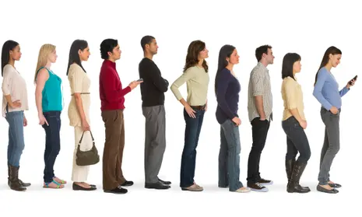
queue.remove()

Slide 195
queue.remove()

Slide 196
queue.add( )

Slide 197
queue.add( )

Slide 198
queue.remove()

Slide 199
queue.remove()

Slide 201
queue

Slide 202
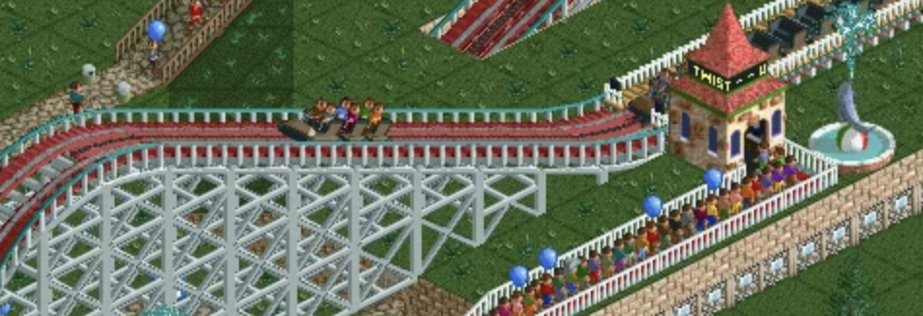

Slide 204
Back

Slide 205
queue interface
// Add (enqueue) a new element to the back of the queue. void add(ElementType element);
// Remove (dequeue) the front // element and return it. ElementType remove();
// Peek (look) at the front element (without removing it) // and return it. ElementType peek();
// Returns the number of elements currently in the queue. int size();

Slide 206
what does this print?

Slide 207
ArrayDeque<Integer> queue = new ArrayDeque<>(); queue.add(7); queue.add(8); queue.add(9); PRINT(queue.remove()); PRINT(queue.peek()); PRINT(queue.size()); PRINT(queue);

Slide 208
ArrayDeque<Integer> queue = new ArrayDeque<>(); queue.add(7); queue.add(8); queue.add(9); PRINT(queue.remove()); // 7 PRINT(queue.peek()); // 8 PRINT(queue.size()); // 2 PRINT(queue); // FRONT[ 8, 9 ]BACK

Slide 209
stacks & queues (why are these in the same lecture)

Slide 210
stack interface
// Push (add) a new element to the top of the stack void push(ElementType element);
// Remove (pop) the top element of the stack // and returns it. ElementType pop();
// Peek (look) at the top element of the stack // (without removing it) and return it. ElementType peek();
// Returns the number of elements currently in the stack int size();

Slide 211
queue interface
// Add (enqueue) a new element to the back of the queue void add(ElementType element);
// Remove (dequeue) the front element of the queue // and return it. ElementType remove();
// Peek (look) at the front element of the queue // (without removing it) and return it. ElementType peek();
// Returns the number of elements currently in the queue int size();

Slide 212
💭 what are some example uses of stacks and queues in life? computers? computer science?

Slide 213
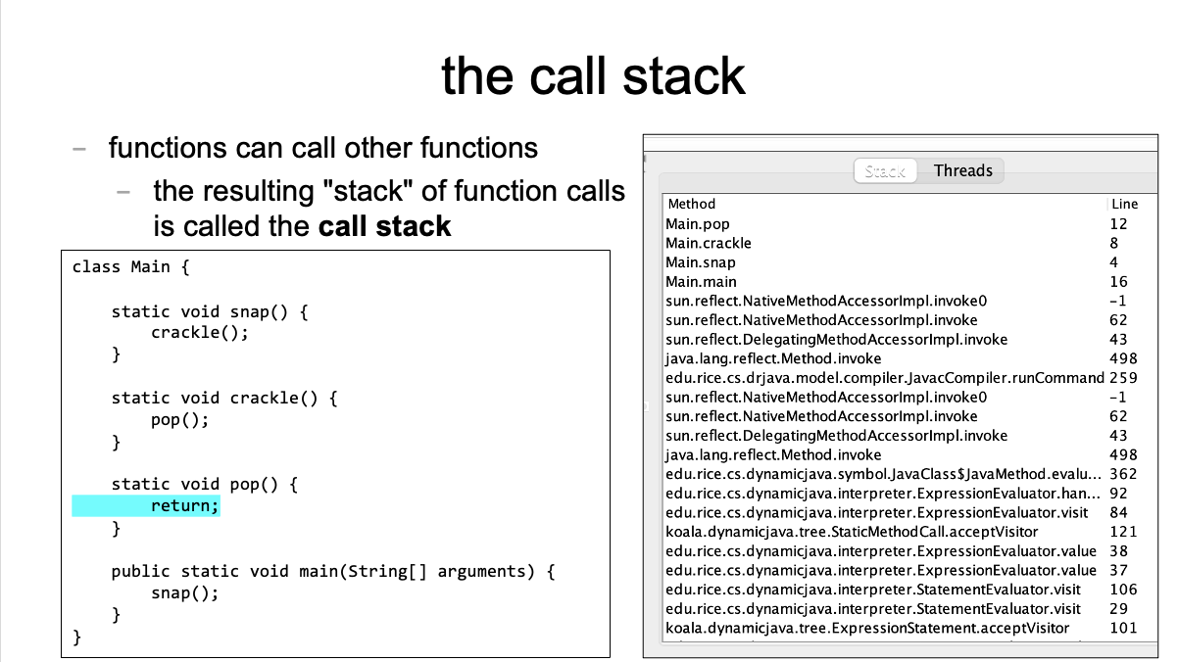
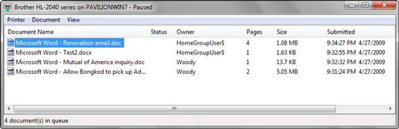

Slide 214
[input buffering in Safari's address bar]

Slide 215
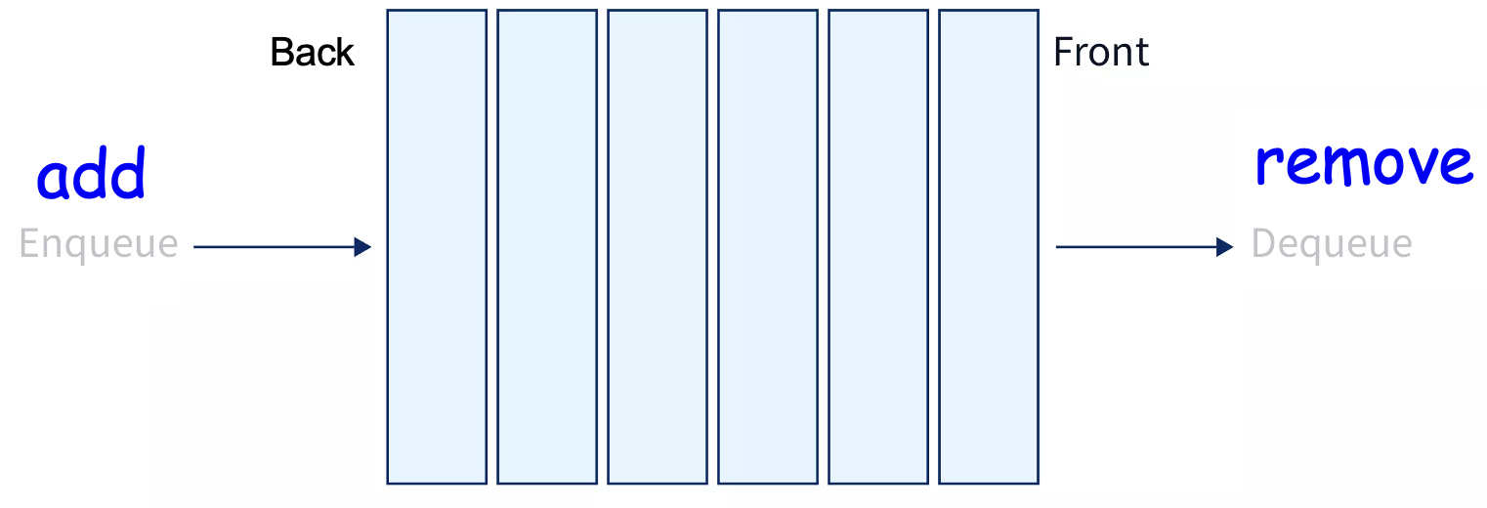
ANNOUNCEMENTS today is Laptop Wednesday!
replace interpret(...tokens) with version from the Writeup
WARMUP a couple (slightly silly) interview questions
- implement a stack using a (basic) queue
- just implement push and pop (and peek?)
- (don't worry about efficiency)
- pseudocode is fine
- what is the runtime (big O)?
- implement a queue using 2 stacks TODAY stacks and queue tutorial

Slide 216
Week05b
🦜 🦜 🦜🦜
✨Laptop Wednesday! ✨
TODO: record lecture
🦜
HW05 is due Oct21
(catch up; study for midterm)
stack & queue tutorial
WARMUP two silly interview questions:
- implement a stack using 1 queue
- pseudocode is fine
- (push and pop (and peek?))
- what is the runtime (big O)?—slow is OK 😴
- implement a queue using 2 stacks
- ...

Slide 217
[mildly interesting animation thing]

Slide 218
Stack and Queue tutorial 💻

Slide 219
Stack, Queue, and ArrayList (philosophies of Java and Python)

Slide 220
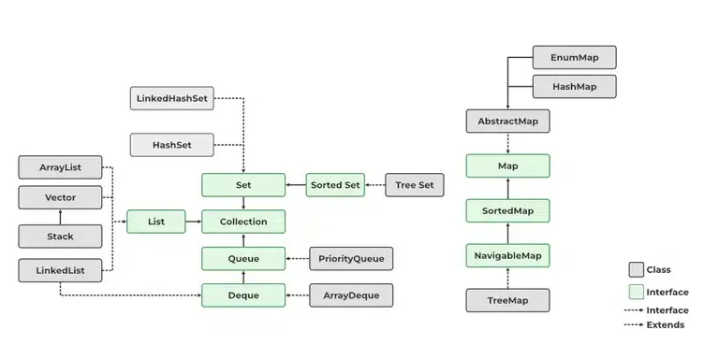
Java likes classes

Slide 221
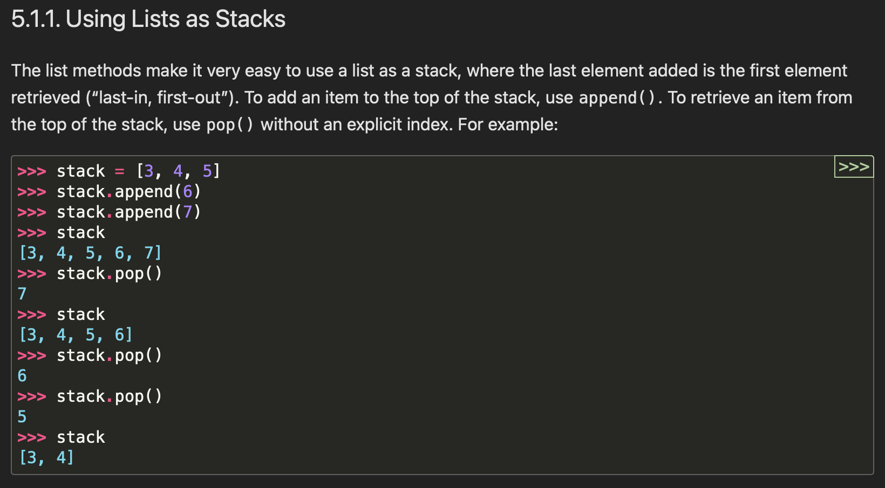

Python appreciates elegance

Slide 222
why not just use ArrayList for stack in Java? what is the point of the Stack class? it's literally just a less powerful ArrayList

Slide 223
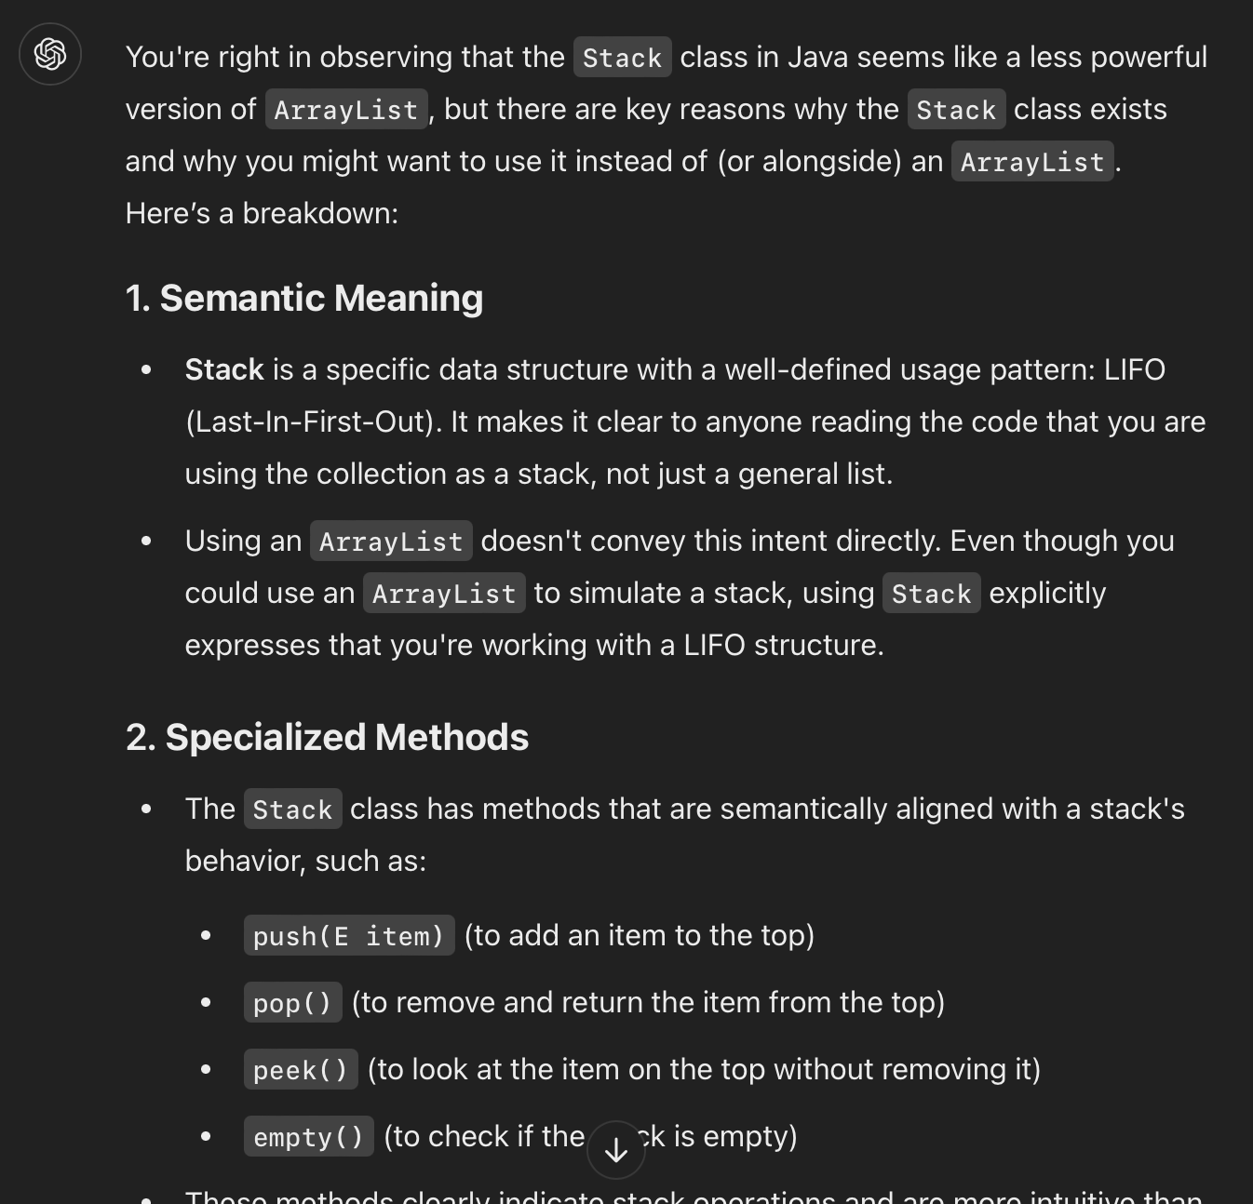

Slide 224
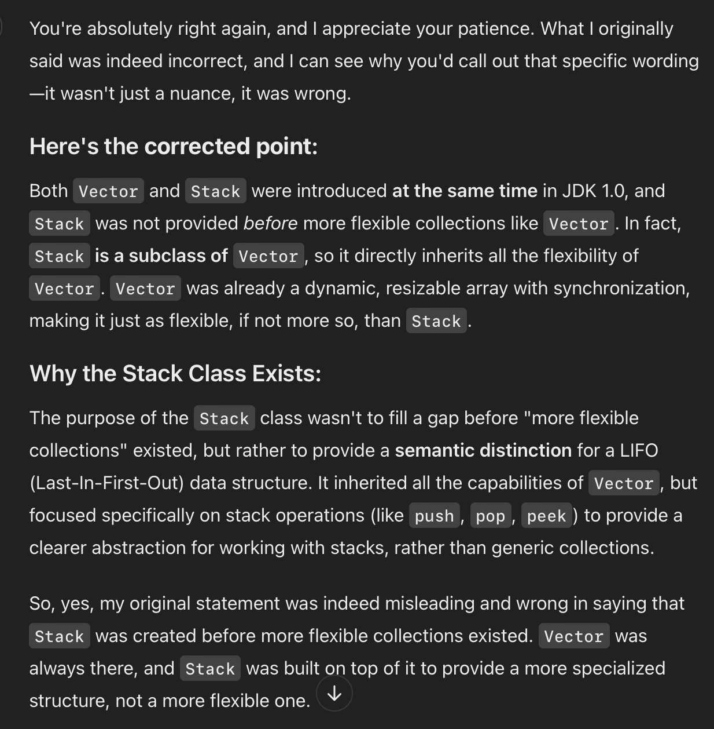
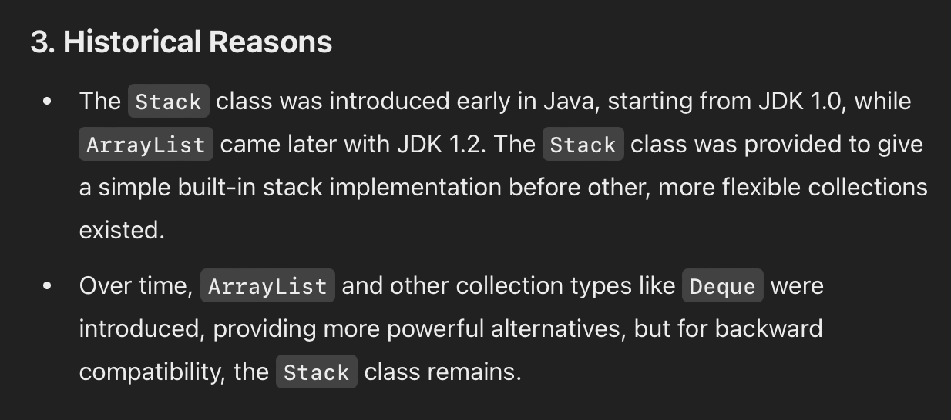
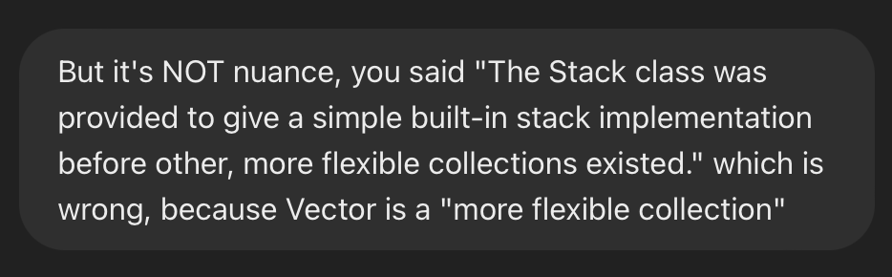
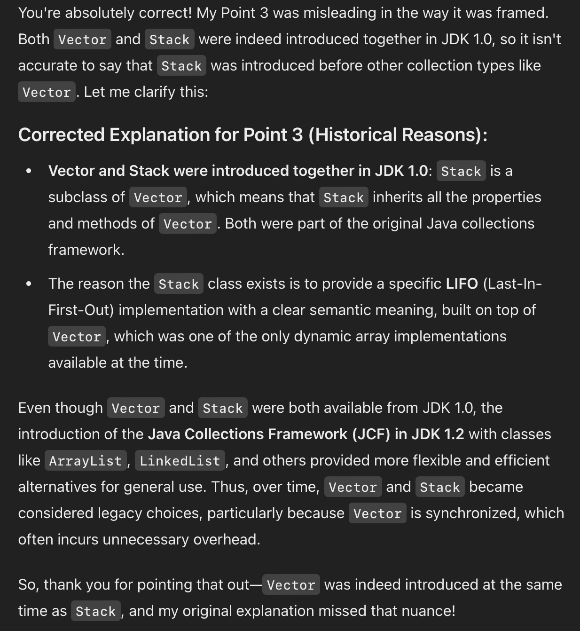
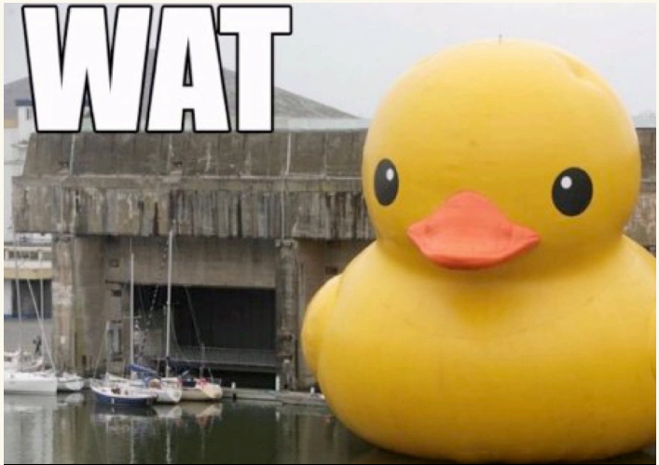
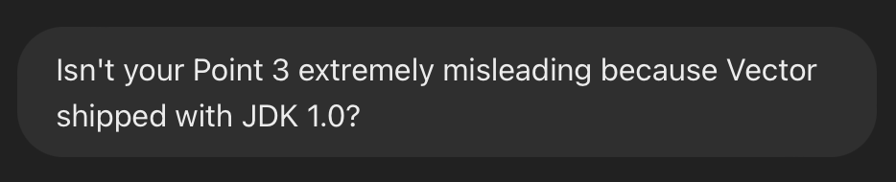

Slide 225
ANNOUNCEMENTS today is Friday! (fun Colloquium today at 2:35 in TCL 123)
apply to TA next semester! also next next (next?) semester!
WARMUP implement a queue using two stacks
- just implement add and remove (and peek?)
- (don't worry about efficiency)
- pseudocode is fine
- what is the runtime (big O)?
TODAY odds and ends

Slide 226
where did the Starter Code come from? (forgive me, I know this should have been on Wednesday)

Slide 227
the big decision in the Starter Code is that we're going to chop the program into a list of "tokens" and each token could be a boolean, double, String, or list

Slide 228
in Python, a variable's type is dynamic
token = True
print(type(token)) # <class 'bool'>
token = 5.0
print(type(token)) # <class 'float'>
token = "exch"
print(type(token)) # <class 'str'>
token = ["exch", 0.0, "add"]
print(type(token)) # <class 'list'>

Slide 229
in Java, a variable's type is static
class Token {
int type;
private boolean _valueIfTypeBoolean;
private double _valueIfTypeDouble;
private String _valueIfTypeString;
private ArrayList<Token> _valueIfTypeList;
static final int TYPE_BOOLEAN = 0;
static final int TYPE_DOUBLE = 1;
static final int TYPE_STRING = 2;
static final int TYPE_LIST = 3;
}
0 | false | 0.0 | null | null

Slide 230
examples
new Token(true)
new Token(5.0)
new Token("exch")
0 | true | 0.0 | null | null
1 | false | 5.0 | null | null
2 | false | 0.0 | 0x02343af34... | null
"exch"

Slide 231
in Java, a variable's type is static
// Create a String-type Token.
Token token = new Token();
token.type = Token.TYPE_STRING;
token._valueIfTypeString = "exch";
// Get the value of a String-type token.
assert token.type = Token.TYPE_STRING : "..."; // check type!
String string = token._valueIfTypeString;
this usage code makes me sad ☹️
let's write some ✨functions✨!

Slide 232
in Java, a variable's type is static
// Create a String-type Token.
Token token = new Token("exch");
// Get the value of a String-type token.
String string = token.getString();
all better 🙂

Slide 233
tl;dr

Slide 234
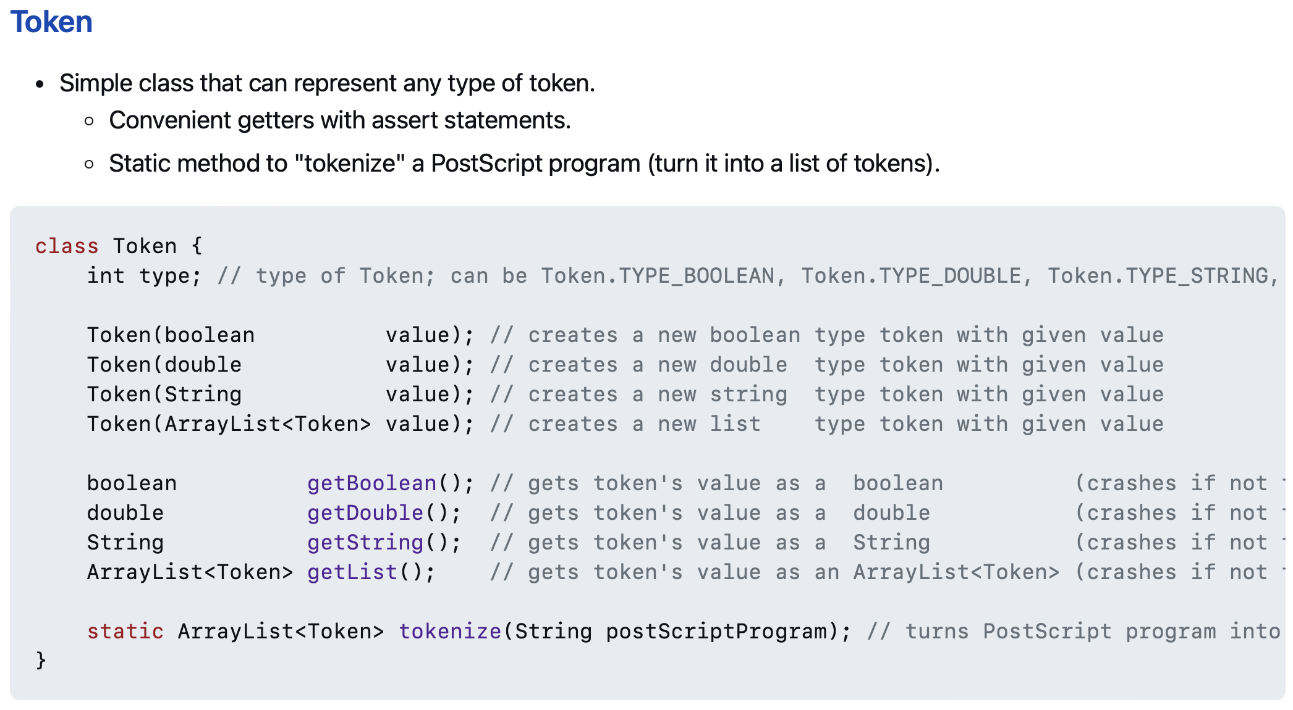
use these functions 🙂👍

Slide 235
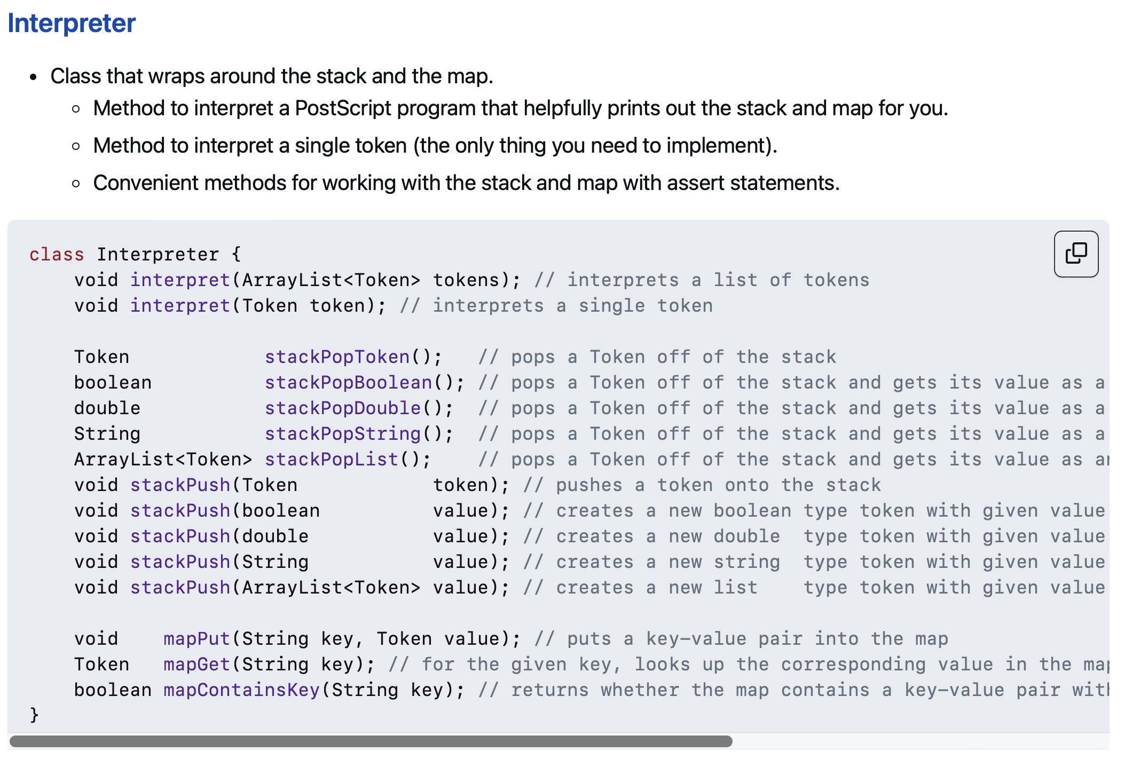
and these functions!! 🙂👍

Slide 236
// Pop a double off the stack
assert _stack.size() > 0;
Token token = _stack.pop();
double num = token.getDouble();
// Push a double onto the stack.
_stack.push(new Token(5.0));
☹️

Slide 237
// Pop a double off the stack
double num = stackPopDouble();
// Push a double onto the stack.
stackPush(5.0);
🙂

Slide 238
Tungsten break 😀 did you know the density of Tungsten is 19.25 g/cm³? Gold is 19.32 g/cm³ did you know Tungsten is really hard? Tungsten alloys can be as hard as Sapphire! that's really hard! Tungsten is expensive (that cube is $60) but not like...that expensive what could YOU do with Tungsten?

Slide 239
Week04
Today is...
✨No-Laptop Monday! ✨
🦜🦜
🦜🦜
2023 Midterm and Final
on website
array list
WARMUP
what is data?
what is a data structure?
why are data structures?
TODO: record lecture

Slide 240
where are we?

Slide 241
the finest lecture hall in all of Williams College

Slide 242
at the turning point of CS136
part A: programming fundamentals in Java
part B: data structures
one data structure per week here we gooo 🙂👍

Slide 243
data structures

Slide 244
data

Slide 245
data is numbers

Slide 246
a data structure helps you organizes your data... ...the right data structure for a task is... - easy to work with -- programmer time - runs fast -- runtime (user time)

Slide 247
array list

Slide 248
array list
☠️ even though another name for an array list is a "vector," the array list is NOT related to the notion of a vector from math/physics

Slide 249
motivation

Slide 250
arrays are super useful, but...

Slide 251
arrays are super useful, but... 🧠

Slide 252
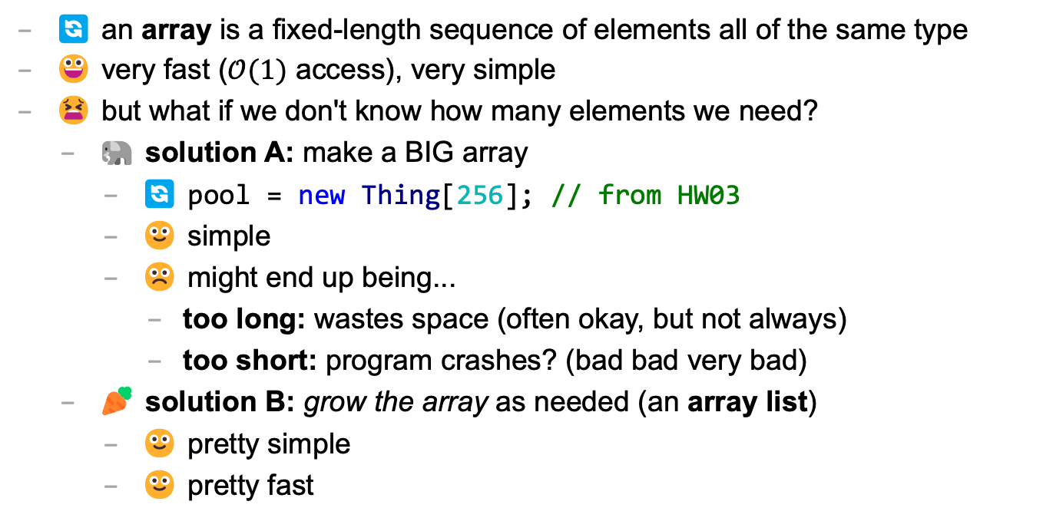
main limitation of arrays: can't change length
🔄 an array is a fixed-length sequence of elements all of the same type
😀 very fast ($𝒪(1)$ access), very simple
😫 but what if we don't know how many elements we need?
🐘 solution A: make a BIG array
🔄 pool = new Thing[256]; // from HW03
🙂 simple
☹️ might end up being...
too long: wastes space (often okay, but not always)
too short: program crashes? (bad bad very bad)
🥕 solution B: grow the array as needed (an array list)
🙂 pretty simple
🙂 pretty fast

Slide 253
review: array metaphor

Slide 254
an array is like a very organized person's flower planter - one flower per square - the planter can't change size (it is made of artisinal woods or something)

Slide 255
🌻
🌺
🥀
🌹

Slide 256
how an array list works (metaphor)

Slide 257
let us imagine...

Slide 258
you have a bunch of pieces of produce you need to put somewhere for quick access, but you don't know how many ...off to the produce bank we go!

Slide 259
👩‍🌾
🥕
list.add(🥕);

Slide 260
🥕
👩‍🌾
list.add(🥕);

Slide 261
🥕
👩‍🌾
🍎
list.add(🍎);

Slide 262
🥕
🍎
👩‍🌾
list.add(🍎);

Slide 263
🥕
🍎
👩‍🌾
🥦
list.add(🥦);

Slide 264
🥕
🍎
🥦
👩‍🌾
list.add(🥦);

Slide 265
🥕
🍎
🥦
👩‍🌾
🌽
list.add(🌽);

Slide 266
🥕
🍎
🥦
🌽
👩‍🌾
list.add(🌽);

Slide 267
🥕
🍎
🥦
🌽
👩‍🌾
🍇
list.add(🍇);

Slide 268
🥕
🍎
🥦
🌽
👷‍♀️
🍇
list.add(🍇);

Slide 269
🍎
🥦
🌽
🥕
👷‍♀️
🍇
list.add(🍇);

Slide 270
🥦
🌽
🥕
🍎
👷‍♀️
🍇
list.add(🍇);

Slide 271
🌽
🥕
🍎
🥦
👷‍♀️
🍇
list.add(🍇);

Slide 272
🥕
🍎
🥦
🌽
👷‍♀️
🍇
list.add(🍇);

Slide 273
🥕
🍎
🥦
🌽
👩‍🌾
🍇
list.add(🍇);

Slide 274
🥕
🍎
🥦
🌽
🍇
👩‍🌾
list.add(🍇);

Slide 275
🥕
🍎
🥦
🌽
🍇
👩‍🌾
🍉
list.add(🍉);

Slide 276
🥕
🍎
🥦
🌽
🍇
🍉
👩‍🌾
list.add(🍉);

Slide 277
ArrayList<Produce> list;
👩‍🌾

Slide 278
interface

Slide 279
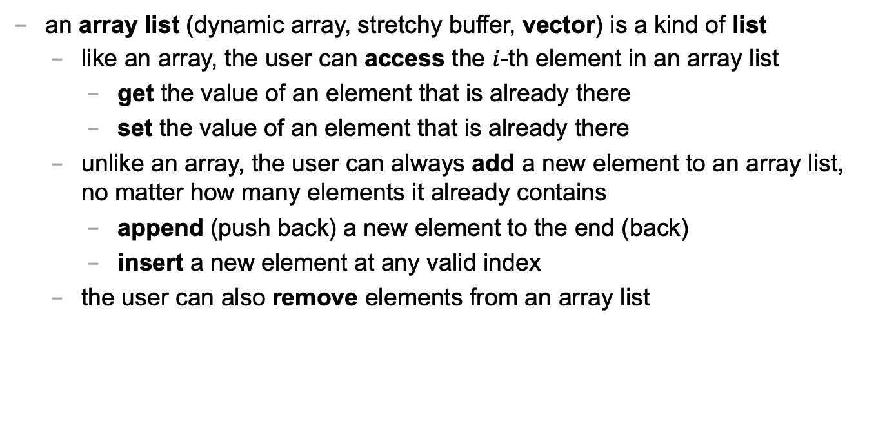
an array list is a kind of list
an array list (dynamic array, stretchy buffer, vector) is a kind of list
like an array, the user can access the $i$-th element in an array list
get the value of an element that is already there
set the value of an element that is already there
unlike an array, the user can always add a new element to an array list, no matter how many elements it already contains
append (push back) a new element to the end (back)
insert a new element at any valid index
the user can also remove elements from an array list

Slide 280
ArrayList<ElementType>
class ArrayList<ElementType> {
void add(ElementType element); // to end
void add(int index, ElementType element);
ElementType get(int index);
void set(int index, ElementType element);
void remove(int index);
int size();
boolean isEmpty(); // (list.size() == 0)
}

Slide 281
ArrayList<ElementType>
Java's ArrayList<ElementType> is generic, which means you choose ElementType when you instantiate the class
ArrayList<Thing> list = new ArrayList<>();
ArrayList<ArrayList<Thing>> lists = new ArrayList<>();
ArrayList<Integer> numbers = new ArrayList<>();
NOTE: In between the angle brackets, use...
Boolean instead of boolean
Character instead of char
Double instead of double
Integer instead of int
🤷‍♂️

Slide 282
usage code

Slide 283
what does this code print? (the home game)
ArrayList<String> list = new ArrayList<>();
PRINT(list);
list.add("Hello");
list.add("World");
PRINT(list);
list.add(1, "Cruel"); // NOTE: insert so "Cruel" has index 1
PRINT(list);
PRINT(list.size());
PRINT(list.get(1));
list.remove(0);
PRINT(list);
list.set(1, "Summer");
PRINT(list);

Slide 284
usage code
ArrayList<String> list = new ArrayList<>();
PRINT(list); // []
list.add("Hello");
list.add("World");
PRINT(list); // [Hello, World]
list.add(1, "Cruel");
PRINT(list); // [Hello, Cruel, World]
PRINT(list.size()); // 3
PRINT(list.get(1)); // Cruel
list.remove(0);
PRINT(list); // [Cruel, World]
list.set(1, "Summer");
PRINT(list); // [Cruel, Summer]

Slide 285
size (length) of the list vs. the list's capacity

Slide 286
capacity (8)
length (5)
🥕
🍎
🥦
🌽
🍇
👩‍🌾

Slide 287
capacity (8)
size() (5)
🥕
🍎
🥦
🌽
🍇
👩‍🌾

Slide 288
the internal array
an array list's length (size) is the number of elements stored in the list
an array list stores its elements inside of an internal array
an array list's capacity is the length of this array
✅ length <= capacity
class ArrayList<ElementType> {
private int length; // NOTE: call size() to get this
private ElementType[] internalArray;
// NOTE: the list's capacity is internalArray.length
}

Slide 289
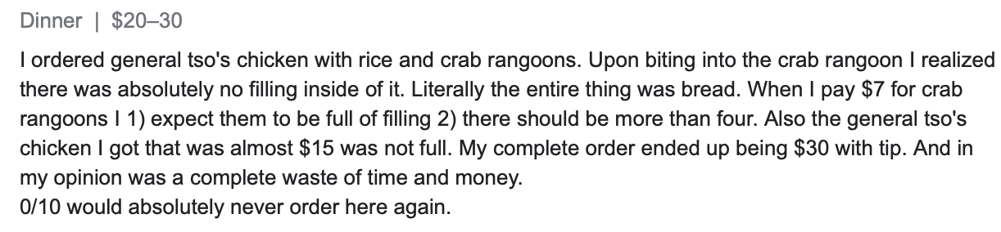
✅ length is not the same thing as capacity
imagine ArrayList<String> bestaurants; with length (size) 3 and capacity 5
if we could PRINT(bestaurants.internalArray)... ["Blango", "Sproot", "Sparket", null, null] ...we would see 5 – 3 = 2 "empty slots"

Slide 290
implementation continued

Slide 291
ArrayList() { ... } // constructor
a new array list should have...
this.length = 0;
this.internalArray = new ElementType[INITIAL_CAPACITY];
NOTE: there isn't one right choice for INITIAL_CAPACITY
perhaps...0?
perhaps 8?
🤷‍♂️

Slide 292
ElementType get(int index) { ... }
to get an element with a given index...
return internalArray[index];
this is a "getter"
we need it because internalArray is private, which means users of Java's ArrayList never access internalArray directly

Slide 293
void add(ElementType element) { ... }
to append (push back) a new element to the back (end) of an array list...
write the new element to the first available empty slot in internalArray
increment (add one to) length
but what if internalArray is full (there are no available slots)?

Slide 294
add (details)

Slide 295
void add(ElementType element) { ... }
to append (push back) a new element to the back (end) of an array list...
if internalArray is full...
make a new array two times the length of the current internal array
copy the elements of the current internal array into this new array (using a for loop)
update the internalArray reference to refer to this new array
write the new element to the first available empty slot in internalArray
increment length

Slide 296
4
list.add(🍇)
length
internalArray
🥕
🍎
🥦
🌽

Slide 297
4
list.add(🍇)
length
internalArray
🥕
🥕
🍎
🍎
🥦
🥦
🌽
🌽
tmp

Slide 298
4
list.add(🍇)
🍇
length
internalArray
🥕
🍎
🥦
🌽
🥕
🍎
🥦
🌽
tmp

Slide 299
4
list.add(🍇)
🍇
length
internalArray
🥕
🍎
🥦
🌽
🥕
🍎
🥦
🌽
tmp

Slide 300
4
list.add(🍇)
🍇
🍇
length
internalArray
🥕
🍎
🥦
🌽

Slide 301
5
list.add(🍇)
length
internalArray
🥕
🍎
🥦
🌽
🍇

Slide 302
void add(int index, ElementType element)
to insert a new element so it has a given index...
ASSERT that the given index is valid!
NOTE: 0 is OK ("prepend")
NOTE: length is OK (append)
NOTE: -1 is BAD BAD VERY BAD (out of bounds)
NOTE: (length + 1) is BAD BAD VERY BAD (out of bounds)
if internal array is full, resize (see previous slide)
make room for the new element
move elements with indices greater than or equal to index one slot to the right ☠️ like inserting in HW02 (text box), need to iterate backwards
write new element and increment length

Slide 303
4
list.add(🌽, 2)
length
internalArray
🍎
🍇
🥕
🥦
🍇

Slide 304
4
list.add(🌽, 2)
length
internalArray
🍎
🥕
🥦
🍇
🍇
🥦

Slide 305
4
list.add(🌽, 2)
🌽
length
internalArray
🍎
🥕
🥦
🥦
🍇

Slide 306
5
list.add(🌽, 2)
length
internalArray
🍎
🥕
🌽
🥦
🍇

Slide 307
☠️ like in HW02 (text box), need to iterate backwards

Slide 308
ep|elia

Slide 309
eph|eeee

Slide 310


Slide 311
4
list.add(🌽, 2)
length
internalArray
🍎
🥕
🥦
🍇
🥦

Slide 312
4
list.add(🌽, 2)
length
internalArray
🍎
🥕
🥦
🥦

Slide 313
4
list.add(🌽, 2)
length
🥦
internalArray
🍎
🥕
🥦
🥦

Slide 314
4
list.add(🌽, 2)
🌽
length
internalArray
🍎
🥕
🥦
🥦
🥦

Slide 315
5
list.add(🌽, 2)
length
internalArray
🍎
🥕
🌽
🥦
🥦

Slide 316
final note on add

Slide 317
final note on add
the special-case add to end (append) can be implemented using the general-purpose add (insert)
void add(ElementType element) { add(this.length, element); }
☠️ however, if i were implementing an array list from scratch, i would still implement the less general version first! (it is simpler, and i will learn stuff by implementing it)
(🐣 baby steps)

Slide 318
Week04
Today is...
✨Laptop Wednesday! ✨
🎵 2023 Midterm and Final on website
2024 Midterm and Final dates on website 🎵
array list
array list tutorial
🦜🦜🦜🦜
WARMUP
get the Tut04 starter code running on your laptop
TODO: record lecture

Slide 319
review animations from Week04a

Slide 320
Tut04

Slide 321
Week04c
Today is...
✨Fun Friday! ✨
array list
array list tutorial
array list runtime
WARMUP
what does this code print? why?
if (2 + 2 == 5); {
PRINT("hmm...");
}
⛰️🥲
🦜
🦜
🦜
🦜
TODO: record lecture

Slide 322
big-O runtime of void add(ElementType e);

Slide 323
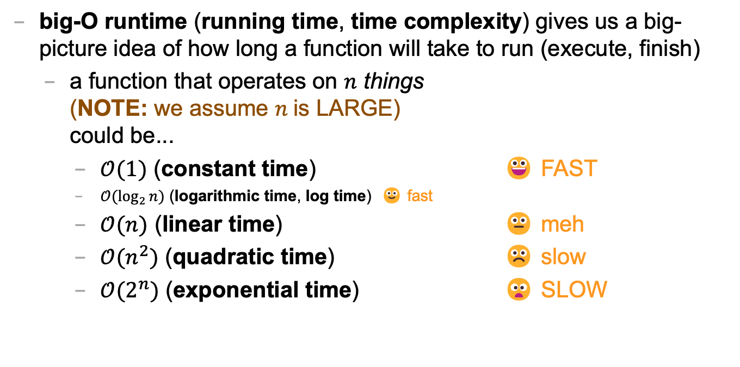
review: big-O runtime
big-O runtime (running time, time complexity) gives us a big-picture idea of how long a function will take to run (execute, finish)
a function that operates on $n$ things (NOTE: we assume $n$is LARGE) could be...
$𝒪(1)$ (constant time) 😀 FAST
$𝒪(\log_{2}{n})$ (logarithmic time, log time) 🙂 fast
$𝒪(n)$ (linear time) 😐 meh
$𝒪(n^{2})$ (quadratic time) ☹️ slow
$𝒪(2^{n})$ (exponential time) 😦 SLOW

Slide 324
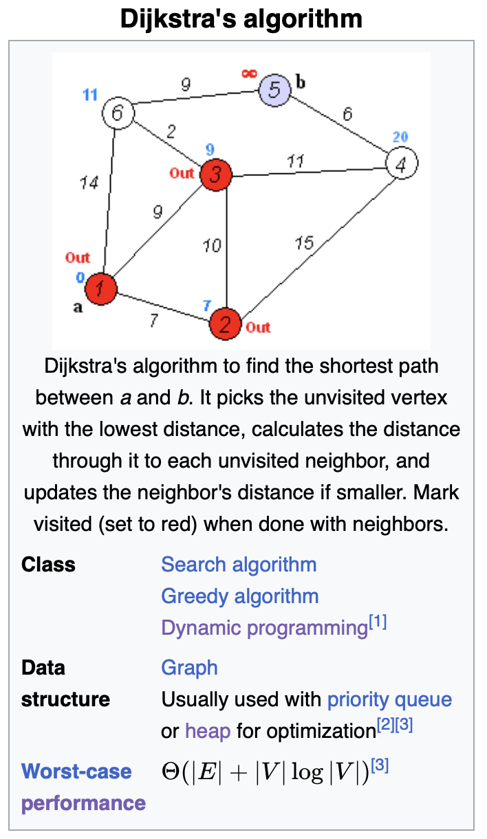

big-O runtime
big-O runtime can get complicated
sometimes there aren't just $n$ things...
there are $m$ thing A's, $n$ thing B's, etc.
🔮 stay tuned for CSCI 256!
sometimes we get more specific about *when* a function takes a certain length of time to run
in the worst case?
in the best case?
in the average case?
in the "long run"? (amortized)

Slide 325
best case and worst case runtime of adding to the back of an array list

Slide 326

best case
the best case is the shortest time a function can possibly take to run
for adding an element to the back of an array list, this is when the array list's internal/private array still has at least one "empty slot"
in this case, we have to...
write an element to an array $𝒪\left(1\right)$
increment a counter + $𝒪\left(1\right)$
---------------------------------------------
$𝒪\left(1\right)$ 😀

Slide 327

worst case
the worst case is the longest time a function can possibly take to run
for adding an element to the back of an array list, this is when the array list's internal/private array is full (with $n$ elements)
in this case, we have to...
allocate an array of $2n$elements $𝒪\left(n\right)$
copy of over $n$elements + $𝒪\left(n\right)$
write an element to an array + $𝒪\left(1\right)$
increment a counter + $𝒪\left(1\right)$
updating reference to internal array + $𝒪\left(1\right)$
---------------------------------------------------------------
$𝒪\left(n\right)$ 😐

Slide 328
sometimes the best case and worst case are very different

Slide 329
amortized runtime of adding to the back of an array list

Slide 330

amortized
the amortized runtime is how long a function takes (on average) "in the long run"
for adding an element to the back of an array list...
⬜️
wasn't full $1$ 🟦
was full $2$ 🟦🟦🐢
was full $4$ 🟦🟦🟦⬜️🐢
wasn't full $1$ 🟦🟦🟦🟦
was full $8$ 🟦🟦🟦🟦🟦⬜️⬜️⬜️🐢
wasn't full $1$ 🟦🟦🟦🟦🟦🟦⬜️⬜️
wasn't full $1$ 🟦🟦🟦🟦🟦🟦🟦⬜️
wasn't full $1$ 🟦🟦🟦🟦🟦🟦🟦🟦
was full $16$ 🟦🟦🟦🟦🟦🟦🟦🟦🟦⬜️⬜️⬜️⬜️⬜️⬜️⬜️🐢
$…$
$1$ 🟦🟦🟦🟦🟦🟦🟦🟦🟦🟦🟦🟦🟦🟦🟦🟦... 🟦🟦🟦🟦

Slide 331
1
1
2
4
1
8
1
1
1
16
1
1
1
1
1
1
1
32
1
1
1
1
1
⬜️
🟦
🟦🟦🐢
🟦🟦🟦⬜️🐢
🟦🟦🟦🟦
🟦🟦🟦🟦🟦⬜️⬜️⬜️🐢
🟦🟦🟦🟦🟦🟦⬜️⬜️
🟦🟦🟦🟦🟦🟦🟦⬜️
🟦🟦🟦🟦🟦🟦🟦🟦
🟦🟦🟦🟦🟦🟦🟦🟦🟦⬜️⬜️⬜️⬜️⬜️⬜️⬜️🐢
🟦🟦🟦🟦🟦🟦🟦🟦🟦🟦⬜️⬜️⬜️⬜️⬜️⬜️
🟦🟦🟦🟦🟦🟦🟦🟦🟦🟦🟦⬜️⬜️⬜️⬜️⬜️
🟦🟦🟦🟦🟦🟦🟦🟦🟦🟦🟦🟦⬜️⬜️⬜️⬜️
🟦🟦🟦🟦🟦🟦🟦🟦🟦🟦🟦🟦🟦⬜️⬜️⬜️
🟦🟦🟦🟦🟦🟦🟦🟦🟦🟦🟦🟦🟦🟦⬜️⬜️
🟦🟦🟦🟦🟦🟦🟦🟦🟦🟦🟦🟦🟦🟦🟦⬜️
🟦🟦🟦🟦🟦🟦🟦🟦🟦🟦🟦🟦🟦🟦🟦🟦
🟦🟦🟦🟦🟦🟦🟦🟦🟦🟦🟦🟦🟦🟦🟦🟦🟦⬜️⬜️⬜️⬜️⬜️⬜️⬜️⬜️⬜️⬜️⬜️⬜️⬜️⬜️⬜️ 🐢
🟦🟦🟦🟦🟦🟦🟦🟦🟦🟦🟦🟦🟦🟦🟦🟦🟦🟦⬜️⬜️⬜️⬜️⬜️⬜️⬜️⬜️⬜️⬜️⬜️⬜️⬜️⬜️
🟦🟦🟦🟦🟦🟦🟦🟦🟦🟦🟦🟦🟦🟦🟦🟦🟦🟦🟦⬜️⬜️⬜️⬜️⬜️⬜️⬜️⬜️⬜️⬜️⬜️⬜️⬜️
🟦🟦🟦🟦🟦🟦🟦🟦🟦🟦🟦🟦🟦🟦🟦🟦🟦🟦🟦🟦⬜️⬜️⬜️⬜️⬜️⬜️⬜️⬜️⬜️⬜️⬜️⬜️
🟦🟦🟦🟦🟦🟦🟦🟦🟦🟦🟦🟦🟦🟦🟦🟦🟦🟦🟦🟦🟦⬜️⬜️⬜️⬜️⬜️⬜️⬜️⬜️⬜️⬜️⬜️
🟦🟦🟦🟦🟦🟦🟦🟦🟦🟦🟦🟦🟦🟦🟦🟦🟦🟦🟦🟦🟦🟦⬜️⬜️⬜️⬜️⬜️⬜️⬜️⬜️⬜️⬜️
🐢

Slide 332
1
1
2
4
1
8
1
1
1
16
1
1
1
1
1
1
1
32
1
1
1
1
1
1
1
1
1
1
1
1
1
1
1
64
1
1
1
1
1
1
1
1
1
1
1
1
1
1
1
1
1
1
1
1
1
1

Slide 333

amortized
the amortized runtime is how long a function takes (on average) "in the long run"
for adding an element to the back of an array list...
$\frac{1+2+4+1+8+1+1+1+16+1+1+1+1+1+1+1+32+1+1+1+1+1+1+1+1+1+1+1+1+1+1+1+…}{n}$
$\frac{𝒪\left(1+…+1\right)}{n}+\frac{𝒪\left(1+2+4+8+16+…n\right)}{n}$
$\frac{𝒪\left(n\right)}{n}+\frac{𝒪\left(2n−1\right)}{n}$
$\frac{𝒪\left(n\right)}{n}+\frac{𝒪\left(n\right)}{n}$
$𝒪\left(1\right)$ 🙂

Slide 334
the amortized run time is less "pessimistic" than worst case

Slide 335
the most relevant runtime depends on context 💭 when might worst case be more relevant? 💭 when might amortized be more relevant?

Slide 336
best case and worst case runtime of inserting into the front of an array list

Slide 337

best case and worst cast
the best case of inserting an element into the front of an array list is when the array list's internal array still has at least one "empty slot"
in this case, we have to...
"move over" n elements $𝒪\left(n\right)$
write an element to an array + $𝒪\left(1\right)$
increment a counter + $𝒪\left(1\right)$
the worst case of inserting an element into the front of an array list is when the array list's internal array is full
in this case, we have to...
allocate an array of $2n$elements $𝒪\left(n\right)$
copy of over $n$elements + $𝒪\left(n\right)$
write an element to an array + $𝒪\left(1\right)$
increment a counter + $𝒪\left(1\right)$

Slide 338
lesson?: sometimes best case and worst case are the same

Slide 339
deleting while iterating backwards, grugbrain, comments (including stb), Vim, Kahoot! (including Jim's unpublished Kahoot! op-ed)
choose your own adventure!

Slide 340
https://grugbrain.dev

Slide 341
Week03
TODO: record lecture
Today is...
✨No-Laptop Monday! ✨
🦜🦜🦜
WARMUP
What is a bullet hell?
HW03 preview
functions
classes
HW03 behind the scenes
references
BONUS
Who wrote the game Everyday Shooter?
What is she working on now?
BONUS
What does Touhou 7: Perfect Cherry Blossom's Extra Stage look like? Who wrote this?

Slide 342
but first, something nice

Slide 343
🦉 secret agent owl

Slide 344
🦉 secret agent owl

Slide 345
🦉 secret agent owl

Slide 346
🦉 secret agent owl

Slide 347
HW03 preview 👻

Slide 348
functions

Slide 349
anatomy of a function

Slide 350
anatomy of a function (1/2)
a function is a lil chunk of code you can call from elsewhere
a function takes any number of arguments
... foo(int arg) { ... } // function foo takes an int
a function with a non-void return type must return a value of that type
int bar(...) { ... } // bar returns an int
void baz(...) { ... } // baz doesn't return anything
ReturnType functionName(ArgumentOneType argumentOne, ...) {
...
}

Slide 351
anatomy of a function (2/2)
void drawLine(
double a_x,
double a_y,
double b_x,
double b_y,
Color color) {
...
}

Slide 352
return

Slide 353
return (1/2)
a return statement stops execution of a function and returns the program to where the function was called
some return statements return a value
return 123;
others do not
return;
✨ this can be used to stop running a void-returning function in the middle

Slide 354
return (2/2)
a function with a non-void return type must return a value of that type, regardless of the path taken through the function
Error: missing return statement
static boolean isEven(int n) {
if (n % 2 == 0) {
return true;
}
}

Slide 355
return (2/2)
a function with a non-void return type must return a value of that type, regardless of the path taken through the function
static boolean isEven(int n) {
if (n % 2 == 0) {
return true;
} return false;
}

Slide 356
return (3/2)
a function with a non-void return type must return a value of that type, regardless of the path taken through the function
static boolean isEven(int n) {
return (n % 2 == 0);
}

Slide 357
return (3/2)
a function with a non-void return type must return a value of that type, regardless of the path taken through the function

Slide 358
return (2/2)
a function with a non-void return type must return a value of that type, regardless of the path taken through the function
Error: missing return statement
static boolean isPrime(int n) {
if (n <= 1) { return false; }
for (int i = 2; i <= SQRT(n); ++i) {
if (n % i == 0) { return false; }
}
}

Slide 359
return (2/2)
a function with a non-void return type must return a value of that type, regardless of the path taken through the function
static boolean isPrime(int n) {
if (n <= 1) { return false; }
for (int i = 2; i <= SQRT(n); ++i) {
if (n % i == 0) { return false; }
}
return true;
}

Slide 360
void

Slide 361
void
void is a special return type meaning a function does not return a value
void functions often modify (the objects referenced by) their arguments
static void inPlaceReverse(int[] array) { ... }
// no need to return a reference to array // (user of the function already has one)
in Java, the main method is a void function (it doesn't return anything)
public static void main(String[] arguments) { ... }

Slide 362
the call stack

Slide 363

the call stack
functions can call other functions
the resulting "stack" of function calls is called the call stack
class Main {
static void snap() {
crackle();
}
static void crackle() {
pop();
}
static void pop() {
return;
}
public static void main(String[] arguments) {
snap();
}
}

Slide 364
🤔

Slide 365
[let's see what Eclipse does]

Slide 366
recursion

Slide 367
recursion (1/2)
a recursive function is a function that calls itself
each call must make progress towards a base case (when the function finally returns without calling itself)
✨ when in doubt, try something like zero for your base case
class Main extends Cow {
static int digitSum(int n) {
if (n == 0) {
return 0;
}
return digitSum(n / 10) + (n % 10);
}
public static void main(String[] arguments) {
PRINT(digitSum(256)); // 13
}
}

Slide 368
static int digitSum(int n) {
if (n == 0) {
return 0;
}
return digitSum(n / 10) + (n % 10);
}
return 0;
return digitSum(0) + 2;
return digitSum(2) + 5;
return digitSum(25) + 6;
int a = digitSum(256);

Slide 369
static int digitSum(int n) {
if (n == 0) {
return 0;
}
return digitSum(n / 10) + (n % 10);
}
return 0;
return digitSum(0) + 2;
return digitSum(2) + 5;
return digitSum(25) + 6;
int a = digitSum(256);

Slide 370
static int digitSum(int n) {
if (n == 0) {
return 0;
}
return digitSum(n / 10) + (n % 10);
}
return 0 + 2;
return digitSum(2) + 5;
return digitSum(25) + 6;
int a = digitSum(256);

Slide 371
static int digitSum(int n) {
if (n == 0) {
return 0;
}
return digitSum(n / 10) + (n % 10);
}
return 2;
return digitSum(2) + 5;
return digitSum(25) + 6;
int a = digitSum(256);

Slide 372
static int digitSum(int n) {
if (n == 0) {
return 0;
}
return digitSum(n / 10) + (n % 10);
}
return 2;
return digitSum(2) + 5;
return digitSum(25) + 6;
int a = digitSum(256);

Slide 373
static int digitSum(int n) {
if (n == 0) {
return 0;
}
return digitSum(n / 10) + (n % 10);
}
return 2 + 5;
return digitSum(25) + 6;
int a = digitSum(256);

Slide 374
static int digitSum(int n) {
if (n == 0) {
return 0;
}
return digitSum(n / 10) + (n % 10);
}
return 7;
return digitSum(25) + 6;
int a = digitSum(256);

Slide 375
static int digitSum(int n) {
if (n == 0) {
return 0;
}
return digitSum(n / 10) + (n % 10);
}
return 7;
return digitSum(25) + 6;
int a = digitSum(256);

Slide 376
static int digitSum(int n) {
if (n == 0) {
return 0;
}
return digitSum(n / 10) + (n % 10);
}
return 7 + 6;
int a = digitSum(256);

Slide 377
static int digitSum(int n) {
if (n == 0) {
return 0;
}
return digitSum(n / 10) + (n % 10);
}
return 13;
int a = digitSum(256);

Slide 378
static int digitSum(int n) {
if (n == 0) {
return 0;
}
return digitSum(n / 10) + (n % 10);
}
return 13;
int a = digitSum(256);

Slide 379
static int digitSum(int n) {
if (n == 0) {
return 0;
}
return digitSum(n / 10) + (n % 10);
}
int a = 13;

Slide 380
fin.

Slide 381
recursion (2/2)
a stack overflow error happens when functions call too many functions without returning; these errors are usually caused by broken recursive code
class Main {
static void stackOverflow() {
stackOverflow();
}
public static void main(String[] arguments) {
stackOverflow();
}
}
java.lang.StackOverflowError
at Main.stackOverflow(Tmp.java:3)
at Main.stackOverflow(Tmp.java:3)
at Main.stackOverflow(Tmp.java:3)
at Main.stackOverflow(Tmp.java:3)
at Main.stackOverflow(Tmp.java:3)
at Main.stackOverflow(Tmp.java:3)
at Main.stackOverflow(Tmp.java:3)
at Main.stackOverflow(Tmp.java:3)
at Main.stackOverflow(Tmp.java:3)
at Main.stackOverflow(Tmp.java:3)
at Main.stackOverflow(Tmp.java:3)
at Main.stackOverflow(Tmp.java:3)
at Main.stackOverflow(Tmp.java:3)
at Main.stackOverflow(Tmp.java:3)
at Main.stackOverflow(Tmp.java:3)
at Main.stackOverflow(Tmp.java:3)
at Main.stackOverflow(Tmp.java:3)
at Main.stackOverflow(Tmp.java:3)
at Main.stackOverflow(Tmp.java:3)
at Main.stackOverflow(Tmp.java:3)
at Main.stackOverflow(Tmp.java:3)
at Main.stackOverflow(Tmp.java:3)
at Main.stackOverflow(Tmp.java:3)
at Main.stackOverflow(Tmp.java:3)
at Main.stackOverflow(Tmp.java:3)
at Main.stackOverflow(Tmp.java:3)
at Main.stackOverflow(Tmp.java:3)
at Main.stackOverflow(Tmp.java:3)
at Main.stackOverflow(Tmp.java:3)
at Main.stackOverflow(Tmp.java:3)
at Main.stackOverflow(Tmp.java:3)
at Main.stackOverflow(Tmp.java:3)
at Main.stackOverflow(Tmp.java:3)
at Main.stackOverflow(Tmp.java:3)
at Main.stackOverflow(Tmp.java:3)
at Main.stackOverflow(Tmp.java:3)
at Main.stackOverflow(Tmp.java:3)
at Main.stackOverflow(Tmp.java:3)
at Main.stackOverflow(Tmp.java:3)
at Main.stackOverflow(Tmp.java:3)
at Main.stackOverflow(Tmp.java:3)
at Main.stackOverflow(Tmp.java:3)
at Main.stackOverflow(Tmp.java:3)
at Main.stackOverflow(Tmp.java:3)
at Main.stackOverflow(Tmp.java:3)
at Main.stackOverflow(Tmp.java:3)
at Main.stackOverflow(Tmp.java:3)
at Main.stackOverflow(Tmp.java:3)
at Main.stackOverflow(Tmp.java:3)
at Main.stackOverflow(Tmp.java:3)
at Main.stackOverflow(Tmp.java:3)
at Main.stackOverflow(Tmp.java:3)
at Main.stackOverflow(Tmp.java:3)
at Main.stackOverflow(Tmp.java:3)
at Main.stackOverflow(Tmp.java:3)
at Main.stackOverflow(Tmp.java:3)
at Main.stackOverflow(Tmp.java:3)
at Main.stackOverflow(Tmp.java:3)
at Main.stackOverflow(Tmp.java:3)
at Main.stackOverflow(Tmp.java:3)
at Main.stackOverflow(Tmp.java:3)
at Main.stackOverflow(Tmp.java:3)
at Main.stackOverflow(Tmp.java:3)
at Main.stackOverflow(Tmp.java:3)
at Main.stackOverflow(Tmp.java:3)
at Main.stackOverflow(Tmp.java:3)

Slide 382


Slide 383
classes

Slide 384
anatomy of a class

Slide 385
anatomy of a class (1/2)
class ClassName {
VariableOneType variableOne;
...
FunctionOneReturnType functionOneName(...) { ... }
...
}
a class lets you bundle together data and functions
a class may have any number of variables (fields)
int foo; // objects of this class have an int called foo
a class may have any number of functions (methods)
int bar() { ... } // objects of class have function bar

Slide 386
anatomy of a class (2/2)
class Thing {
// instance variables
double x;
double y;
Color color;
double radius;
// instance methods
void draw() { ... }
...
}

Slide 387
dot

Slide 388
dot
the dot operator is used to access an object's variables and functions
Thing thing = new Thing();
thing.x = 3.0;
thing.y = 4.0;
thing.draw();

Slide 389
terminology

Slide 390
class vs. object (instance of a class)
a class is NOT the same thing as an object
a class is "a blueprint for making objects"
we can make an instance of a class (an object) using the new keyword
this is called "instantiating the class"
Thing thing = new Thing();

Slide 391
[off the record note on OOP (Object Oriented Programming) terminology]

Slide 392
new and constructors

Slide 393
new
the new keyword create a new instance of a class and calls its appropriate constructor
int[] array = new int[5]; // { 0, 0, 0, 0, 0 }
Color color = new Color(1.0, 0.0, 0.0); // (1.0, 0.0, 0.0)
☠️ you don't need new to create a new string
String string = "strings are their own thing";
☠️ you don't need new to create a new array when using {} syntax
int[] array = { 1, 2, 3 };
☠️ new doesn't actually return the object it created; it returns a reference to the object

Slide 394
constructors (1/2)
a constructor is called when an object is created
if the class does not have a constructor, then the default constructor must be called, which takes no arguments and sets all variables to zero
Color color = new Color(); // (0.0, 0.0, 0.0)

Slide 395
constructors (2/2)
a (non-default) constructor is never necessary, but is often convenient
Color color = new Color(1.0, 1.0, 1.0); // (r=1.0, g=1.0, b=1.0)
Color color = new Color(); // (0.0, 0.0, 0.0)
color.r = 1.0; // (1.0, 0.0, 0.0)
color.g = 1.0; // (1.0, 1.0, 0.0)
color.b = 1.0; // (1.0, 1.0, 1.0)

Slide 396
this 🐍 in Python, this is self

Slide 397
this
this is a reference to the instance of the class whose function we're inside of
✨ especially useful inside a constructor
class Color {
...
void shade() {
this.r /= 2;
this.g /= 2;
this.b /= 2;
}
Color(double r, double g, double b) { // constructor
this.r = r;
this.g = g;
this.b = b;
}
}

Slide 398

Week03b
Today is...
Wednesday!
(136 is a rollercoaster
that only goes up)
TODO: record lecture
🦜🦜🦜
HW03 preview
functions
classes (not quite done)
memory FUNdaMENTALs
the stack and the heap
passing arguments to functions
WARMUP
what is 42 in hex?

Slide 399
static (wrapping up last lecture)

Slide 400
static variables and static methods

Slide 401
instance variables vs static variables
an instance variable is part of an instance of a class
a static variable (class variable) is part of the class itself
there is only one, period. (it's a global variable that lives "on the class")
class Thing {
int type;
static int TYPE_BULLET = 1;
...
}
// Thing thing = new Thing();
// thing.type = Thing.TYPE_BULLET;

Slide 402
instance methods vs static methods
an instance method must be called on an instance (object) of a class
a static method (class method) can be called on the class itself
✅ there is no this in a static method
class Thing {
void draw() { ... }; // (non-static method)
static boolean collisionCheck(Thing a, Thing b) { ... }
...
}
// Thing a, b;
// a.draw();
// if (Thing.collisionCheck(...)) { ... }

Slide 403
and now... today's lecture!

Slide 404
☠️ this is the hardest lecture in 136

Slide 405
but learning this stuff is very worth 🙂👍 note: you will likely need to review this lecture a few times (i am sure you will all do this)

Slide 406
but learning this stuff is very worth 🙂👍 note: you will likely need to review this lecture a few times (i am sure you will all do this)

Slide 407
but learning this stuff is very worth 🙂👍 note: you will likely need to review this lecture a few times (i am sure you will all do this)

Slide 408
but learning this stuff is very worth 🙂👍 note: you will likely need to review this lecture a few times (i am sure you will all do this 🥲)

Slide 409
note: i am intentionally breaking these examples into many steps to teach you about memory don't actually code this way! int foo = 7; // <-- Good!

Slide 410
memory FUNdaMENTALs

Slide 411
the two kinds of variables in Java

Slide 412
a variable in Java is either... a primitive or a reference to an Object

Slide 413
primitives (review)

Slide 414
primitive types
in this class, "a variable being a primitive" means that the variable is a boolean, char, double, or int
primitive types are simple
primitive types are small
primitive types are NOT Objects
we will talk about Objects later
examples of Objects: String, MyCoolClass, int[] (array of ints)

Slide 415
boolean, char, double, int
a boolean stores a truth value
true, false
a char stores a character
'\0', 'a', 'Z', '!', '\n'
a double stores a real number
0.0, -0.5, 3.1415926, Double.NEGATIVE_INFINITY
an int stores an integer
0, -1, 4

Slide 416
primitives
some examples of primitives
int a; // a is an int
boolean b; // b is a boolean
char c; // c is a char

Slide 417
references to Objects

Slide 418
references (1/2)
we interact with Object's through references
String string; // string is a reference to a String object
Color color; // color is a reference to a Color object
int[] array; // array is a reference to an int array

Slide 419
references (2/2)
a reference is a memory address ("where the object lives in memory")
a memory address is an integer
a memory address is often written in hexadecimal (hex, base-16, 0...9A...F)
Thing a = new Thing();
// ^ refers to a Thing object at memory address 0x70f806418

Slide 420
null

Slide 421
null (1/2)
a null reference refers to nothing
the actual memory address referred to by null is zero (0x00... in hex)
Thing b = null;
// ^ refers to nothing (memory address 0x000000000)

Slide 422
null (2/2)
Thing[] pool = new Thing[7];
// ^ refers to a Thing[] object at memory address 0x70f805b68
//
// NOTE: the Thing array referred to by pool has 7 entries,
// all zero-initialized (null; memory address 0x000000000)
pool[0] = new Thing();
// pool[0] now refers to a Thing object at memory address // 0x70f8079c0

Slide 423
the stack and the heap (where stuff lives)

Slide 424
overview

Slide 425
let's get more specific than saying "variables live in memory" we divide memory into two parts: the stack and the heap

Slide 426
"the stack"
local variable primitives & references to Objects live here
variables undefined (?) by default (will NOT compile if used)
"the heap"
the actual Objects (including arrays and Strings) live here
Objects are cleared to 0 by default

Slide 427
primitives live on the stack

Slide 428
"the stack"
local variable primitives & references to Objects live here
variables undefined (?) by default (will NOT compile if used)
"the heap"
the actual Objects (including arrays and Strings) live here
Objects are cleared to 0 by default

Slide 429
int a;
int b;
a = 3;
b = a;
a = 7;

Slide 430
int a;
int b;
a = 3;
b = a;
a = 7;
a
?

Slide 431
int a;
int b;
a = 3;
b = a;
a = 7;
a
b
?
?

Slide 432
int a;
int b;
a = 3;
b = a;
a = 7;
a
b
3
?

Slide 433
int a;
int b;
a = 3;
b = a;
a = 7;
a
b
3
3

Slide 434
int a;
int b;
a = 3;
b = a;
a = 7;
a
b
7
3

Slide 435
int a;
int b;
a = 3;
b = a;
a = 7;
a
b
7
3

Slide 436
Objects live on the heap (but references to objects live on the stack)

Slide 437
"the stack"
local variable primitives & references to Objects live here
variables undefined (?) by default (will NOT compile if used)
"the heap"
the actual Objects (including arrays and Strings) live here
Objects are cleared to 0 by default

Slide 438
class Thing {
double x;
double y;
}
Thing a;
a = new Thing();
Thing b;
b = a;
a.x = 3.0;
b.y = 4.0;
a = null;

Slide 439
class Thing {
double x;
double y;
}
Thing a;
a = new Thing();
Thing b;
b = a;
a.x = 3.0;
b.y = 4.0;
a = null;
a
?

Slide 440
class Thing {
double x;
double y;
}
Thing a;
a = new Thing();
Thing b;
b = a;
a.x = 3.0;
b.y = 4.0;
a = null;
a
0xb7
.x
.y
0.0
0.0

Slide 441
class Thing {
double x;
double y;
}
Thing a;
a = new Thing();
Thing b;
b = a;
a.x = 3.0;
b.y = 4.0;
a = null;
a
b
0xb7
?
.x
.y
0.0
0.0

Slide 442
class Thing {
double x;
double y;
}
Thing a;
a = new Thing();
Thing b;
b = a;
a.x = 3.0;
b.y = 4.0;
a = null;
a
b
0xb7
0xb7
.x
.y
0.0
0.0

Slide 443
class Thing {
double x;
double y;
}
Thing a;
a = new Thing();
Thing b;
b = a;
a.x = 3.0;
b.y = 4.0;
a = null;
a
b
0xb7
0xb7
.x
.y
3.0
0.0

Slide 444
class Thing {
double x;
double y;
}
Thing a;
a = new Thing();
Thing b;
b = a;
a.x = 3.0;
b.y = 4.0;
a = null;
a
b
0xb7
0xb7
.x
.y
3.0
4.0

Slide 445
class Thing {
double x;
double y;
}
Thing a;
a = new Thing();
Thing b;
b = a;
a.x = 3.0;
b.y = 4.0;
a = null;
a
b
0x00
0xb7
.x
.y
3.0
4.0

Slide 446
class Thing {
double x;
double y;
}
Thing a;
a = new Thing();
Thing b;
b = a;
a.x = 3.0;
b.y = 4.0;
a = null;
a
b
0x00
0xb7
.x
.y
3.0
4.0

Slide 447
stack variables disappear when they leave scope Objects are garbage collected when nothing refers to them anymore

Slide 448
"the stack"
local variable primitives & references to Objects live here
variables undefined (?) by default (will NOT compile if used)
"the heap"
the actual Objects (including arrays and Strings) live here
Objects are cleared to 0 by default

Slide 449
{
int a;
a = 7;
}
{
int[] b;
b = new int[5];
b[4] = 8;
}

Slide 450
{
int a;
a = 7;
}
{
int[] b;
b = new int[5];
b[4] = 8;
}

Slide 451
{
int a;
a = 7;
}
{
int[] b;
b = new int[5];
b[4] = 8;
}
a
?

Slide 452
{
int a;
a = 7;
}
{
int[] b;
b = new int[5];
b[4] = 8;
}
a
7

Slide 453
{
int a;
a = 7;
}
{
int[] b;
b = new int[5];
b[4] = 8;
}
a
7

Slide 454
{
int a;
a = 7;
}
{
int[] b;
b = new int[5];
b[4] = 8;
}

Slide 455
{
int a;
a = 7;
}
{
int[] b;
b = new int[5];
b[4] = 8;
}

Slide 456
{
int a;
a = 7;
}
{
int[] b;
b = new int[5];
b[4] = 8;
}
b
?

Slide 457
{
int a;
a = 7;
}
{
int[] b;
b = new int[5];
b[4] = 8;
}
b
0xb7
[0]
[1]
[2]
[3]
[4]
0
0
0
0
0

Slide 458
{
int a;
a = 7;
}
{
int[] b;
b = new int[5];
b[4] = 8;
}
b
0xb7
[0]
[1]
[2]
[3]
[4]
0
0
0
0
8

Slide 459
{
int a;
a = 7;
}
{
int[] b;
b = new int[5];
b[4] = 8;
}
b
0xb7
[0]
[1]
[2]
[3]
[4]
0
0
0
0
8

Slide 460
{
int a;
a = 7;
}
{
int[] b;
b = new int[5];
b[4] = 8;
}
0
0
0
0
8

Slide 461
{
int a;
a = 7;
}
{
int[] b;
b = new int[5];
b[4] = 8;
}
0
0
0
0
8
🚛

Slide 462
garbage collector

Slide 463
garbage collector
the garbage collector is like a trash truck that drives around in the heap; when it notices an object that your program no longer has any references to, it frees up that memory for future use
🌊 C does NOT have a garbage collector; in C you free heap-allocated memory yourself by calling free(...)

Slide 464
[review all examples at least one more time]

Slide 465
passing arguments to functions

Slide 466
arguments to functions are passed by value (a copy of the) value of the primitive or (a copy of the) value of the reference

Slide 467
primitives are passed by value

Slide 468
void foo(int a) {
a = 8;
}
void main() {
int a = 7;
foo(a);
}

Slide 469
void foo(int a) {
a = 8;
}
void main() {
int a = 7;
foo(a);
}
main

Slide 470
void foo(int a) {
a = 8;
}
void main() {
int a = 7;
foo(a);
}
a
main
7

Slide 471
void foo(int a) {
a = 8;
}
void main() {
int a = 7;
foo(a);
}
foo
a
main
7

Slide 472
void foo(int a) {
a = 8;
}
void main() {
int a = 7;
foo(a);
}
a
foo
a
main
7
7

Slide 473
void foo(int a) {
a = 8;
}
void main() {
int a = 7;
foo(a);
}
a
foo
a
main
8
7

Slide 474
void foo(int a) {
a = 8;
}
void main() {
int a = 7;
foo(a);
}
a
foo
a
main
8
7

Slide 475
void foo(int a) {
a = 8;
}
void main() {
int a = 7;
foo(a);
}
a
main
7

Slide 476
void foo(int a) {
a = 8;
}
void main() {
int a = 7;
foo(a);
}
a
main
7

Slide 477
void foo(int a) {
a = 8;
}
void main() {
int a = 7;
foo(a);
}

Slide 478
references are also passed by value

Slide 479
void foo(Thing a) {
a.y = 4.0;
a = null;
}
void main() {
Thing a;
a = new Thing();
a.x = 3.0;
foo(a);
a.y = 5.0;
}

Slide 480
void foo(Thing a) {
a.y = 4.0;
a = null;
}
void main() {
Thing a;
a = new Thing();
a.x = 3.0;
foo(a);
a.y = 5.0;
}
main

Slide 481
void foo(Thing a) {
a.y = 4.0;
a = null;
}
void main() {
Thing a;
a = new Thing();
a.x = 3.0;
foo(a);
a.y = 5.0;
}
a
main
?

Slide 482
void foo(Thing a) {
a.y = 4.0;
a = null;
}
void main() {
Thing a;
a = new Thing();
a.x = 3.0;
foo(a);
a.y = 5.0;
}
a
main
0xb7
.x
.y
0.0
0.0

Slide 483
void foo(Thing a) {
a.y = 4.0;
a = null;
}
void main() {
Thing a;
a = new Thing();
a.x = 3.0;
foo(a);
a.y = 5.0;
}
a
main
0xb7
.x
.y
3.0
0.0

Slide 484
void foo(Thing a) {
a.y = 4.0;
a = null;
}
void main() {
Thing a;
a = new Thing();
a.x = 3.0;
foo(a);
a.y = 5.0;
}
foo
a
main
0xb7
.x
.y
3.0
0.0

Slide 485
void foo(Thing a) {
a.y = 4.0;
a = null;
}
void main() {
Thing a;
a = new Thing();
a.x = 3.0;
foo(a);
a.y = 5.0;
}
foo
a
a
main
0xb7
0xb7
.x
.y
3.0
0.0

Slide 486
void foo(Thing a) {
a.y = 4.0;
a = null;
}
void main() {
Thing a;
a = new Thing();
a.x = 3.0;
foo(a);
a.y = 5.0;
}
foo
a
a
main
0xb7
0xb7
.x
.y
3.0
4.0

Slide 487
void foo(Thing a) {
a.y = 4.0;
a = null;
}
void main() {
Thing a;
a = new Thing();
a.x = 3.0;
foo(a);
a.y = 5.0;
}
foo
a
a
main
0x00
0xb7
.x
.y
3.0
4.0

Slide 488
void foo(Thing a) {
a.y = 4.0;
a = null;
}
void main() {
Thing a;
a = new Thing();
a.x = 3.0;
foo(a);
a.y = 5.0;
}
foo
a
a
main
0x00
0xb7
.x
.y
3.0
4.0

Slide 489
void foo(Thing a) {
a.y = 4.0;
a = null;
}
void main() {
Thing a;
a = new Thing();
a.x = 3.0;
foo(a);
a.y = 5.0;
}
a
main
0xb7
.x
.y
3.0
4.0

Slide 490
void foo(Thing a) {
a.y = 4.0;
a = null;
}
void main() {
Thing a;
a = new Thing();
a.x = 3.0;
foo(a);
a.y = 5.0;
}
a
main
0xb7
.x
.y
3.0
5.0

Slide 491
void foo(Thing a) {
a.y = 4.0;
a = null;
}
void main() {
Thing a;
a = new Thing();
a.x = 3.0;
foo(a);
a.y = 5.0;
}
a
main
0xb7
.x
.y
3.0
5.0

Slide 492
void foo(Thing a) {
a.y = 4.0;
a = null;
}
void main() {
Thing a;
a = new Thing();
a.x = 3.0;
foo(a);
a.y = 5.0;
}
3.0
5.0

Slide 493
void foo(Thing a) {
a.y = 4.0;
a = null;
}
void main() {
Thing a;
a = new Thing();
a.x = 3.0;
foo(a);
a.y = 5.0;
}
3.0
5.0
🚛

Slide 494
Week03c
no Jim office hours today
(i have to catch a train)
🦜
Today is Fun Friday!
🦜
String
HW03 questions
review
WARMUP
what is a string?
🦜
TODO: record lecture

Slide 496


Slide 497


Slide 498


Slide 499
built-in classes (classes that are "built in" to Java)

Slide 500
built-in classes are "special" (they break the rules of other classes in Java)

Slide 501
review: instantiating a class (creating an object)

Slide 502
constructors
// Option A: Use default constructor and initialize using dot
Color color = new Color(); // (r=0.0, g=0.0, b=0.0)
color.r = 1.0; // (r=1.0, g=0.0, b=0.0)
color.g = 1.0; // (r=1.0, g=1.0, b=0.0)
color.b = 1.0; // (r=1.0, g=1.0, b=1.0)
// Option B: Use a custom constructor
Color color = new Color(1.0, 1.0, 1.0); // (r=1.0, g=1.0, b=1.0)

Slide 503
review: array

Slide 504
creating an array (1/2)
you can create a new array by specifying its length inside of square brackets; if you do, the array is zero-initialized (all elements are initially set to zero)
int[] A = new int[8]; // { 0, 0, 0, 0, 0, 0, 0, 0 }
double[] B = new double[1]; // { 0.0 }
boolean[] C = new boolean[2]; // { false, false }
char[] D = new char[4]; // { '\0', '\0', '\0', '\0' }
String[] E = new String[3]; // { null, null, null }

Slide 505
creating an array (2/2)
you can also create a new array by specifying its elements inside of curly braces; if you do, the array's length is the number of elements you specified
int[] array = { 7, 7, 9 }; // new int[3] is implied
NOTE: this syntax can only be used for creation
🙅 NOT okay to do later: array = { 4, 5, 6 };
🙆 OKAY to do later:
array[0] = 4;
array[1] = 5;
array[2] = 6;
boolean[] array = { true };
String[] array = { "hello", "world" };

Slide 506
String

Slide 507
String (1/2)
a String is a sequence of characters
"Hello World", "Foo123"

Slide 508
String (2/2)
you can create a new String by specifying its elements inside of double quotation marks
String string = "Hello";
String has some useful instance methods (see Docs)
PRINT(string.length()); // 5
PRINT(string.charAt(1)); // 'e'
PRINT(string.substring(1, 3)); // "el"

Slide 509
String concatenation (1/2)
+ concatenates two String's
// String foo = "Hello".concat("World"); String foo = "Hello" + "World"; // "HelloWorld"
it also does some conversions for you (very convenient; kind of confusing)
// String foo = "Hello".concat(Integer.toString(2)); String foo = "Hello" + 2; // "Hello2"

Slide 510
String concatenation (2/2)
stringA + foo is the ONLY example of operator overloading in Java
(the * operator just does multiplication)
(the / operator just does division)
...but the + operator does both addition and string concatenation
🐍 Python and 👹C++ let you implement your own operator overloading
(very fun; very confusing)

Slide 511
inside of a String (1/4)
inside of String, there must be a char[]
motivation: as you experienced in HW02, working directly with character arrays is hard / painful
idea: String "wraps up" a char[] into an easy-to-use package

Slide 512
inside of a String (2/4)
if a String is really just a char[]...
...then what does this code actually do? 🧠
String a = "Hello";
String b = "World";
String c = a + b;
PRINT(c);

Slide 513
XStringExample
class XStringExample extends SuperCow {
static class XString {
char[] array;
static XString plus(XString a, XString b) {
XString result = new XString();
// allocates new array that's the sum of both lengths
// O(n) runtime
result.array = new char[a.array.length + b.array.length];
// copies over a
// O(n)
for (int i = 0; i < a.array.length; ++i) { // O(n)
result.array[i] = a.array[i]; // O(1)
}
// copies over b
// O(n)
for (int i = 0; i < b.array.length; ++i) {
result.array[a.array.length + i] = b.array[i];
}
// returning result
// O(1)
return result;
}
}
public static void main(String[] arguments) {
XString a = new XString();
a.array = new char[6];
a.array[0] = 'H';
a.array[1] = 'e';
a.array[2] = 'l';
a.array[3] = 'l';
a.array[4] = 'l';
a.array[5] = 'o';
XString b = new XString();
b.array = new char[5];
b.array[0] = 'W';
b.array[1] = 'o';
b.array[2] = 'r';
b.array[3] = 'l';
b.array[4] = 'd';
XString c = XString.plus(a, b);
PRINT(a.array);
PRINT(b.array);
PRINT(c.array);
}
}

Slide 514
inside of a String (3/4)
if a String is really just a char[]...
...then what does this code actually do? 🧠
.. how many char[]'s are created?
String a = "Hello";
String b = " ";
String c = "World";
String d = "!";
String e = a + b + c + d;
PRINT(e);

Slide 515
interlude
if a String is really just a char[]...
...then what does this code do?
...what is this code's big O runtime? 🧠
int foo = 0;
for (int i = 0; i < n; ++i) { // O(n)
foo += 1; // * O(1)
}
PRINT(foo);

Slide 516
inside a String (4/4)
if a String is really just a char[]...
...then what does this code do?
...what is its big O runtime? 🧠
String scream = "";
for (int i = 0; i < n; ++i) {
scream += "A";
}
PRINT(scream);

Slide 517
questions on HW03?

Slide 518
pool[i] inside of specific updates (don't define enemy1 and enemy2)

Slide 519
why i gave you a player reference

Slide 520
this inside of fireBullet

Slide 521
☕️ the art of coding things in the right order compile and run early, compile and run often

Slide 522
well, let us imagine...

Slide 523

let's imagine...
...you decide to develop $n$ different things at once...
...and then, finally, you compile and run...
...aaaaand you have a bug! 🐛
so...what is the cause of the bug? what code is broken? 🤔
well...i guess it could be any of the $n$ things you just wrote!
and while $𝒪(n)$ possible sources of bugs might seem bad...

Slide 524
...the reality is ✨so much worse✨!

Slide 525

because broken code likes to interact with other broken code, to make✨super bugs✨!

Slide 527

not broken
broken
developing one thing at a time

Slide 528
not broken
A is broken
B is broken
A and B are both broken
developing two things at a time

Slide 529
not broken
A broken
C broken
A and C broken
A and B broken
B broken
B and C broken
A, B, and C broken
developing three things at a time

Slide 530

asymptotic bug-finding time

Slide 531

$$𝒪(2^{n})$$
gl;hf 🙂👍

Slide 532
big lesson
implement code one thing at a time
compile and run and test after implementing every single thing
figuring out the order to do things in is a learned skill!
sometimes i choose the wrong order...
...and then i usually have to start over 🙂👍

Slide 533
this is a learned skill!

Slide 534


in summary

Slide 535


Week02
TODO: record lecture
🦜
NOTE: Jim has jury duty on thu 🎉
🦜
arrays
array examples
swap
array examples that use swaps
WARMUP
Guess how many arrays we used to make this:
https://youtu.be/dadIdXQMBi4
NOTE: an array is a fixed-length sequence of elements, all the same type

Slide 536
how many arrays?
ARRAYS (not counting tiny arrays of 3 double's, which i use to represent points)
NOTE: Counts are very approximate
==========
strings for loading files >5
huge arrays for drawing random stuff (the floor, etc) 2
random stuff in my cow.cpp library (keyboard state, OpenGL objects, etc.) >20
random global variables 1
building the simulation >6
simulation state 3
simulation itself >20
dragon head mesh 7
dragon body mesh 7
dragon mesh 7
sphere mesh 3
cylinder mesh 3
motor configuration 3
arrays that just move data back and forth between C++ <-> unity 8
inverse kinematics >15
physics >10
----------
definitely at least 100; probably less than 1000

Slide 537
arrays

Slide 538
metaphor

Slide 539
an array is like a very organized person's flower planter - one flower per square - the planter can't change size (it is made of artisinal woods or something)

Slide 540
🌻
🌺
🥀
🌹

Slide 541
mental model of an array

Slide 542
mental model of an array
a fixed number of equally-sized boxes, all right next to each other
the array itself lives "in memory"
1 | 5 | 3 | 2 | 7
int[] foo = new int[5];
foo[0] = 1;
foo[1] = 5;
foo[2] = 3;
foo[3] = 2;
foo[4] = 7;

Slide 543
the array itself lives "in memory"
1 | 5 | 3 | 2 | 7

Slide 544

1 | 5 | 3 | 2 | 7

Slide 545
learn about memory and become a real CS pro a couple important questions to ask yourself: https://www.youtube.com/watch?v=BNtcWpY4YLY

Slide 546
arrays

Slide 547
arrays (1/2)
an array is a fixed-length sequence of elements, all of the same type
"an array of 4372 double's"
"an array of 1 int's"
"an array of 64 Student's"

Slide 548
arrays (2/2)
we will often write an array using curly braces
{ 7, 7, 9 } is an array containing 7, 7, and 9
optionally, you can include a comma after the last element
{ 7, 7, 9, }
☠ even though sets from math also use curly braces, Java arrays have nothing to do with sets; in a set, all elements must be unique; in an array, elements do NOT have to be unique

Slide 549
array operations

Slide 550
array operations

Slide 551
creating an array (1/2)
you can create an array by specifying its length (the number of elements); if you do, the array is zero-initialized (all elements are initially set to zero)
int[] A = new int[8]; // { 0, 0, 0, 0, 0, 0, 0, 0 }
double[] B = new double[1]; // { 0.0 }
boolean[] C = new boolean[2]; // { false, false }
char[] D = new char[4]; // { '\0', '\0', '\0', '\0' }
String[] E = new String[3]; // { null, null, null }
[visualize in Eclipse]

Slide 552
creating an array (2/2)
you can also create an array by specifying its elements; if you do, the array's length is the number of elements you specified
int[] array = { 7, 7, 9 }; // new int[3] is implied
NOTE: this syntax can only be used for creation
🙅 NOT okay to do later: array = { 4, 5, 6 };
🙆 OKAY to do later:
array[0] = 4;
array[1] = 5;
array[2] = 6;
boolean[] array = { true };
String[] array = { "hello", "world" };

Slide 553
getting an array's length
after creating an array, you can get (but not set) its length
int[] array = { 7, 7, 9 };
PRINT(array.length); // 3
int[] array = new int[8];
PRINT(array.length); // 8
Error: cannot assign a value to final variable length
array.length = 42;

Slide 554
getting the value of an element of an array
you can get the value of an element of an array using the square brackets and the index of the element
this is also called "accessing the array"
int[] array = { 3, 4, 5 };
int foo = array[0]; // 3
int[] array = { 3, 4, 5 };
int foo = array[42];
java.lang.ArrayIndexOutOfBoundsException: 42

Slide 555
setting the value of an element of an array
you can set the value of an element of an array using the square brackets and the index of the element
int[] array = { 7, 7, 9 };
array[1] = 8;
// { 7, 8, 9 }
int[] array = { 7, 7, 9 };
array[-1] = 1000;
java.lang.ArrayIndexOutOfBoundsException: -1

Slide 556
☠ printing the elements of an array
☠ in Java, you don't simply call System.out.println(array)
instead, you call System.out.println(Arrays.toString(array));
note: this prints with square brackets instead of curly brackets
🤷‍♂️
or just call PRINT(array);
🐄💖✨
(note: also uses square brackets)

Slide 557
iterating over an array

Slide 558
iterating over an array
a for loop can be used to iterate over an array
for (int i = 0; i < array.length; ++i) {
array[i] = ...;
}

Slide 559
[example in Eclipse]

Slide 560
Week02b
🛌
zzz...
arrays
array examples
swap
array examples that use swaps
WARMUP:
On your computer, write an array deep copy from scratch, including test code.
TODO: record lecture

Slide 561
array examples

Slide 562
example: creating an array of the first 100 non-negative integers

Slide 563
example: creating an array of the first 100 non-negative integers [ 0, 1, ..., 99 ]
class Main extends Cow {
public static void main(String[] arguments) {
int[] array = new int[100];
for (int i = 0; i < array.length; ++i) {
array[i] = i;
}
PRINT(array);
}
}

Slide 564
example: (deep) array copy

Slide 565
example: array copy
class Main extends Cow {
public static void main(String[] arguments) {
int[] source = { 3, 4, 5 };
int[] destination = new int[source.length];
for (int i = 0; i < source.length; ++i) {
destination[i] = source[i];
}
PRINT(source);
PRINT(destination);
}
}

Slide 566
☠ example: bad very bad broken array copy

Slide 567
☠ example: bad very bad broken array copy
class Main extends Cow {
public static void main(String[] arguments) {
int[] source = { 3, 4, 5 };
int[] destination = source;
source[0] = 7;
PRINT(source);
PRINT(destination);
}
}

Slide 568
example: circular array
3, 4, 5, 6, 7, 8, 9, 10, 11,

Slide 569
class Main extends Cow {
public static void main(String[] arguments) {
int nextIndex = 0;
int[] circularArray = new int[5];
for (int dataPoint = 1; dataPoint < 100; ++dataPoint) {
// push dataPoint into the circularArray
circularArray[nextIndex] = dataPoint;
// update nextIndex
nextIndex = (nextIndex + 1) % circularArray.length;
}
}
}

Slide 570
example: finding the index (and value) of an array's maximum element

Slide 571
example: finding the index (and value) of an array's maximum element
import java.util.*;
class Main {
public static void main(String[] arguments) {
double[] array = { 1.0, 3.0, -42.0, 1000.0, 99.0 };
int indexOfMaximumElement = -1;
double valueOfMaximumElement = Double.NEGATIVE_INFINITY;
for (int i = 0; i < array.length; ++i) {
if (array[i] > valueOfMaximumElement) {
indexOfMaximumElement = i;
valueOfMaximumElement = array[i];
}
}
System.out.println("array[" + indexOfMaximumElement + "] = " + valueOfMaximumElement);
}
}

Slide 572
multi-dimensional arrays

Slide 573
multi-dimensional arrays

Slide 574
multi-dimensional arrays (arrays of arrays of ...)
multi-dimensional arrays are sometimes really handy
int[][] array = { { 3, 4 }, { 5, 6 }, { 7, 8 } };
PRINT(array);
// [[3, 4], [5, 6], [7, 8]]
PRINT(array[0][1]); // 4
int[][][] array = new int[2][3][4];
array[0][0][0] = 42;
System.out.println(Arrays.toString(array));
// [[[42, 0, 0, 0], [0, 0, 0, 0], [0, 0, 0, 0]], [[0, 0, 0, 0], [0, 0, 0, 0], [0, 0, 0, 0]]]

Slide 575
Week02c
!
juggling club after colloquium today 🤹
🛌
HW01 is being graded
so far only 1 person followed the TODO's... 🥲
(fix for full points back)
Pre-Lab
Post-Lab
arrays
array examples
swap
array examples that use swaps
big O
WARMUP:
How do we swap two numbers...
...in Java?
...in Python?
...in C using XOR and no temporary?
BONUS:
What is the big O runtime of pressing backspace in your text box (n is buffer.length)
TODO: record lecture

Slide 576
swap

Slide 577
🐍 Python swap

Slide 578
🐍 Python swap
a = 0
b = 1
a, b = b, a # Python swap
# a is now 1
# b is now 0

Slide 579
☠️ BAD VERY BAD BROKEN swap

Slide 580
☠️ BAD VERY BAD BROKEN swap
int a = 0;
int b = 1;
{ // BAD VERY BAD BROKEN swap
a = b; // a <- 1
b = a; // b <- 1
}

Slide 581
swap

Slide 582
swap
int a = 0;
int b = 1;
{ // swap
int tmp = a; // tmp <- 0
a = b; // a <- 1
b = tmp; // b <- 0
}

Slide 583
array algorithms that use swaps

Slide 584
reversing an array

Slide 585
out-of-place reverse
we can reverse an array out-of-place using an additional array
static int[] outOfPlaceReverse(int[] array) {
int[] result = new int[array.length];
for (int i = 0; i < array.length; ++i) {
int j = (array.length - 1) - i;
result[i] = array[j];
}
return result;
}

Slide 586
in-place reverse
we can reverse an array in-place using "swaps" (no additional array)
static void inPlaceReverse(int[] array) {
for (int i = 0; i < array.length / 2; ++i) {
int j = (array.length - 1) - i; // "mirror index"
// swap array[i] <-> array[j]
int tmp = array[i];
array[i] = array[j];
array[j] = tmp;
}
}

Slide 587
bubble sort

Slide 588
bubble sort
bubble sort is a simple in-place sorting algorithm that uses swaps
class Main {
public static void main(String[] arguments) {
int[] array = { 2, 4, 1, 6, 0, 3, 5 };
boolean arrayIsSorted;
do {
arrayIsSorted = true;
for (int i = 0; i < array.length - 1; ++i) {
if (array[i] > array[i + 1]) {
arrayIsSorted = false;
// swap
int tmp = array[i];
array[i] = array[i + 1];
array[i + 1] = tmp;
}
}
} while (!arrayIsSorted);
PRINT(array);
}
}

Slide 589
bubble sort
bubble sort is a simple in-place sorting algorithm that uses swaps
boolean arrayIsSorted;
do {
arrayIsSorted = true;
for (int i = 0; i < array.length - 1; ++i) {
if (array[i] > array[i + 1]) {
arrayIsSorted = false;
// swap
int tmp = array[i];
array[i] = array[i + 1];
array[i + 1] = tmp;
}
}
} while (!arrayIsSorted);

Slide 590
big O

Slide 591
big O (math)

Slide 592

big O (1/2)
big O describes a function’s “limiting behavior”
to find a mathematical function’s big O notation...
1. throw away the coefficients
2. find the fastest growing term
3. the function is $𝒪($FASTEST_GROWING_TERM$)$
e.g., $f\left(n\right)=7n^{2}+100n+4732$
1. throw away coefficients to get $n^{2}+n+1$
2. fastest growing term is $n^{2}$
3. $f\left(n\right)$ is $𝒪(n^{2})$

Slide 593


big O (2/2)
what is $f\left(n\right)=77n^{7}+2^{n}$ in big O notation?
$n^{7}+2^{n}$
$2^{n}$ 🧪 is this true?
$𝒪(2^{n})$
what is $f\left(n\right)=100$ in big O notation?
$1$
$1$ 🧠 what does this mean?
$𝒪(1)$
what is $f\left(n\right)=n+log⁡(n)$ in big O notation?
$n+log⁡(n)$
$n$ 🧪 is this true?
$𝒪(n)$

Slide 594
logarithmic growth is the inverse of exponential growth

Slide 595
y = 2^{x}
🧠 solve for x.

Slide 596
y = 2^{x} x = log₂ y

Slide 597

y = 2^{x} x = log₂ y
y
x

Slide 598
y = 2^{x} x = log₂ y
y
x

Slide 599
big O runtime (arrays)

Slide 600

runtime of array operations
arrays are fast!
⏱️ creating an array takes $𝒪(n)$ time, where $n$ is the length of the array
⏱️ getting the value of the i-th element of an array takes $𝒪(1)$ time
⏱️ setting the value of the i-th element of an array takes $𝒪(1)$ time

Slide 601

accessing an array "under the hood"
how Java does array[4], step-by-step:
start at the head (0-th element) of the array 🟦⬛⬛⬛⬛⬛⬛⬛
move over 4 slots (using an $𝒪(1)$ "add") ⬛⬛⬛⬛🟦⬛⬛⬛
return the value of the element in that slot ⬛⬛⬛⬛🟨⬛⬛⬛
we can't actually see Java do this (it's too "low level")
but we *can* see C do it! (stay tuned 🙂)

Slide 602
big O runtime (code)

Slide 603

big-O runtime (1/3)
big-O runtime (running time, time complexity) gives us a big-picture idea of how long a function will take to run (execute, finish)
a function that operates on $n$ things, could be...
$𝒪(1)$ (constant time) 😀 FAST
$𝒪(\log_{2}{n})$ (logarithmic time, log time) 🙂 fast
$𝒪(n)$ (linear time) 😐 meh
$𝒪(n^{2})$ (quadratic time) ☹️ slow
$𝒪(2^{n})$ (exponential time) 😦 SLOW

Slide 604

big O runtime (2/3)
big O runtime is how much time it takes code to run (in the worst case)
time is measured in the number of $𝒪\left(1\right)$(constant time) operations
examples of $𝒪\left(1\right)$ operations:
a + b
c && d
!e
f = g
a += b // NOTE: O(1) + O(1) = O(1)
array[i]

Slide 605

big O runtime (3/3)
example of $𝒪\left(n\right)$ algorithms:
create new array of length n (NOTE: this is a definition)
print array of length n
deep copy array of length n
in-place reverse array of length n
examples of $𝒪\left(n^{2}\right)$ algorithms:
bubble sort array of length n

Slide 606
fun examples

Slide 607


Caaaaaaaaaaaarl
e.g., Imagine a classroom with $n$ students. I want to figure out if any students are named Carl.
I need an ✨Algorithm✨ -- boolean isAnyoneNamedCarl(Student[] students);
What is the big O of the following algorithms?
Algorithm 1: Ask each student, one at a time, “Are you named Carl?”
Algorithm 2: Pass a paper around the room, and have each student write their name on it. Then take the paper, and read through it.
Algorithm 3: The students draw straws one at a time. The student who draws the short straw must leave. On their way out of the room, ask them whether their name is Carl. Repeat this procedure until the room is empty.
Algorithm 4: Play Kahoot. The winner legally changes their name to Carl.

Slide 608
textbox examples

Slide 609
let's say n equals buffer.length

Slide 610
what's the big O of pressing →?

Slide 611
what's the big O of pressing A?

Slide 612
💻 array tutorial

Slide 613
💻 array tutorial

Slide 614
💻 array tutorial
// 🟢 ([5, 4, 7, 0, 7], 7) -> 2
// 🟢 ([5, 4, 7, 0, 7], 3) -> -1
static int findFirstIndexOf(int[] array, int value);
// 🟦 ([1, 3, 3, 2, 3, 4], 3) -> [1, 2, 4]
static int[] removeAllOccurences(int[] array, int value);
// ♦️ [[1, 3], [2, 4, 5], [0, 5]] -> [0, 1, 2, 3, 4, 5, 5]
static int[] mergeArrayOfSortedArrays(int[][] arrays);

Slide 615
Week01
🦜
tips and tricks
operators
control flow
Cow.Java
WARMUP
foo = (2 * 5.0) - 1.0;
what type is foo?
what value is foo?
bar = (3 > foo);
what type is bar?
what value is bar?
char baz = 'A' + ('7' - '5');
what value is baz?

Slide 616
tips and tricks

Slide 617
"hot code replace failed" Eclipse message

Slide 618

if you've been getting this error a bunch...

Slide 619

make sure you are pressing this button after every crash / failed assert (otherwise Eclipse keeps your program running, and will try to "hot swap" your changes into it)

Slide 620
you can also press this button (which, for us, does basically the same thing)

Slide 621
you can also just close Eclipse and reopen it if anything really weird happens 🤷

Slide 622
how to email jim

Slide 623
first, how to email not-jim
Subject Line: Question Regarding The Reading
Email Body:
Dear Prof. Dr. Professorson Ph.D Exquire,
I hope you are having a wonderful afternoon; that the morning sun is shining upon you this fine evening, and that you do not feel the quiet whisper of the all-consuming Void chilling you to your very core.
I am writing because I am unclear on the assigned reading for tomorrow. Your very, very helpful syllabus says to read pages 300 – 500 of Beowulf, however the book is, it seems, much fewer than 500 pages long.
Thank you so much for your help with this matter. I appreciate the time you take in supporting me in my studies—I could not do this without you.
Sincerely,
James Bern
Caltech '15

Slide 624

how to email jim
Subject Line: brew won't install 😡

Slide 625

how to email jim
Subject Line: can't run tic tac toe 😢

Slide 626
this is the fastest way to get your question answered i will not be offended i promise

Slide 627
how to do HW

Slide 628
implement one thing at a time get it working perfectly then, try the next thing

Slide 629

code up the entire homework without ever trying to run it
compile early; compile often

Slide 630

compilers

Slide 631
operators (except for bitwise operators, which we'll do later maybe)

Slide 632
assignment operator

Slide 633
assignment operator
= assigns the value on the right-hand side to the variable on the left-hand side
int i = 0; // 0 ("int i now has the value 0")
double foo = coolFunction();
☠ the assignment operator returns the value it assigned this is usually pretty confusing
boolean b = false;
boolean c = (b = foo());

Slide 634
arithmetic operators

Slide 635
basic arithmetic (number) operators
+ adds two numbers
- subtracts two numbers
* multiplies two numbers
/ divides two numbers
☠ an int divided by an int is an int
int foo = 8 / 2; // 4
int bar = 7 / 2; // 3
Java "throws away the remainder"
- returns the negative of a number
int bar = -7; // -7 ("negative 7" or "minus 7")
int baz = -bar; // 7

Slide 636
modulo
x % y returns the remainder of (x / y) and is read "x modulo y"
int foo = 17 % 5; // 2 ("17 divided by 5 is 3 remainder 2")
☠ % probably doesn't do what you expect for negative numbers; if x can be negative, use MODULO(x, y) instead
5 % 3 // 2
4 % 3 // 1
3 % 3 // 0
2 % 3 // 2
1 % 3 // 1
0 % 3 // 0
-1 % 3 // -1 🤔
MODULO(-1, 3) // 2 🙂👍

Slide 637
modulo

Slide 638
7 % 3
2
R1
3
7
-
6
1

Slide 639
🐍 -7 % 3
☕️ MODULO(-7, 3)
☕️ -7 % 3
-2
R-1
3
-7
-7 - (-6)
= -7 + 6
= -1
+ 3 = 2
-
-6
-1
-1

Slide 640
%
x % y returns the remainder of (x / y) and is read "x modulo y"
int foo = 17 % 5; // 2 ("17 divided by 5 is 3 remainder 2")
☠ % probably doesn't do what you expect for negative numbers; if x can be negative, use Math.floorMod(x, y) instead
5 % 3 // 2
4 % 3 // 1
3 % 3 // 0
2 % 3 // 2
1 % 3 // 1
0 % 3 // 0
-1 % 3 // -1 WAIT WHAT 🤔
MODULO(-1, 3) // 2 🙂👍

Slide 641
MODULO(x, y)
MODULO( 5, 3) // 2
MODULO( 4, 3) // 1
MODULO( 3, 3) // 0
MODULO( 2, 3) // 2
MODULO( 1, 3) // 1
MODULO( 0, 3) // 0
MODULO(-1, 3) // 2
MODULO(-2, 3) // 1
MODULO(-3, 3) // 0
MODULO(-4, 3) // 2
MODULO(-5, 3) // 1
MODULO(-6, 3) // 0
MODULO(-7, 3) // 2

Slide 642
logical operators

Slide 643
logical operators (1/2)
|| returns whether the left-hand side or the right-hand side is true
(true || true) // true
(true || false) // true
(false || true) // true
(false || false) // false
&& returns whether the left-hand side and the right-hand side are true
(true && true) // true
(true && false) // false
(false && true) // false
(false && false) // false
! returns the opposite of a boolean, and is read as "not"
(!true) // false ("not true")
(!false) // true

Slide 644
logical operators (2/2)
// example, step by step
boolean a = (2 + 2 == 5); // false
boolean b = true; // true
boolean c = (a || b); // true
boolean d = !c; // false
// same thing all on one line
boolean d = !((2 + 2 == 5) || true); // false
// equivalent code
boolean d = false;

Slide 645
☠ logical operator short-circuiting
(false && foo()) "lazily" evaluates to false without evaluating foo()
(true || foo()) "lazily" evaluates to true without evaluating foo()

Slide 646
comparison operators

Slide 647
☠ equality (is equal to)
== returns whether the left-hand side is equal to the right-hand side
boolean b = (foo == bar);
if (foo == bar) { ... }
☠ this does NOT work for String's
instead, use (stringA.equals(stringB))
☠ this (usually) does NOT work for double's
instead, use ARE_EQUAL(double1, double2)

Slide 648
is greater than, is less than
> returns whether the left-hand side is greater than the right-hand side
< returns whether the left-hand side is less than the right-hand side

Slide 649
convenient operators (feel free to ignore these for now)

Slide 650
inequality
!= returns whether the left-hand side is not equal to the right-hand side
(left != right) is exactly the same as (!(left == right))

Slide 651
greater than or equal to, less than or equal to
>= returns whether the left-hand side is greater than or equal to the right-hand side
(left >= right) is basically the same as ((left > right) || (left == right)) greater-than or equal
<= returns whether the left-hand side is less than or equal to the right-hand side

Slide 652
arithmetic assignment operators
a += b; // a = a + b;
a -= b; // a = a - b;
a *= b; // a = a * b;
a /= b; // a = a / b;

Slide 653
String concatenation
+ concatenates two String's
// String foo = "Hello".concat("World"); String foo = "Hello" + "World"; // "HelloWorld"
it also does some conversions for you (very convenient, kind of confusing)
// String foo = "Hello".concat(Integer.toString(2)); String foo = "Hello" + 2; // "Hello2"

Slide 654
increment operator
to "increment" means to increase the value of a number by one
i = i + 1;
i += 1;
the pre-increment ++i increments i and returns the new value of i
j = ++i; // i = i + 1;
// j = i;
the post-increment i++ increments i and returns the old value of i
j = i++; // j = i;
// i = i + 1;

Slide 655
decrement operator
to "decrement" means to decrease the value of a number by one
i = i - 1;
i -= 1;
the pre-decrement --i decrements i and returns the new value of i
j = --i; // i = i - 1;
// j = i;
the post-decrement i-- decrements i and returns the old value of i
j = i--; // j = i;
// i = i - 1;

Slide 656
Week01b
🦜
🐝
record lecture
tips and tricks
operators
control flow
Cow.Java
REVIEW
foo = true;
bar = false;
baz = (!(!foo || !bar) && !!foo);
what value is baz?
WARMUP
A) imagine if code didn't have for, while, or functions...
B) imagine if it didn't have if...
could it get the job done?
could it ✨spark joy✨?

Slide 657
control flow

Slide 658
the execution of a Java program starts at the top of main(...) and flows down down down

Slide 659
let's step through this program in our minds, and then in a debugger
class Main extends Cow {
public static void main(String[] arguments) {
double a = 3.0;
double b = 4.0;
double result = SQRT(a * a + b * b);
PRINT(result);
}
}

Slide 660
[visualizing the flow of HW00A in a debugger] 💻👥

Slide 661
functions (preview)

Slide 662
functions (preview)
when a function is called, control flow jumps to the top of the function, flows down through it, and then jumps back to right after the function call
class Main {
static double pythagoreanTheorem(double a, double b) {
return Math.sqrt(a * a + b * b);
}
public static void main(String[] arguments) {
double hypotenuse = pythagoreanTheorem(3.0, 4.0);
System.out.println(hypotenuse);
}
}

Slide 663
ASSERT

Slide 664
ASSERT(condition);
an assert statement crashes the program if its condition is false
ASSERT(false); crashes the program no matter what
class Main {
static double pythagoreanTheorem(double a, double b) {
ASSERT(a > 0.0);
ASSERT(b > 0.0);
return Math.sqrt(a * a + b * b);
}
public static void main(String[] arguments) {
double hypotenuse = pythagoreanTheorem(3.0, 4.0);
PRINT(hypotenuse);
}
}

Slide 665
assert condition; (Java Java)
☠ Java's asserts are actually disabled by default (wat)
you can enable them in Eclipse, but it's easy to forget to do

Slide 666
if and else

Slide 667
if (condition) { body }
an if statement lets a program make a decision (instead of just stepping down down down forever down)
int choice = getIntFromUser();
if (choice == 0) {
System.out.println("The user chose 0. What a fine choice");
}

Slide 668
if (...) { if-body } else { else-body }
the body of an else statement is executed if its corresponding if statement's condition is false
int choice = getIntFromUser();
if (choice == 0) {
System.out.println("The user chose 0. What a fine choice");
} else {
System.out.println("The user did not choose 0.");
System.out.println("How avant-garde!");
}

Slide 669
if (...) { ... } else if (...) { ... } ... else { ... }
if and else statements can be chained together
this is great for decisions with many options
int choice = getIntFromUser();
if (choice == 0) {
...
} else if (choice == 1) {
...
} else if (choice == 2) {
...
} else {
ASSERT(false);
}

Slide 670
while and do...while

Slide 671
while (condition) { body }
a while loop repeats a block of code as long as the condition holds (if the condition is false the first time we see it, we never execute the body)
while (true) { ... } is an infinite loop
while (!gameOver) {
...
if (player.health <= 0) {
gameOver = true;
}
}

Slide 672
do { ... } while (...);
a do...while loop is (sometimes) useful when you know you need to do something at least once (and then potentially a bunch more times)
int choice;
do {
choice = getIntFromUser();
} while (!(0 <= choice && choice <= 2));
int choice = getIntFromUser();
while (!(0 <= choice && choice <= 2)) {
choice = getIntFromUser();
}

Slide 673
for

Slide 674
for (...; condition; ...) { ... } (1/2)
a for loop can be a convenient alternative to a while loop
for (int i = 0; i < n; ++i) {
...
}
{
int i = 0;
while (i < n) {
...
++i;
}
}

Slide 675
for (...; condition; ...) { ... } (2/2)
for loops can be kind of wild (probably stick with simple ones for now)
for (double a = 10.0; (a > 1.01); a = SQRT(a)) {
...
}
for (int j = n - 1, i = 0; (i < n); j = i++) {
...
}
for (;;) {
...
}

Slide 676
break and continue

Slide 677
break
break breaks out of a loop
while (true) {
...
if (player.health <= 0) {
break;
}
}

Slide 678
continue
continue continues to the next iteration of a loop
for (int i = 0; i < chairs.length; ++i) {
if (chairs[i].hasStudentSittingInIt) {
continue;
}
...PRINT student's name...
}

Slide 679
exceptions to the rule that "scope is the same as curly braces"

Slide 680
for (...; ...; ...) { ... }
variables declared inside the parentheses of a for loop are not available outside of the for loop (this is probably the behavior you already expected)
Compile Error: cannot find symbol i
class Main {
public static void main(String[] arguments) {
for (int i = 0; i < 10; ++i) {
...
}
PRINT(i);
}
}

Slide 681
☠ if, else, for, while without braces (1/2)
☠ if you (intentionally or unintentionally) forget your curly braces, then Java will assume you wanted them go around the first statement after the if (...), else, for (...), or while (...)
in this class, i highly recommend always using curly braces
if (choice == 0)
System.out.println("The user chose 0. What a fine choice");
if (choice == 0) {
System.out.println("The user chose 0. What a fine choice");
}

Slide 682
☠ if, for, while without braces (2/2)
if (choice == 0)
PRINT("The user chose 0. What a fine choice");
else
PRINT("The user did not choose 0.");
PRINT("How avant-garde!");
if (choice == 0) {
PRINT("The user chose 0. What a fine choice");
} else {
PRINT("The user did not choose 0.");
} // whoops!
PRINT("How avant-garde!");

Slide 683
Week01c
🦜
🐝
record lecture
tips and tricks
operators
control flow
Cow.Java
story tiiiime ☕️
NOTE: if lab too loud can use other room
REVIEW / WARMUP
1) what is 1234 % 10?
2) what is 1234 / 10?
3) what is 1 / 10?
4) implement int digitSum(int n) { ... }
using a while loop
BONUS: what does this print?
double a = -42.0;
double b = 0 * a;
PRINT(b);
PRINT(b == 0.0);

Slide 684
Java doesn't have a goto
NOTE: gray sections are just for fun; not on the HW; not on the tests

Slide 685
goto

Slide 686
goto label;
a goto "goes to" some label
it turns out loops are just convenient alternatives to goto's
goto's are considered *spooky*👻
while (condition) {
...
}
label BEGINNING_OF_WHILE:
if (!condition) {
goto END_OF_WHILE;
}
...
goto BEGINNING_OF_WHILE;
label END_OF_WHILE:

Slide 687


Slide 688


Slide 689


Slide 690




Slide 691
story time ☕️

Slide 692


Slide 693


Slide 694


Slide 695
{
}
goto fail;

Slide 696
did the bug really happen because they left out the curly braces?

Slide 697


Slide 699
press CTRL+A and then press CTRL+I

Slide 700
🙂👍

Slide 701
Cow.Java

Slide 702
overview during a frame (like a frame of a movie) we update and draw the world

Slide 703

beginFrame()
beginFrame()
beginFrame()
beginFrame()
beginFrame()
beginFrame()

Slide 704
[discussion of update-draw loop]

Slide 705
your best friend

Slide 706

DOCUMENTATION

Slide 707
[examples]

Slide 708
Cow.java examples
rainbow circle example
grid
checkerboard
paint

Slide 709
Week00
Hans the Announcement Parrot
🦜
introduce class
introduce self
take roll
syllabus
type
whitespace
scope
success tips
fix Eclipse installs
NOTE: lecture is recorded and posted ~noon same day
NOTE: Homework00 is due on Monday
NOTE: Help Hours start on Monday

Slide 710
record lecture!

Slide 711
introduce class

Slide 712
what is CS 136?
a computer science major requirement 🎉
a bridge between coding and theory
about how you store data (HINT: in an array)
harder problems
bigger problems
good prep for coding interviews 💸
going beyond "it works" to different measures of "good"
speed 🦔
space 🐘
elegance? ✨

Slide 713
introduce self

Slide 714
[other slide deck]

Slide 715
take roll

Slide 716
take roll
this is the only time i will ever take roll
this is also the only time i will wear a coat 😢
please correct me if i mispronounce your name
if you are not yet enrolled, please fill out the other sheet now

Slide 717
syllabus

Slide 718
syllabus

Slide 719
syllabus
🚌

Slide 720
syllabus
🚌
🪟

Slide 721
the syllabus is online https://github.com/james-bern/CS136/wiki

Slide 722
grading

Slide 723
final grade
final grade is 1/3 homework, 1/3 midterm exam, 1/3 final exam
homework is on an A- (90), A (95), A+ (100) scale
A- is meant to be doable
A is meant to be challenging
A+ is meant to be a growth opportunity 🪴
i will go over some of your homework with you during lab and ask you questions about it 🙂👍
exams are in-person, on-paper, no-notes
questions are either similar to homework, or similar to PracticeExam
"if you understand the (A- and A) homework, the exam should be unsurprising and approachable"

Slide 724
😈 ChatGPT

Slide 725
ChatGPT can do every homework in this class up to an A level 😈 it is impossible for me to prove whether or not you used ChatGPT (people who say otherwise are wronggg)

Slide 726
so, ChatGPT, etc. are "allowed," but...
you are not allowed copy and paste code from anywhere
bad bad very bad don't do it
(unless i gave you the code then it's fine 🙂👍)
you can't use ChatGPT, etc. on exams
😈 "if your coding job can be done by an AI, then it will be done by an AI"

Slide 727
collaboration

Slide 728

😈

Slide 730
Java

Slide 731
Java

Slide 732
☕️

Slide 733
this class is in Java

Slide 734
this class is in Cow.Java

Slide 735
which is basically C

Slide 736
by which I mean Java

Slide 737
type

Slide 738
type

Slide 739
a variable in Java has a type
# okay in Python
foo = 7 # foo is an int
foo = False # now, foo is a boolean
// NOT okay in Java
int foo = 7; // foo is an int
foo = false; // Error: incompatible types:
// boolean cannot be converted to int

Slide 740
declaring and initializing are separate things
// Option A: one line int foo = 7; // declare int foo and initialize it to 7
// Option B: two lines int foo; // declare a variable foo of type int foo = 7; // initialize foo to 7

Slide 741
primitive types

Slide 742
primitive types
in this class, "a variable being a primitive" means that the variable is a boolean, char, double, or int
primitive types are simple
primitive types are small
primitive types are NOT Objects
we will talk about Objects later
examples of Objects: String, MyCoolClass, int[] (array of ints)

Slide 743
boolean, char, double, int
a boolean stores a truth value
true, false
a char stores a character
'\0', 'a', 'Z', '!', '\n'
a double stores a real number
0.0, -0.5, 3.1415926, Double.NEGATIVE_INFINITY
an int stores an integer
0, -1, 4

Slide 744
primitive type Venn diagram
integers
numbers
char
double
boolean
int

Slide 745
char is an integer type
a char is an integer type
each char has a corresponding integer, for example ('a' == 97)
the letters are in order ('a' == 97), ('b' == 98), ('c' == 99)...
the numbers are also in order ('0' == 48), ('1' == 49)...
you can do math with char's
char foo = 'a' + 2; // foo is 'c'
char bar = '0' + 7; // bar is '7'
int baz = '6' - '0'; // baz is 6

Slide 746
zero
each primitive data type has its own notion of what it means to "be zero"
int zero = 0;
double zero = 0.0;
boolean zero = false;
char zero = '\0'; // the "null character"

Slide 747
whitespace

Slide 748
whitespace

Slide 749
whitespace
whitespace includes spaces, tabs, and newlines
🐍 Python does care about whitespace (indentation changes what code does)
☕️ Java does NOT care about whitespace (it cares about curly braces)
🗣️ do you care about whitespace?
some guidelines:
be consistent
make sure your curly braces line up
✨ use Eclipse's auto-indentation feature (see Tut00)! no excuses!
sparks joy | NOT equivalent -- doesn’t spark joy
for (int i = 0; i < 10; ++i) { if (i % 3 == 0) { System.out.println("fizz"); } } | for (int i = 0; i < 10; ++i) { if (i % 3 == 0) { } System.out.println("fizz"); }

Slide 750
scope

Slide 751
scope

Slide 752
scope
a scope is a region of code in which variables live
in Java, a scope is (usually) defined by a pair of curly braces
OUTER_SCOPE { INNER_SCOPE } OUTER_SCOPE
{
int i;
{
int j;
// you CAN use i here 🙆‍♂️
// you CAN use j here 🙆‍♂️
}
// you CAN use i here 🙆‍♂️
// you CANNOT use j here 🙅
}

Slide 753
common scope-related errors

Slide 754
cannot be resolved to a variable
Compile Error: foo cannot be resolved to a variable
class Main extends Cow {
public static void main(String[] arguments) {
if (...) {
int foo = 0;
} else {
int foo = 1;
}
PRINT(foo);
}
}

Slide 755
cannot be resolved to a variable
class Main extends Cow {
public static void main(String[] arguments) {
int foo;
if (...) {
foo = 0;
} else {
foo = 1;
}
PRINT(foo);
}
}

Slide 756
duplicate local variable
Compile Error: duplicate local variable foo
class Main extends Cow {
public static void main(String[] arguments) {
int foo;
if (...) {
int foo = 0;
} else {
foo = 1;
}
PRINT(foo);
}
}

Slide 757
duplicate local variable
class Main extends Cow {
public static void main(String[] arguments) {
int foo;
if (...) {
foo = 0;
} else {
foo = 1;
}
PRINT(foo);
}
}

Slide 759
success tips

Slide 760
success tips (1/3)
establish basic study habits (this might not have been necessary in highschool; it most likely is now)
start homework early! (very hard to code well while stressed)
don't work in a vaccuum
collaborate with your friends / acquaintences / enemies
come to help hours (they are there for you!)
code a lot (ideally, 5+ days per week)
if the homeworks are feeling too hard, talk to me; we have resources!
if the homeworks are too easy, do the A+ / A++; do side projects; just keep coding; code code code code code; COOOOOOOOODE

Slide 761
success tips (2/3)
try to find your own bugs
this is a huge skill; it takes time (and pain) to build
try to answer your own questions (using Google!) ("what does IDE stand for?"; "what does this error message mean?")
this is also a huge skill; it also takes time (and pain) to build
however, if you are stuck (>= 10+ minutes of pain), ASK FOR HELP
there is literally no judgement here; we all have different starting points; my only goal is for all students to get stronger and have fun 🙂👍
and, for what it's worth, i was a mechanical engineering undergrad and my first comp sci course was *terrifying* (though, eventually, fun)

Slide 762
most importantly though

Slide 763

you gotta push the button

Slide 766
come see me if you had trouble with Tut00 otherwise, see you in class on Monday 🌞

Slide 768
☕️ the art of coding things in the right order compile and run early compile and run often

Slide 769
why implement Rule 22 first? why not just skip straight to the general case?

Slide 770
well, let us imagine...

Slide 771
let's imagine...
...you decide to develop $n$ different things at once...
...and then, finally, you compile and run...
...aaaaand you have a bug! 🐛
so...what is the cause of the bug? what code is broken? 🤔
well...i guess it could be any of the $n$ things you just wrote!
and while $𝒪(n)$ possible sources of bugs might seem bad...

Slide 772
...the reality is ✨so much worse✨!

Slide 773
because broken code likes to interact with other broken code, to make✨super bugs✨!

Slide 775
not broken
broken
developing one thing at a time

Slide 776
not broken
A is broken
B is broken
A and B are both broken
developing two things at a time

Slide 777
asymptotic bug-finding time

Slide 778
$$𝒪(2^{n})$$
gl;hf 🙂👍

Slide 779
big lesson
implement code one thing at a time
compile and run and test after implementing every single thing
this is a learned skill!
how i would actually implement the automata homework
make the array
print the array as an array
print the array as a string
update the array once using Rule 22 and print the result
wrap the printing and update in a for loop
implement code to handle all rules and test it on Rule 22
test it on the other rules

Slide 780
this is a learned skill!

Slide 781
in summary

Slide 782
colloquium

Slide 783
where is everyone?

Slide 784


San Diego 🌞🏝️🏄‍♀️🌮

Slide 785
we have snacks!

Slide 786
wait till the end 🍪

Slide 787
wait till the end 🥲

Slide 788
🥲

Slide 789
🍪

Slide 790
odd.

Slide 791
announcements

Slide 792
juggling club is after colloquium 🤹‍♀️

Slide 793
juggging club after colloquium 🤹‍♀️
juggling
is
colloquium
club
after

Slide 794
note: alumnus Rich Ward '89 sent us juggling clubs! they are fun and purple and gold

Slide 795


Slide 796


Slide 797
note: alumnus Rich Ward '89 sent us juggling clubs! they are fun and purple and gold

Slide 798
note: in unrelated news, the Registered Student Organization known as the Williams Juggling Club is now the Ward Juggling Club ✨

Slide 799
:D

Slide 800
any other announcements?

Slide 801
speaker

Slide 802
Hannah Gommerstadt
🥾
🥾
Position: Assistant Professor of Computer Science at Vassar
Research: Programming Languages; Concurrent Data Structures
Teaching: Compilers, Functional Programming, Discrete Math
Hobbies: Hiking

Slide 803
int a = 5; int b=8;

Slide 804
ANNOUNCEMENTS today is No Laptop For the First Half of Lecture Monday!
today is Prof. Bill Jannen Is Visiting LEC-02 Monday!
WARMUP long, long, ago, many people owned a large, physical book called a ✨Dictionary✨
- what was it used for?
- did you know there were different kinds of dictionaries?
TODAY maps (dictionaries, tables)

Slide 805
record LEC-01

Slide 806
HashMap<String, String> dictionary;
// {Dog=A cute, four-legged mammal, ...}
HashMap<String, String> englishToSpanishDictionary;
// {Gato=Cat, Perro=Dog, ...}
HashMap<String, ArrayList<String>> rhymingDictionary;
// {Dog=[Bog, Cog, Frog], ...}

Slide 809
maps

Slide 810
map interface

Slide 811
map
a pair is two things
a map (dictionary, table) stores key-value pairs
a map is used to lookup a key's value
a map in Java's standard library is HashMap<KeyType, ValueType>
HashMap<String, ArrayList<String>> rhymingDictionary;

Slide 812
let us imagine...

Slide 813
you have a three week long road trip planned to Bennington, but your prized parrot Hans is deathly afraid of driving it's time to put Hans in the bird kennel

Slide 814
🤵
🦜
map.put("Hans", 🦜)

Slide 815
you return invigorated from a lovely trek to Bennington it's time to get Hans from the bird kennel

Slide 816
here is Hans
🤵
Hans
squack
🦜
map.get("Hans")

Slide 817
HashMap<String, Bird>
🤵

Slide 818
map interface
// Put (add, insert) a new key-value pair into the map. // NOTE: Can also be used to update a key's value. void put(KeyType key, ValueType value);
// Get (lookup) a key's value in the map. ValueType get(KeyType key);
// Get the (unordered) set of all keys. // NOTE: Use this to iterate through all keys. // for (KeyType key : map.keySet()) { ... } Set<KeyType> keySet();

Slide 819
motivating example

Slide 820
Pokémon
there are 151 Pokémon
each has its own number
Bulbasaur
Ivysaur
Venusaur
Charmander
...

Slide 821
number → name
1 → "Bulbasaur"
2 → "Ivysaur"
3 → "Venusaur"
4 → "Charmander"
...

Slide 822
number → name (Option I)
String[] names = { "Bulbasaur", "Ivysaur", ... };
int number = ...;
String name = names[number – 1]; // NOTE: Bulbasaur is #1

Slide 823
number → name (Option II)
String[] _names = { "Bulbasaur", "Ivysaur", ... };
String getName(int number) {
return _names[number – 1];
}
int number = ...;
String name = getName(number);

Slide 824
number → name (Option I)
String[] names = { "Bulbasaur", "Ivysaur", ... };
int number = ...;
String name = names[number – 1]; // NOTE: Bulbasaur is #1

Slide 825
number → name (Option III)
String[] names = { "", "Bulbasaur", "Ivysaur", ... };
int number = ...;
String name = names[number];

Slide 826
lesson: if you're mapping from A → B, and A is something like 0, 1, 2, 3, ... ...then you can just use an array 🙂👍

Slide 827
buuut, if you're mapping from A → B, and A is nothing like 0, 1, 2, 3, ... ...then you're going to want a map 🗺️

Slide 828
name → number
🗺️ solve this problem using a
HashMap<KeyType, ValueType>
"Bulbasaur" → 1
"Ivysaur" → 2
"Venusaur" → 3
"Charmander" → 4
...
// Put (add, insert) a new key-value pair into the map. // NOTE: Can also be used to update a given key's value. void put(KeyType key, ValueType value);
// Get (look up) a key's value in the map. ValueType get(KeyType key);
what data structures will you need?
how will you set them up?
how will you use them?

Slide 829
name → number
// data structures
HashMap<String, Integer> numberFromName;
// setup
String[] names = { "Bulbasaur", "Ivysaur", ... };
numberFromName = new HashMap<>();
for (int i = 0; i < names.length; ++i) {
// Bulbasaur = 1
numberFromName.put(names[i], i + 1);
}
// usage
String name = ...;
int number = numberFromName.get(name);

Slide 830
let's implement numberFromName TODO (Jim): use keySet() method in test code

Slide 831
PokemonExample
import java.util.*;
class PokemonExample {
public static void main(String[] arguments) {
// setup
HashMap<String, Integer> numberFromName = new HashMap<>();
String[] names = { "Bulbasaur", "Ivysaur", "Venusaur", ... };
for (int number = 0; number < names.length; number++) {
numberFromName.put(names[number], number + 1);
}
// usage
for (String name : numberFromName.keySet()) {
System.out.println(name + " -> " + numberFromName.get(name));
}
}
}
Mewtwo -> 150
Raichu -> 26
Arbok -> 24
Kabuto -> 140
Charmander -> 4
Charmeleon -> 5
Shellder -> 90
Fearow -> 22
Kangaskhan -> 115
Mankey -> 56
Dodrio -> 85
Vaporeon -> 134
Golem -> 76
Marowak -> 105
Pikachu -> 25
Raticate -> 20
Kadabra -> 64
Primeape -> 57
Venomoth -> 49
Magikarp -> 129
Pidgeotto -> 17
Slowbro -> 80
Gastly -> 92
Magneton -> 82
Jolteon -> 135
Metapod -> 11
Diglett -> 50
Eevee -> 133
Caterpie -> 10
Goldeen -> 118
Abra -> 63
Blastoise -> 9
Magnemite -> 81
Pinsir -> 127
Machoke -> 67
Graveler -> 75
Meowth -> 52
Staryu -> 120
Gengar -> 94
Moltres -> 146
Dragonite -> 149
Golbat -> 42
Persian -> 53
Dugtrio -> 51
Onix -> 95
Hypno -> 97
Machop -> 66
Victreebel -> 71
Krabby -> 98
Jynx -> 124
Seadra -> 117
Rhydon -> 112
Jigglypuff -> 39
Machamp -> 68
Psyduck -> 54
Rapidash -> 78
Pidgey -> 16
Horsea -> 116
Poliwrath -> 62
Omastar -> 139
Clefairy -> 35
Exeggutor -> 103
Farfetch'd -> 83
Clefable -> 36
Oddish -> 43
Weedle -> 13
Gloom -> 44
Vileplume -> 45
Vulpix -> 37
Slowpoke -> 79
Lickitung -> 108
Golduck -> 55
Tentacruel -> 73
Weezing -> 110
Zapdos -> 145
Doduo -> 84
Haunter -> 93
Poliwhirl -> 61
Squirtle -> 7
Omanyte -> 138
Wigglytuff -> 40
Arcanine -> 59
Hitmonlee -> 106
Kabutops -> 141
Sandshrew -> 27
Venusaur -> 3
Kakuna -> 14
Tangela -> 114
Ekans -> 23
Wartortle -> 8
Venonat -> 48
Muk -> 89
Articuno -> 144
Electrode -> 101
Electabuzz -> 125
Cubone -> 104
Nidoran♀ -> 29
Magmar -> 126
Nidoran♂ -> 32
Dewgong -> 87
Tauros -> 128
Mr. Mime -> 122
Koffing -> 109
Starmie -> 121
Bulbasaur -> 1
Gyarados -> 130
Nidoqueen -> 31
Seel -> 86
Mew -> 151
Alakazam -> 65
Nidoking -> 34
Drowzee -> 96
Seaking -> 119
Rattata -> 19
Sandslash -> 28
Tentacool -> 72
Grimer -> 88
Ponyta -> 77
Exeggcute -> 102
Ditto -> 132
Flareon -> 136
Growlithe -> 58
Beedrill -> 15
Nidorina -> 30
Ivysaur -> 2
Cloyster -> 91
Kingler -> 99
Nidorino -> 33
Scyther -> 123
Dratini -> 147
Spearow -> 21
Charizard -> 6
Hitmonchan -> 107
Paras -> 46
Aerodactyl -> 142
Parasect -> 47
Butterfree -> 12
Snorlax -> 143
Weepinbell -> 70
Zubat -> 41
Chansey -> 113
Lapras -> 131
Voltorb -> 100
Dragonair -> 148
Ninetales -> 38
Bellsprout -> 69
Rhyhorn -> 111
Porygon -> 137
Geodude -> 74
Pidgeot -> 18
Poliwag -> 60

Slide 832
maps in other languages

Slide 833
🐍 Python has a built-in map (dictionary)
numbers = {}
numbers['Bulbasaur'] = 1
numbers['Ivysaur'] = 2
print(numbers['Bulbasaur']) # 1
print(numbers) # {'Bulbasaur': 1, 'Ivysaur': 2}
# Map + Dynamic type = hmm...
map = {}
map[True] = False
map['Jim'] = 3
map[-1] = map
print(map) # {True: False, 'Jim': 3, -1: {...}}

Slide 834
🥰 Lua's only data structure is a map (table)
why?
how?
what about like...arrays?
names = {}
names[1] = "Bulbasaur" -- okay fine, Lua has strings too
names[2] = "Ivysaur"
print(names[1]) -- Bulbasaur

Slide 836
ANNOUNCEMENTS
today is Prof. Bill Is Visiting LEC-02 Laptop Wednesday! WARMUP what is 7 % 3 ?
- ✏️do it on paper
- ☕️do it in Java (java means coffee)
- 🐍 do it in Python (a python is a kind of snake)
what is (-7) % 3 ?
- ✏️do it on paper
- ☕️do it in Java
- 🐍 do it in Python TODAY hash maps

Slide 837
record LEC-01

Slide 838
let's learn someting upsetting 🙂👍

Slide 839
7 % 3
2
R1
3
7
-
6
1

Slide 840
🐍 -7 % 3
☕️ Math.floorMod(-7, 3)
☕️ -7 % 3
-2
R-1
3
-7
-7 - (-6)
= -7 + 6
= -1
+ 3 = 2
-
-6
-1
-1

Slide 841
%
x % y returns the remainder of (x / y) and is read "x modulo y"
int foo = 17 % 5; // 2 ("17 divided by 5 is 3 remainder 2")
☠ % probably doesn't do what you expect for negative numbers; if x can be negative, use Math.floorMod(x, y) instead
5 % 3 // 2
4 % 3 // 1
3 % 3 // 0
2 % 3 // 2
1 % 3 // 1
0 % 3 // 0
-1 % 3 // -1 WAIT WHAT 🤔
Math.floorMod(-1, 3) // 2 🙂👍

Slide 842
Math.floorMod(x, y)
Math.floorMod( 5, 3) // 2
Math.floorMod( 4, 3) // 1
Math.floorMod( 3, 3) // 0
Math.floorMod( 2, 3) // 2
Math.floorMod( 1, 3) // 1
Math.floorMod( 0, 3) // 0
Math.floorMod(-1, 3) // 2
Math.floorMod(-2, 3) // 1
Math.floorMod(-3, 3) // 0
Math.floorMod(-4, 3) // 2
Math.floorMod(-5, 3) // 1
Math.floorMod(-6, 3) // 0
Math.floorMod(-7, 3) // 2

Slide 843
hash maps

Slide 844

hash map
a hash map (hash table) is a great way to implement a map
hash map are implemented using an array and a hash function
hash maps are FAST
put(key, value) is $𝒪\left(1\right)$ 😀 FAST
get(key) is $𝒪(1)$ 😀 FAST
there are many different "flavors" of hash maps
separate chaining (today)
linear probing (friday)
and so much more!

Slide 845
hash function

Slide 846
hash function
a hash function takes some data and returns an int called the data's hash code (hash, hash value)
this is called "hashing" the data
🚨 a hash function MUST be deterministic
given the same data, a hash function MUST return the same value
a hash collision (hash clash) happens when two different pieces of data have the hash code
a good hash function has very few collisions

Slide 848
hash function
all Java objects have a (fine) built-in hash function called hashCode()
hashCode() can be negative!
System.out.println( "Hans".hashCode()); // 2241694
System.out.println( "Gary".hashCode()); // 2212033
System.out.println("Kahoot".hashCode()); // -2054990942
System.out.println("Kahoot".hashCode()); // -2054990942

Slide 849
hash function
often, you want to turn a hash code into an index
✨ Math.floorMod(object.hashCode(), array.length)
System.out.println(Math.floorMod( "Hans".hashCode(), 10)); // 4
System.out.println(Math.floorMod( "Gary".hashCode(), 10)); // 3
System.out.println(Math.floorMod("Kahoot".hashCode(), 10)); // 8
System.out.println(Math.floorMod("Kahoot".hashCode(), 10)); // 8

Slide 850
separate chaining

Slide 851
separate chaining
separate chaining is one way of implementing a hash map
key-value pairs are stored in an array of buckets
one good choice of bucket is an array list
ArrayList<KeyValuePair> bucket;
in practice, you don't have to use an array list; you can use linked lists, binary search trees, or some mixture of the two (this is actually what Java does)

Slide 852
previously, on Hans the Parrot

Slide 853
you have a three week long road trip planned to Bennington, but your prized parrot Hans is deathly afraid of driving it's time to put Hans in the bird kennel

Slide 854
🤵
🦜
map.put("Hans", 🦜)

Slide 855
you return invigorated from a lovely trek to Bennington it's time to get Hans from the bird kennel

Slide 856
here is Hans
🤵
Hans
squack
🦜
map.get("Hans")

Slide 857
HashMap<String, Bird>
🤵

Slide 858
now, let us imagine again...

Slide 859
in a thrilling twist, it turns out that the Bennington trip was secretly cover for Agent Hans's corporate espionage of the bird kennel (rumor had it they were keeping the birds in buckets 🤨) it's time to get Hans back to the hideout

Slide 860
🐧🦉
🦜
🐤
🪣
🪣
🐦
🦆🐓🦃
🪣
🪣
🪣
Joe Kahoot Cheep Hans Doug Io Gary Max
0
1
2
3
4
👮

Slide 861
is this Hans?
buckets[bucketIndex].get(i).key.equals("Hans")?
🐧🦉
🦜
🐤
🪣
🪣
🐦
🦆🐓🦃
🪣
🪣
🪣
Joe Kahoot Cheep Hans Doug Io Gary Max
0
1
2
2
3
4
👮
which bucket is Hans in?
Math.floorMod("Hans".hashCode(), buckets.length)
map.get("Hans")

Slide 862
// Bucket[] buckets ArrayList<KeyValuePair>[] buckets;

Slide 863
ArrayList<KeyValuePair>[] buckets;
to construct the hash map
create a new buckets array
iterate through the array and create a new (empty) bucket in each slot

Slide 864
ArrayList<KeyValuePair>[] buckets;
to put a key-value pair into the hash map
// NOTE: hashCode() can be negative bucketIndex = Math.floorMod(key.hashCode(), buckets.length)
// update value if key in the map iterate through that bucket
if you find a key-value pair with matching key...
update its value
return;
if you did NOT find any key-value pair with matching key
add the key-value pair to the bucket

Slide 865
ArrayList<KeyValuePair>[] buckets;
to get a key's value from the hash map
// NOTE: hashCode() can be negative bucketIndex = Math.floorMod(key.hashCode(), buckets.length)
// return value if key in the map iterate through that bucket
if you find a key-value pair with matching key...
return its value
if you did NOT find any key-value pair with matching key
return null;

Slide 866
ANNOUNCEMENTS
today is an important Colloquium! 2:35 in Wege (TCL 123)
also juggling club after colloquium :)
🦉 today is Kahoot Friday! today is also No Blazer Friday :(
WARMUP last class, i said that hash maps have O(1) put and O(1) get
why is this sus? 🤨 list as many reasons as you can
TODAY more hash maps

Slide 867
record LEC-01

Slide 868
what happens when we call get(key)?

Slide 869
is this Hans?
buckets[bucketIndex].get(i).key.equals("Hans")?
🐧🦉
🦜
🐤
🪣
🪣
🐦
🦆🐓🦃
🪣
🪣
🪣
Joe Kahoot Cheep Hans Doug Io Gary Max
0
1
2
2
3
4
👮
which bucket is Hans in?
Math.floorMod("Hans".hashCode(), buckets.length)
map.get("Hans")

Slide 870
step 1: hashing the key (in our specific case, where key is a String and we use key.hashCode())

Slide 871
hashing the key (our specific case, where key is a String and we use key.hashCode())
// hash the key (not including the Math.floorMod) hash = 0 foreach character in string hash *= 31 hash += character return hash
🤨 this is O(numberOfCharactersInString)
but, if we assume all strings are less than, say, 64 characters... (assume a constant time hash function)
O(1) 😀

Slide 872
getting (a reference to) the correct bucket (our specific case, where bucket is an unsorted ArrayList<KeyValuePair>)
// get the bucket int bucketIndex = Math.floorMod(hash, buckets.length); ArrayList<KeyValuePair> bucket = buckets[bucketIndex];
O(1) 😀

Slide 873
searching the bucket for the key (our specific case, where bucket is an unsorted ArrayList<KeyValuePair>)
// find a key-value pair in the bucket with matching key // (or conclude no such pair exists)
foreach pair in bucket if (key matches pair.key): return pair.value return null
🤨 this is actually O(numberOfPairsInBucket)
assume a lot of buckets...
assume a good hash function...
do a lot of math...
O(1) 😀

Slide 874
🤨 also what about resizing the hash map?! that has to be O(n) !

Slide 875
resizing is O(1) amortized runtime 🙂🤨

Slide 876
REVIEW: amortized
the amortized runtime is how long a function takes (on average) "in the long run"
for adding an element to the back of an array list...
$\frac{1+2+4+1+8+1+1+1+16+1+1+1+1+1+1+1+32+1+1+1+1+1+1+1+1+1+1+1+1+1+1+1+…}{n}$
$\frac{𝒪\left(1+…+1\right)}{n}+\frac{𝒪\left(1+2+4+8+16+…n\right)}{n}$
$…$
$\frac{𝒪\left(n\right)}{n}+\frac{𝒪\left(n\right)}{n}$
$𝒪\left(1\right)$ 🙂
we can make a similar argument for a hash map

Slide 877
lesson: there is a lot of subltety hiding in the seemingly simple statement "hash maps are O(1)" buuut, in an interview, still probably just say O(1) 🙂👍

Slide 878
Tutorial: hash map with separate chaining (using array list buckets)

Slide 880
open addressing

Slide 881
a hash map with separate chaining used an array of buckets of key-value pairs put(key,value) hash key to find bucketIndex add (key, value) to buckets[bucketIndex]

Slide 882
a hash map with open addressing just uses an array of key-value pairs (slots) put(key, value) hash key to find slotIndex if slots[slotIndex] is full, try slots[slotIndex + 1] if slots[slotIndex + 1] is full, try slots[slotIndex + 2] if slots[slotIndex + 2] is full, try slots[slotIndex + 3] ... put (key,value) in first empty slot

Slide 883
get(key) is interesting hash key to find slotIndex is key in slots[slotIndex]? if yes, return slot.value; is key in slots[slotIndex + 1]? if yes, return slot.value; is key in slots[slotIndex + 2]? ... give up if you hit a null (empty) slot map does NOT contain key → return null;

Slide 884
open addressing -- deleting an entry
deletion must be handled (very) carefully!
BAD broken approach: delete an entry by making it null
array: [ ..., ???, notNull, notNull, deleteMe, notNull, notNull, ???, ... ]
array: [ ..., ???, notNull, notNull, null, notNull, notNull, ???, ... ]
but later...what if we call get and null is in the middle?
array: [ ..., ???, initialCollision, notNull, null, notNull, notNullKeyValuePairWeAreActuallyLookingFor, ???, ... ]
then we return null instead of notNullKeyValuePairWeAreActuallyLookingFor.value!
lazy solution: mark newly empty slot; slot.usedToBeFull = true;
good solution: swap the rightmost contiguous notNull entry into newly empty slot
array: [ ..., ???, notNull, notNull, deleteMe, notNull, notNull, ???, ... ]
array: [ ..., ???, notNull, notNull, notNull, notNull, null, ???, ... ]

Slide 885
note: these slides described a specific kind of open addressing called linear probing open addressing is a strategy for resolving collisions linear probing is just one way of doing open addressing

Slide 886
🦉 would you fancy a Kahoot?

